Slide 1

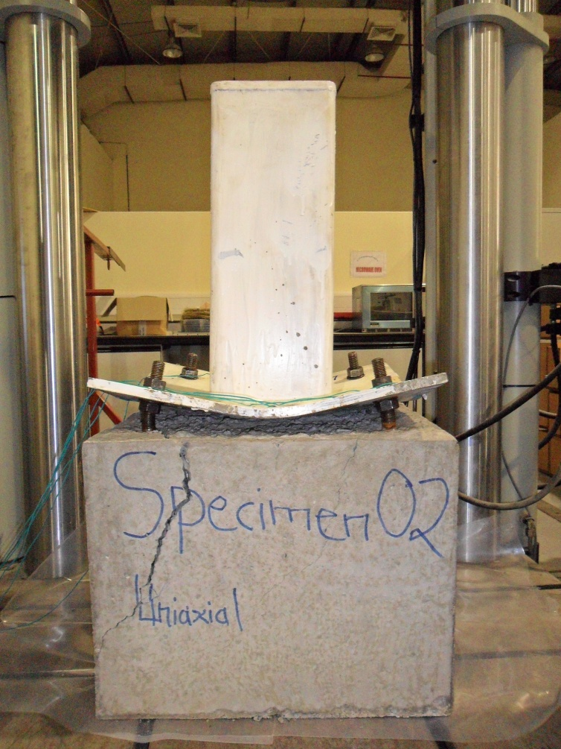

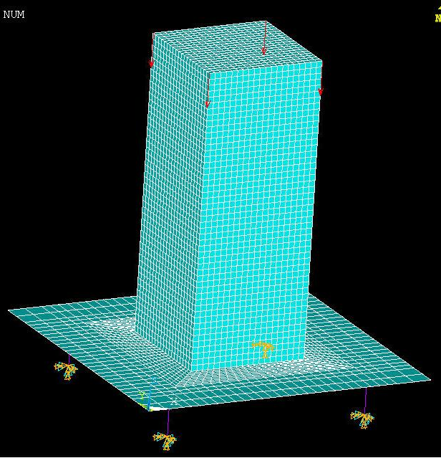
Non-linear Finite Element Analysis of Steel Base Plates on Leveling Nuts
American University of Sharjah
College of Engineering
Department of Civil Engineering
Dr. Sami W. Tabsh
(Supervisor)
Abdul Wahab Kayani
MS Thesis defense - January 17th, 2012

Slide 2
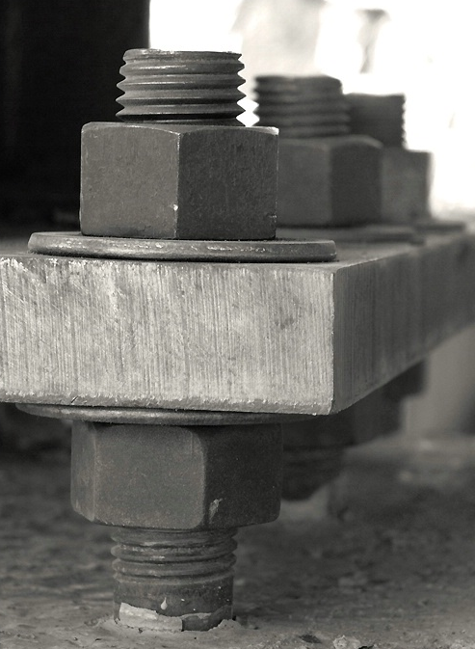
Outline
Introduction
Statement of Problem
Objectives
Background
Scope
Laboratory Testing
Finite Element Modeling
Results
Conclusions
Recommendations

Slide 3

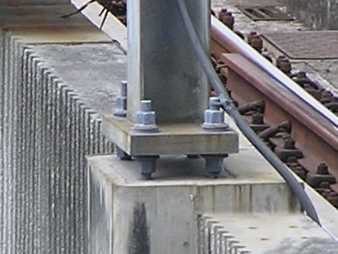
Introduction
Highway signs, Traffic signals, and Luminaries in parks, stadiums and transport facilities all require base plates on leveling nuts for support to foundation.

Slide 4
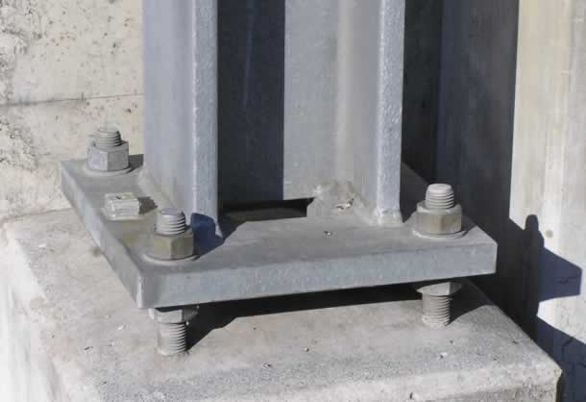
Introduction
Base plates with leveling nuts are regularly used for structural supports of utility poles and other columns. The purpose of leveling nuts is to attain the required alignment of the vertical member.
Base plates and columns come welded from factory before being assembled on site with nuts on anchor bolts.

Slide 5
Introduction
Base plates are preferably fabricated from ASTM A36 steel (F_{y}=250 MPa) due to their high ductility demand.
Cast in place anchor bolts are commonly used with the base plate; Preferred specification is ASTM F1554 (F_{y}=380 MPa).
The loading on the base plates can be:
  Concentric axial loads
  Uniaxial Bending
  Biaxial Bending
P
P
P
M_{y}
M_{x}
M_{x}
Notes:
Most base plates are designed as square to match the foundation shape and can be more accommodating for square anchor rod patterns.

Slide 6
Introduction
The loading from the column into the connection mainly induces:
  Flexural stresses in the steel base plate
  Axial forces (compression or tension) in the anchor bolts.
Bolt reactions can be approximately obtained with reasonable accuracy by assuming the base plate to be infinitely rigid on elastic supports (i.e. as a pile cap).
Shear stresses in the base plate are negligibly small.
Notes:
Most base plates are designed as square to match the foundation shape and can be more accommodating for square anchor rod patterns.

Slide 7
Introduction
Membrane stresses may also be created by either gravity or lateral loads.
The empty space between base plate and concrete foundation is often filled by grout to prevent corrosion and deterioration of the base plate and anchor bolts.
However, the grout cannot be counted for any structural strength as it is prone to cracking with temperature changes and shrinkage effects.
Axial load
Nuts resisting bending of base plate
Notes:
Membrane stresses are generally created by the lateral loads. But they might also be created by gravity loads only because the plate is rigidly connected to the anchor nuts, which resist its movement.
Anchor rods are needed to transfer the load from the base plate to the concrete foundation.

Slide 8

Statement of Problem
It has been reported that in the last five years, at least 80 defective poles installed have been taken down in Texas because of cracks and other signs of structural failure.
About 33% of signal supports inspected in United States were having cracks in either the base plates or the concrete foundation due to fatigue.
Limited Research on the base plates column connection.

Slide 9
Background
M_{max} = (F₁+F₂)(e)
Location of M_{max}
W=w1+w2
F₁
F₂
e
Assumed angle
M = (Z or S)* F_{y}
Section Moduli “S” and “Z” must be determined in order to calculate bending stresses in the base plate.
In finding S or Z, some engineers use the effective width, while others the complete width of the plate to calculate section modulus.
w₁
w₂
Notes:
Section Modulii “S” or “Z” which is a function of effective plate width times the square of the plate thickness must be determined in order to calculate bending stresses in the base plate.

Slide 10
Background
b
b_{eff}
M
M
Theoretical stress distribution
Simplified rectangular stress distribution
Determining an effective width of a base plate on leveling nuts due to moment generated by the bolts is analogous to using an effective flange width in a concrete T-beam!
Notes:
Due to lack of research in the area of base plates supported on leveling nuts, the current design method for calculating the thickness of such plates varies from one designer to designer.

Slide 11
Objectives
The main objective of this study is to develop a procedure, based on the Load and Resistance Factor Design format, that can help structural engineers in the utility industry proportion and size base plates on leveling nuts.
Nonlinear finite element structural analysis will be used as the basis behind the development of the procedure.
Notes:
Enhancing the engineering design aspect of these structures will result in optimized designs based on a rational approach.
It will help unify the design of such plates and reduce the subjective aspect.
It will reduce premature failures in base plates which are caused due to lack of understanding of their structural behavior.

Slide 12
Objectives
To accomplish the stated objective, we will:
Research the published literature on steel base plates on leveling nuts.
Carry out laboratory testing of steel base plates on leveling nuts.
Conduct a parametric analysis on base plates to better understand the structural behavior.
Develop simple expressions of the influence angle that help in computing an effective width of the base plate when the connection is subjected to concentric or eccentric loads.
Notes:
Enhancing the engineering design aspect of these structures will result in optimized designs based on a rational approach.
It will help unify the design of such plates and reduce the subjective aspect.
It will reduce premature failures in base plates which are caused due to lack of understanding of their structural behavior.

Slide 13
Scope
Column size
Bolt eccentricity and sizes
Number and spacing between bolts
Base Plate Thickness and under plate clearance
Notes:
Thickness varying between 10 and 40 mm.
Size of the tubular column ranging from 100 to 300 mm.
Bolt Eccentricity varies between 40 to 110 mm.
The steel material will be modeled as elastic-perfectly plastic with yield strength equal to 250 MPa.
Material nonlinearity will be taken into account.

Slide 14
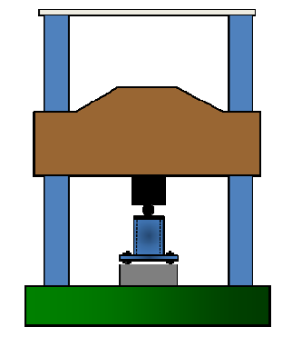
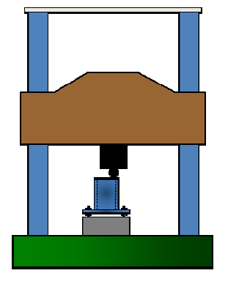
Scope
Concentric Axial Load
Uniaxial Bending Load
Biaxial Bending Load

Slide 15
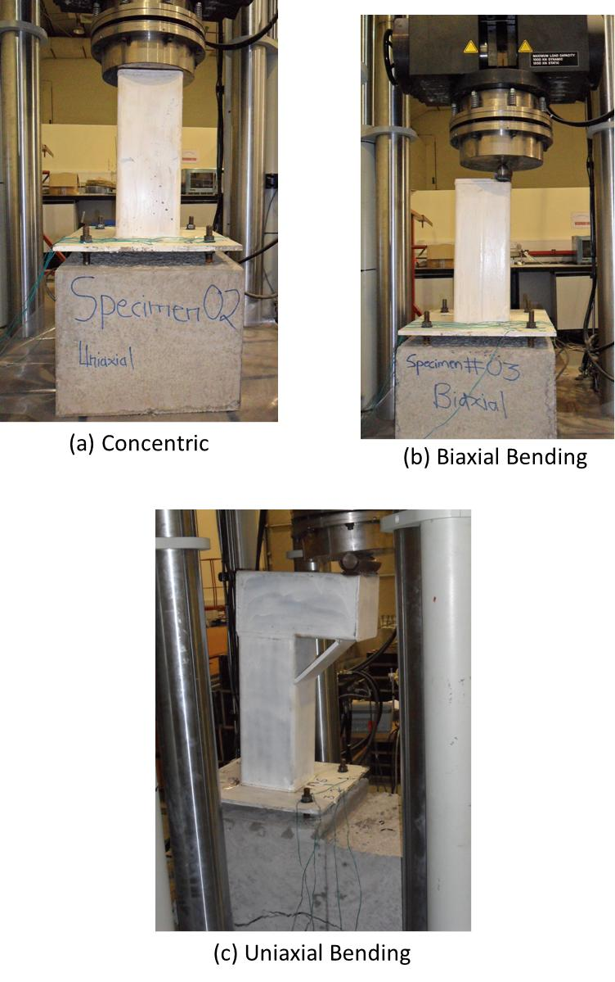
Laboratory Testing
Notes:
Concentric load will be applied through the actuator directly on the column head.
Effect of biaxial Bending was created by applying load through a sphere placed in the steel holder to act as a roller support.
Uniaxial bending was induced in the steel base plate by applying load through a solid cylinder.

Slide 16
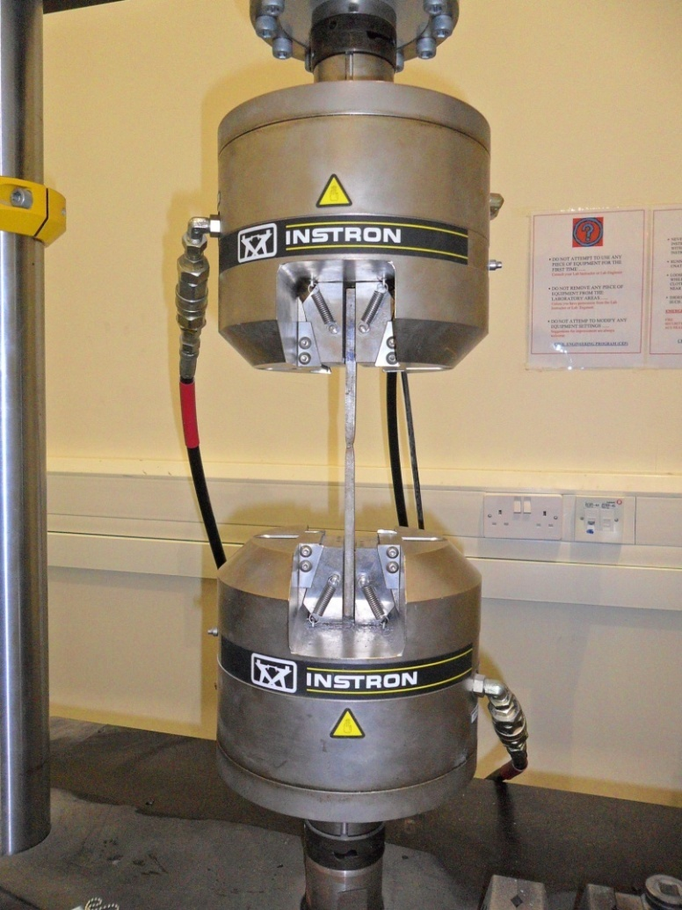
Laboratory Testing
Steel Coupon test
Notes:
Typical elastic linear behavior of steel
Followed by increasing strain with almost uniform stress
Until strain hardening starts
Ending at ultimate strength followed by necking and complete failure

Slide 17
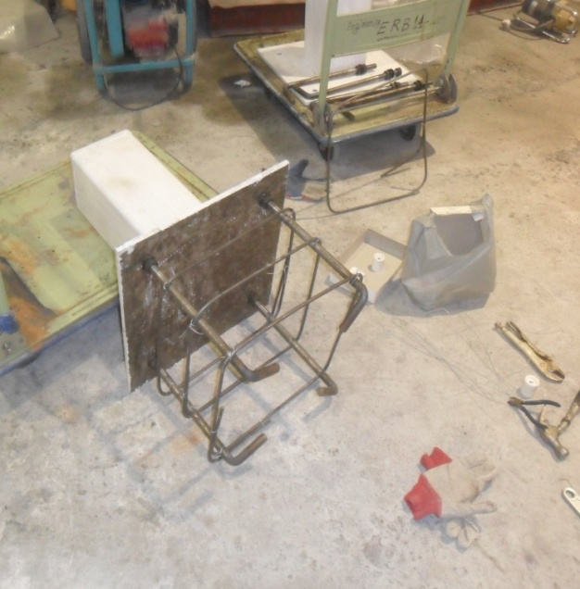
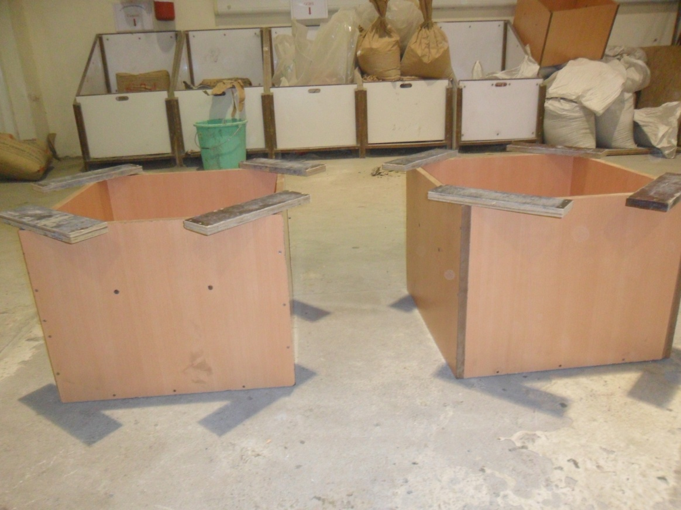
Laboratory Testing
Tying of Stirrups/ties
Erecting Formwork
Notes:
Stirrups were required to prevent lateral movement of anchor bolts under applied loads.
The formwork was erected for each specimen.

Slide 18
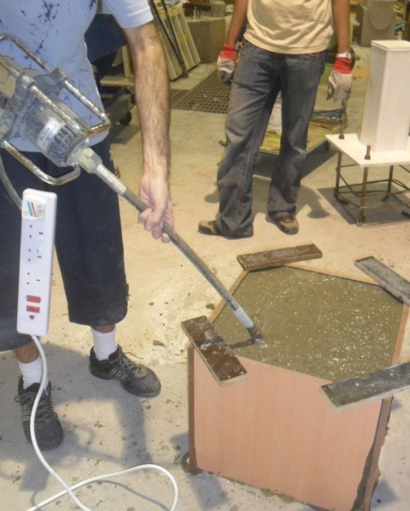
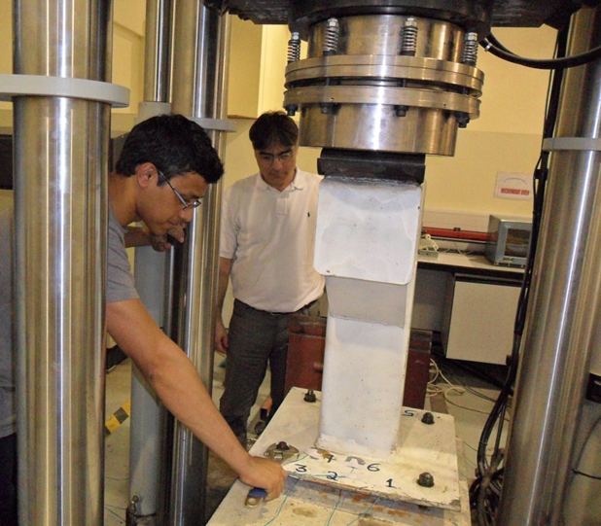
Laboratory Testing
Vibration of Concrete
Final adjustment of base plate
Notes:
The concrete was prepared in AUS Lab and vibrated to make sure to avoid segregation.
Leveling of base plate was checked before the start of each test and nuts were properly tightened.

Slide 19
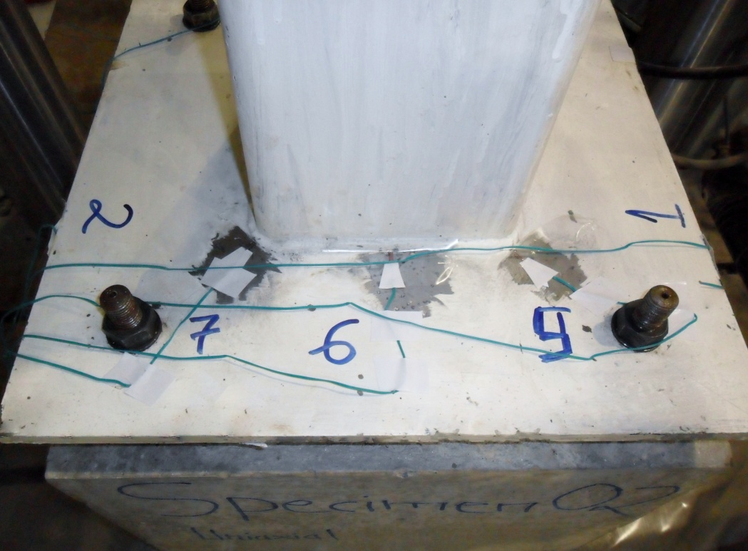
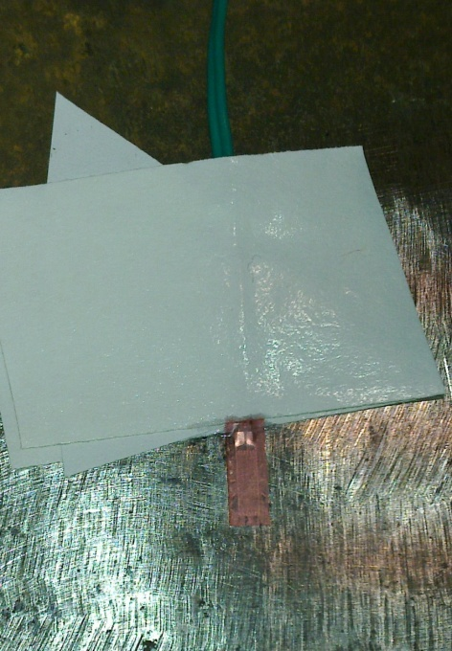
Laboratory Testing
Type: N11-FA-5-120-11VSE3
Gauge Length: 5 mm
Resistance: 120 (+/- 0.3%)
Gauge Factor: 2.10 (+/- 1%)
Thermal Expansion: 11 PPM/ºC
Installation of Strain Gauges
Notes:
5 mm strain gauges were installed at eight different locations in each specimen.
Four of the strain gauges were glued at the bottom and four at the top surface of steel base plate.
The strain gauges were required to be installed with precision and great care.
The surface was grinded and cleaned properly before gluing the strain gauges.

Slide 20
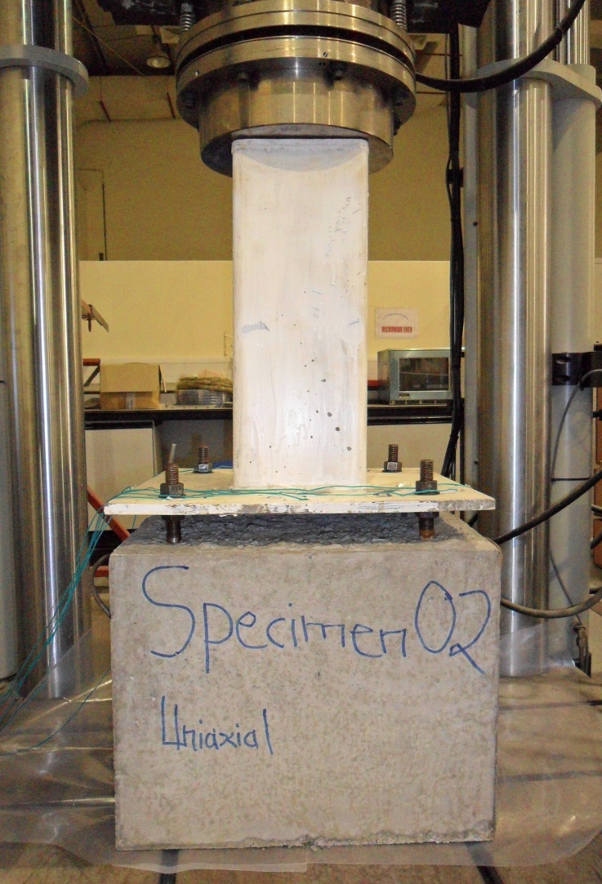
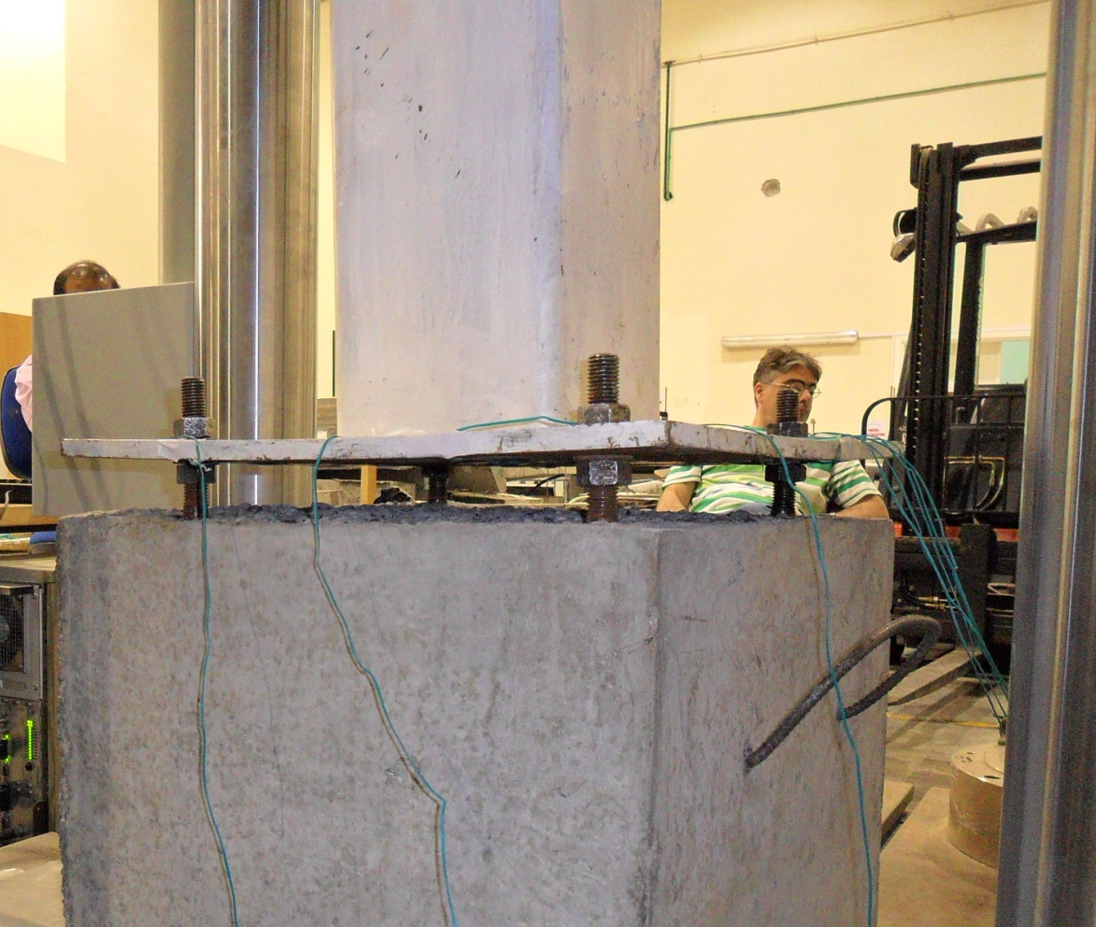
Laboratory Testing – Concentric Load
Before application of load
Clear spacing under the plate
Notes:
The load was applied at a rate of 15 KN/min from UTM.

Slide 21
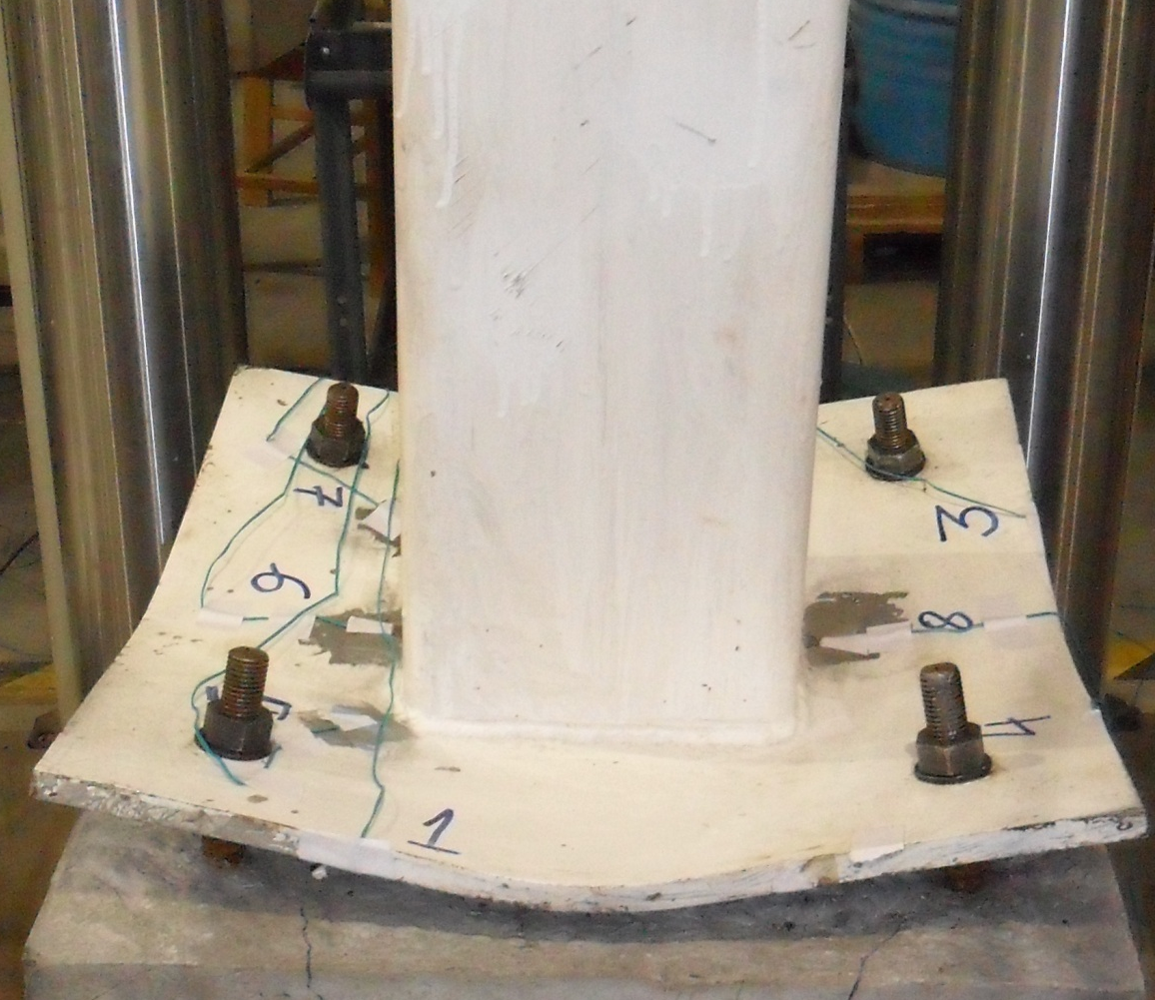
Laboratory Testing – Concentric Load
Base Plate at Failure
Deflection in Base Plate

Slide 22
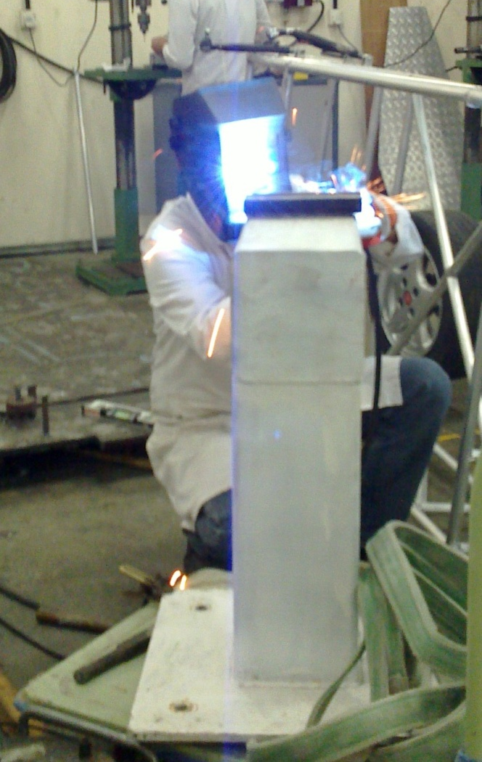
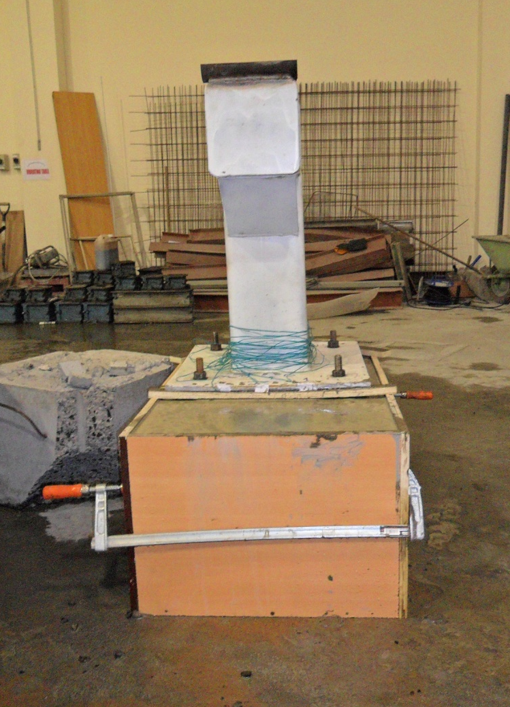
Laboratory Testing – Unieccentric Load
Welding Cylinder on top
Concrete poured in the formwork

Slide 23
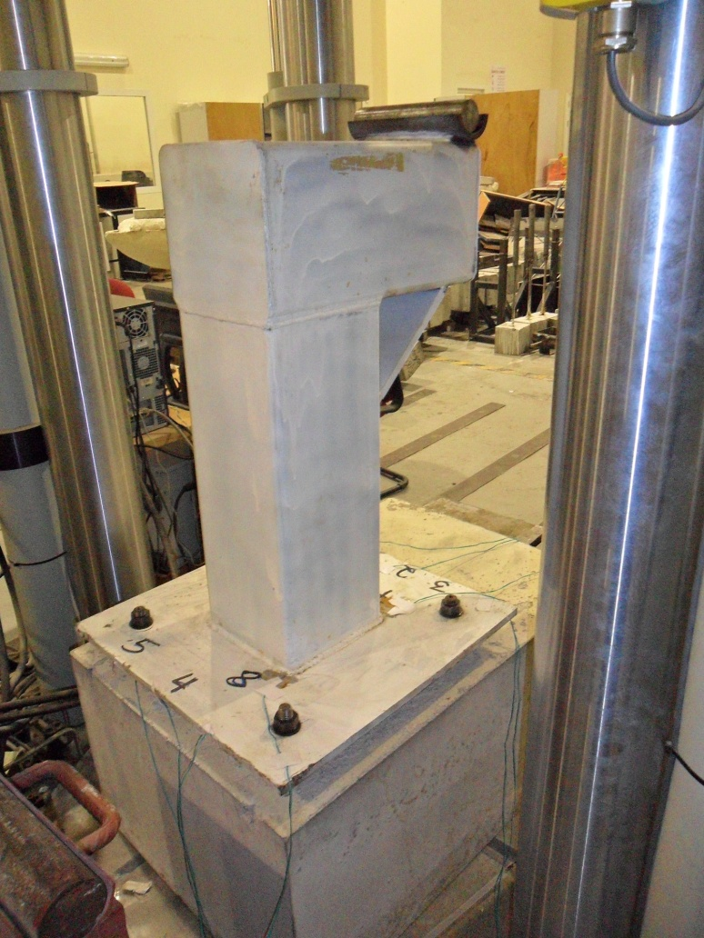
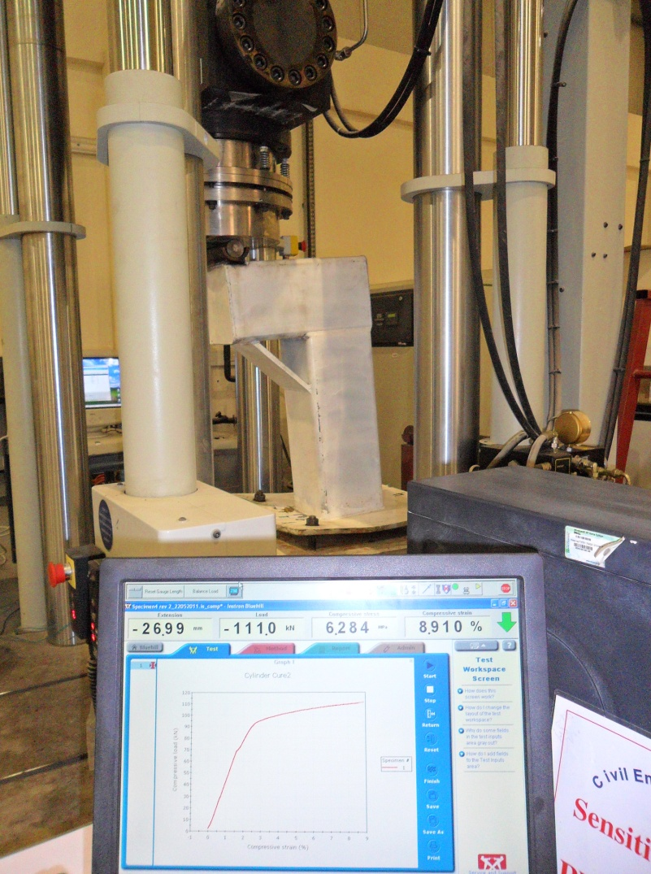
Laboratory Testing – Unieccentric Load
Before application of load
Specimen under load

Slide 24
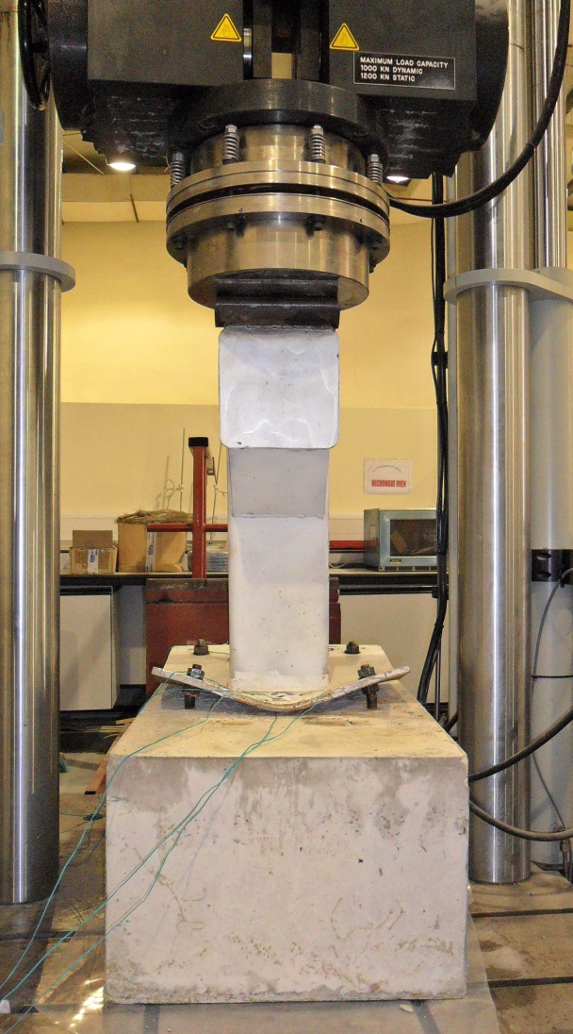
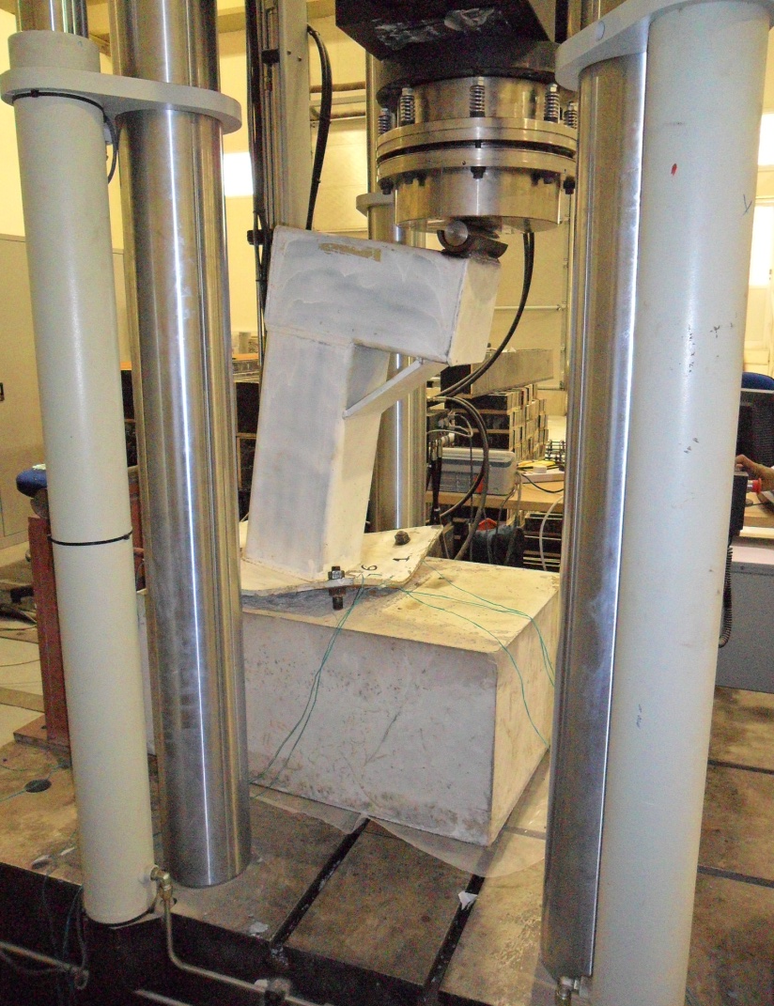
Laboratory Testing – Unieccentric Load
Specimen at Failure
Deflection in Base Plate

Slide 25
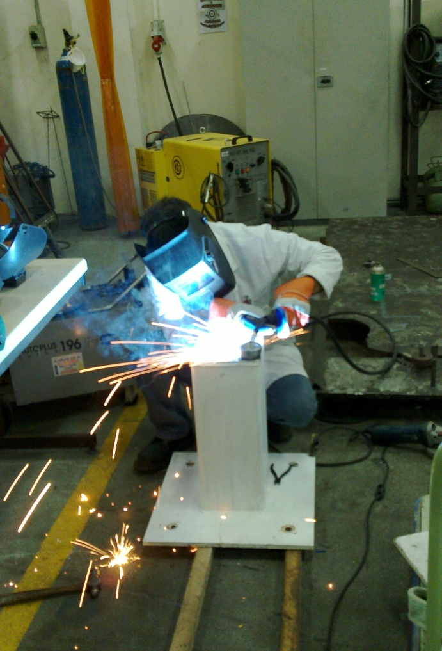
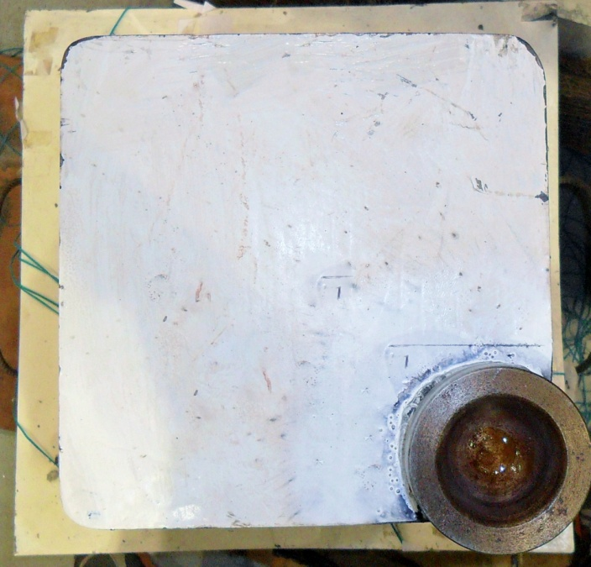
Laboratory Testing – Biaxial Load
Top view of column
Welding of sphere holder on column head

Slide 26
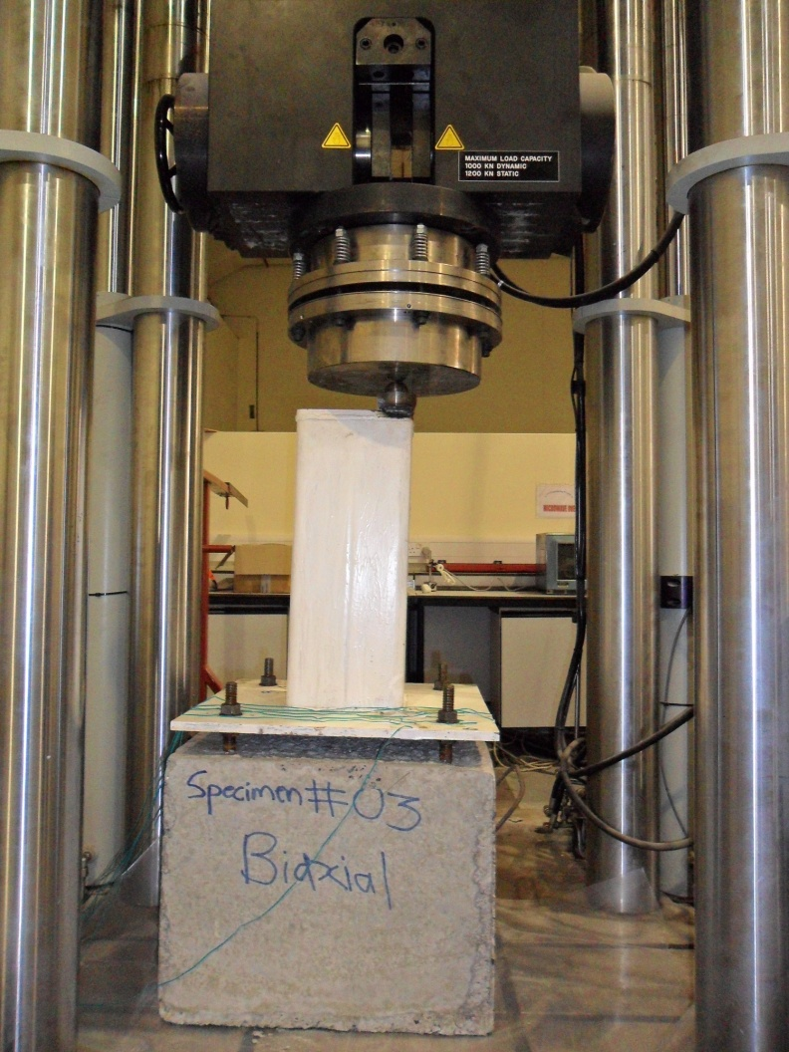
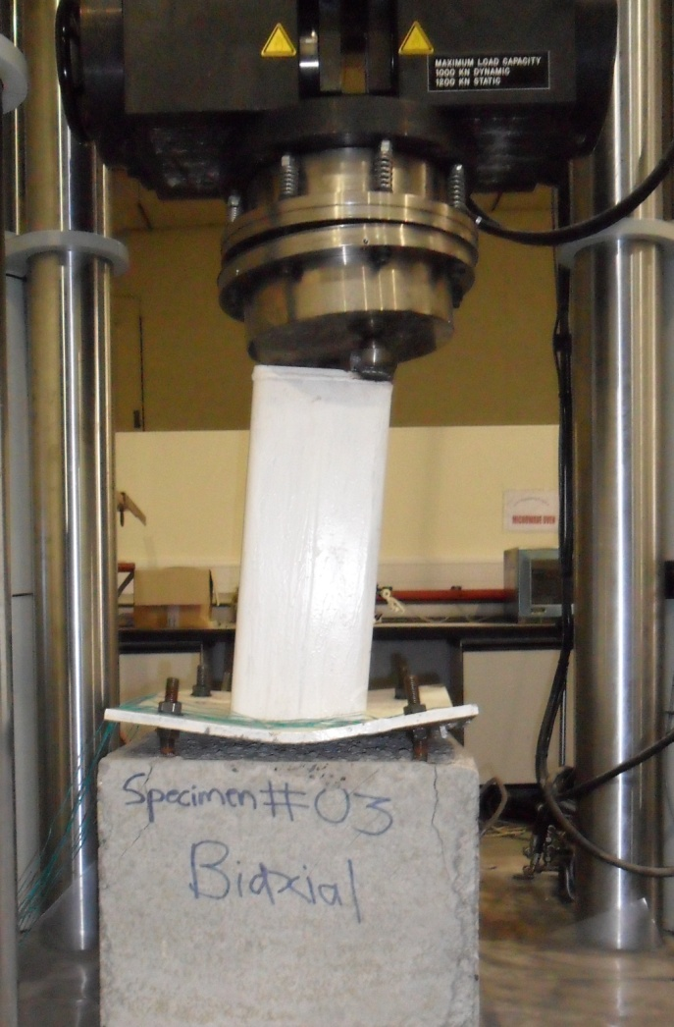
Laboratory Testing – Biaxial Load
Applying load during testing
At Failure

Slide 27
Finite Element Modeling
The Concept
The object is divided into many smaller bodies or elements interconnected at common points called nodes or boundary lines.
Nodal Displacements
In structural cases, the unknowns are nodal displacements or stresses created by the applied force. These stresses and displacements are found at each node constituting the element.
Equilibrium Equations
Algebraic equations are expressed in terms of nodal displacements using the equations of equilibrium.
Notes:
In the finite element method the object is divided into many smaller bodies or elements and interconnected at common points called nodes or boundary lines. Each of the small elements is solved separately using algebraic equations and the unknowns are calculated. The result of all the elements is unified to obtain the solution of the object under study. In structural cases, the unknowns are displacements or stresses created by the applied force. These stresses and displacements are found at each node constituting the element, with each element making up the structure that is subjected to load.
The stiffness method assumes that the displacements of the nodes (under the applied loads) are unknown and uses them in finding the governing equations. Algebraic equations are expressed in terms of nodal displacements using the equations of equilibrium and an applicable law relating forces to displacements.

Slide 28
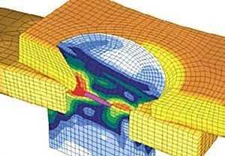
Finite Element Modeling
Finite Elements
Solid Elements (3 DOF’s)
Structural Elements (6 DOF’s)
Type of Structural Elements
Beam Elements
Shell elements
Non-Linear Analysis
Ductile Metals (Reduced Modulus)
Set of Nonlinear Equations
Iteration (Total load applied through small increments)
Notes:
When ductile metals are loaded beyond elastic range, the linear stress strain relation is taken over by complicated nonlinear relation accompanied by much reduced modulus as compared to modulus of elasticity. Finite element elastic-plastic analysis is much more complex than simple elastic analysis. The Finite element method equation is replaced by a set of nonlinear equations that are to be solved by iteration. Iteration basically divides the total applied load into small increments for more precise numerical results.

Slide 29
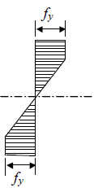
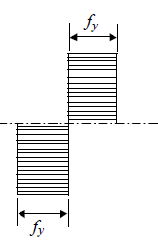
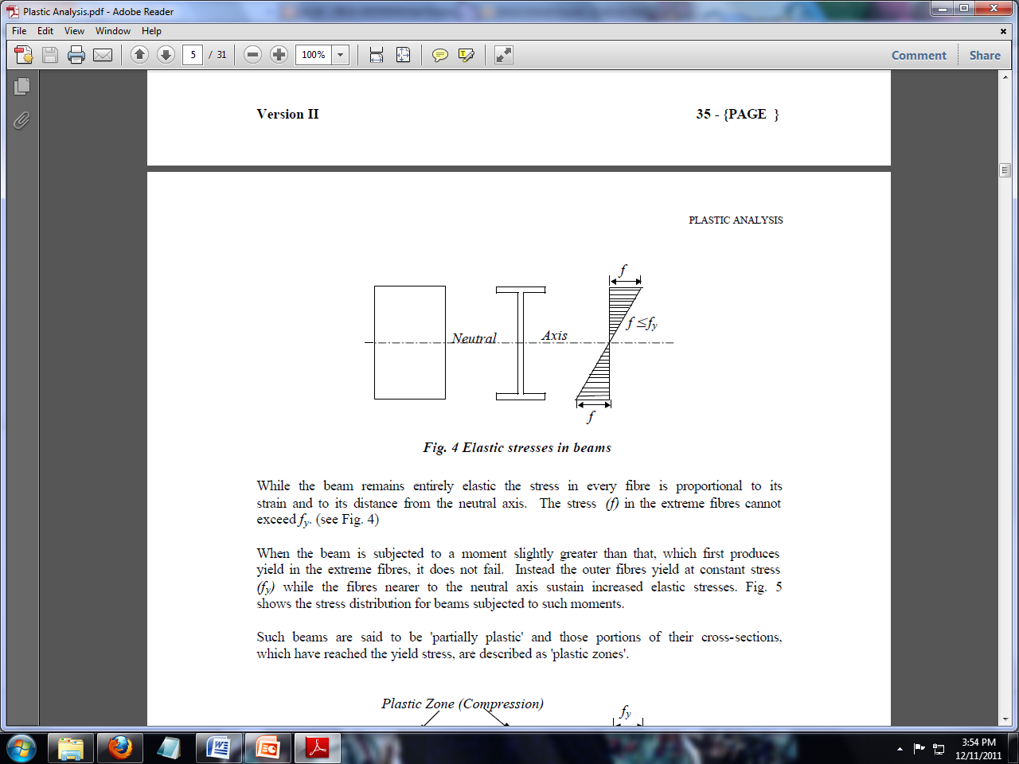
Finite Element Modeling
When the load is applied to a steel specimen, initially the specimen behaves entirely elastic.
When the load is further increased, the stress in the extreme fibers reaches the yield stress. Zones of yielding across the depth are developed (plastic zone) with further increase in load.

Slide 30

Finite Element Modeling
ANSYS
Software to solve finite element problems
Material Properties, Applied load, Boundary Conditions and type of Analysis.
Component | ANSYS Element | Nodes Per Element | DOF Per Node
Base Plate | SHELL 43 | Four | 3 Translational 3 Rotational
Column | SHELL 43 | Four
Anchor Bolt | BEAM 188 | Two
Leveling Nuts | SHELL 43 | Four
Notes:
ANSYS (2007) is a software tool for solving a wide variety of finite element problems.
The analyst defines the finite element model properties such as position of the element nodal coordinates, the manner in which elements are connected, material properties, applied loads, boundary conditions and the kind of analysis to be performed.

Slide 31
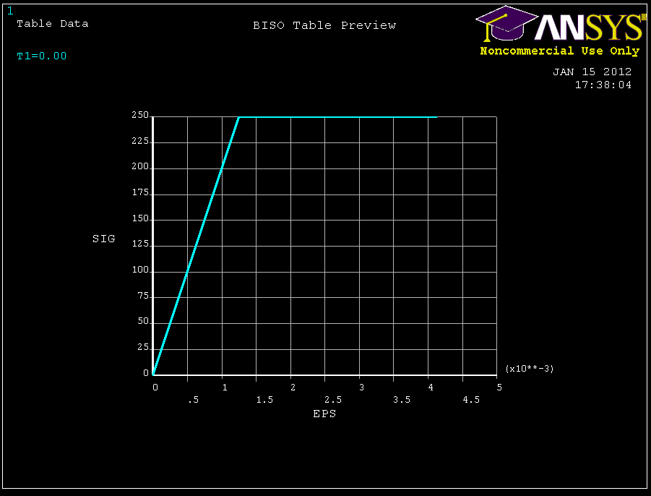
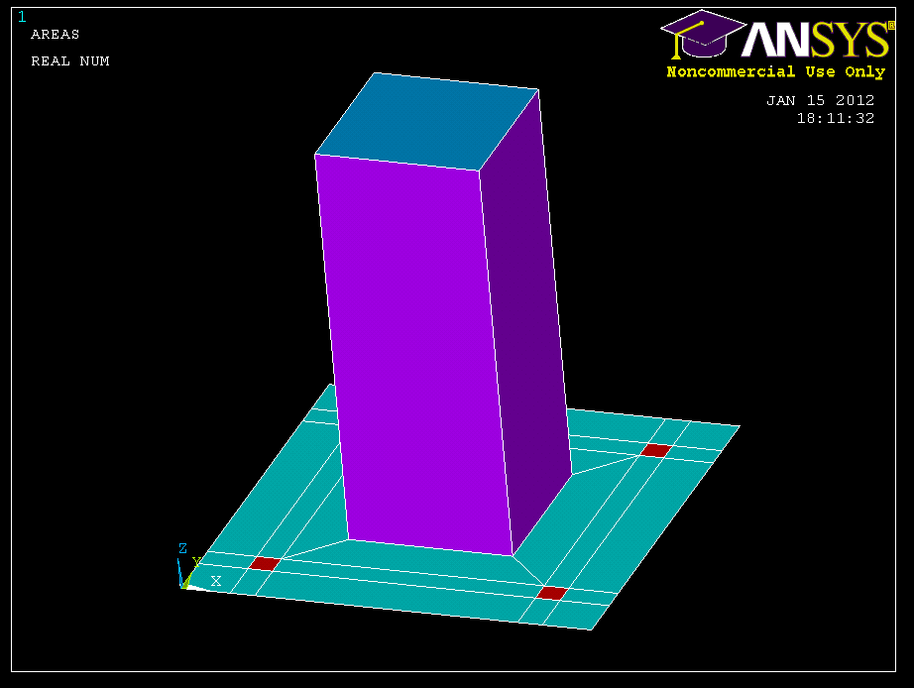
Finite Element Modeling
Material & Section Properties

Slide 32
Finite Element Modeling
Verification of ANSYS model (Deflection of Column Head)

Slide 33
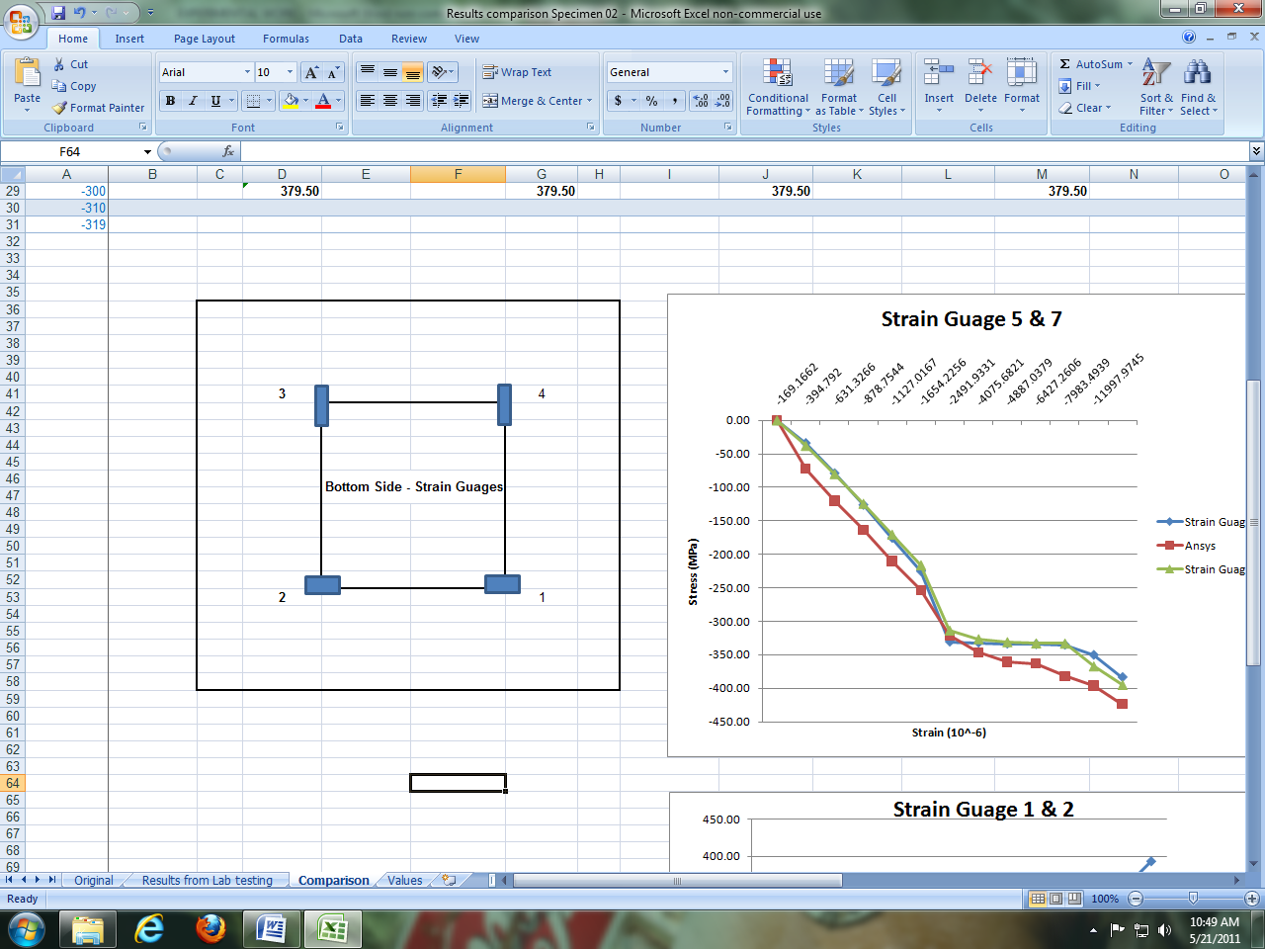
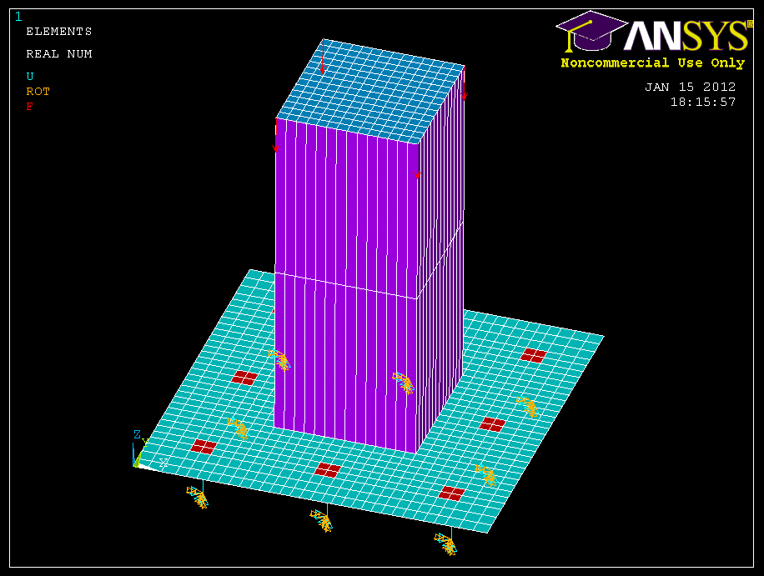
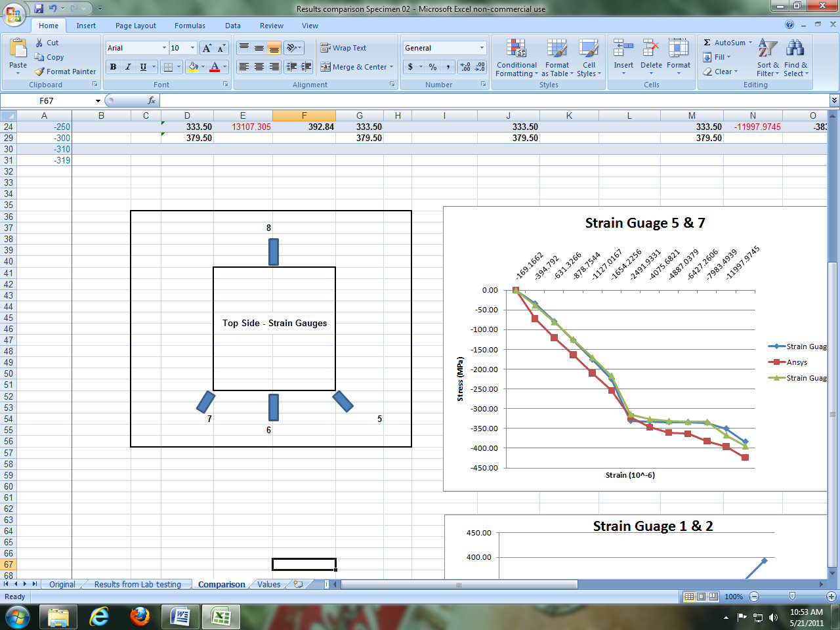
Finite Element Modeling
Concentric Load Model & Strain Gauge Locations

Slide 34
Finite Element Modeling
Verification of Concentric Load Model

Slide 35
Finite Element Modeling
Verification of Concentric Load Model

Slide 36
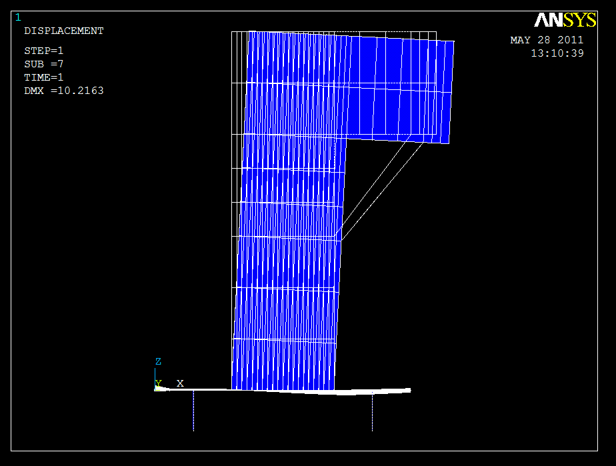
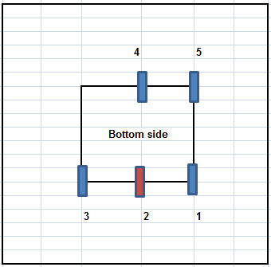
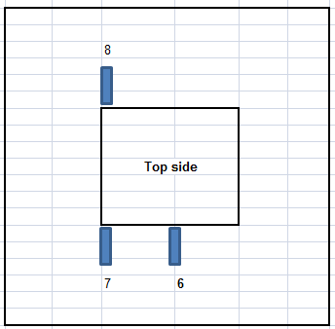
Finite Element Modeling
Uniaxial Bending Load Model & Strain Gauge Locations

Slide 37
Finite Element Modeling
Uniaxial Bending Model Verification

Slide 38
Finite Element Modeling
Uniaxial Bending Model Verification

Slide 39
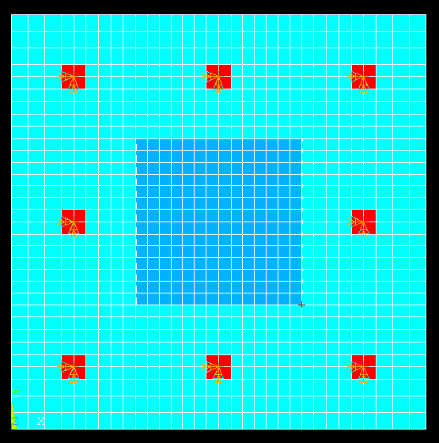
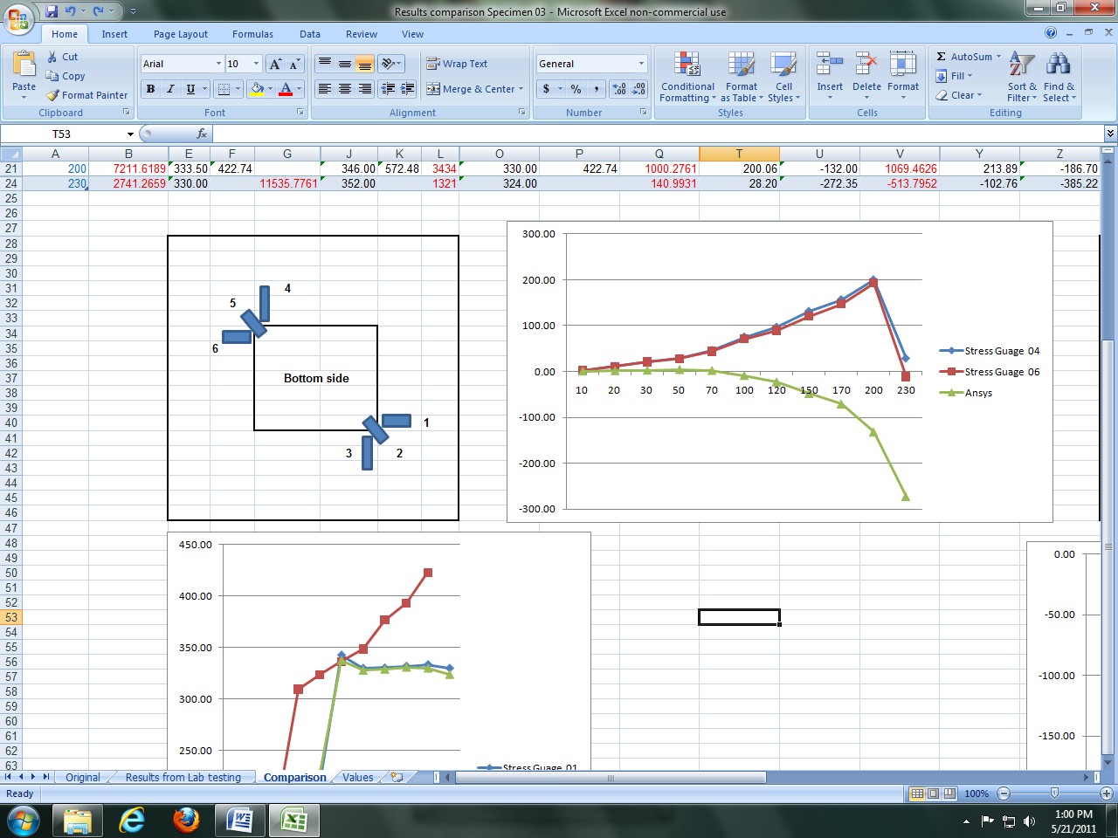
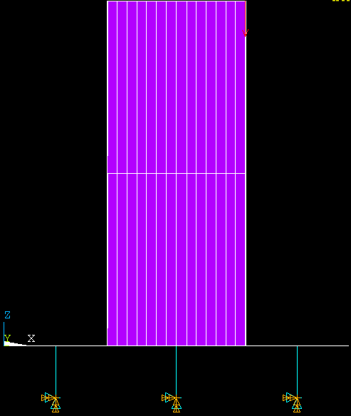
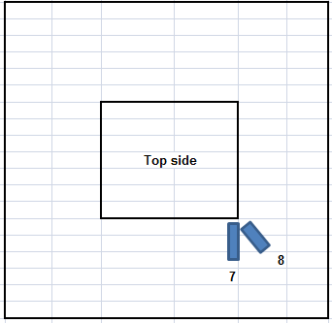
Finite Element Modeling
Biaxial Bending Load Model & Strain Gauge Locations

Slide 40
Finite Element Modeling
Biaxial Bending Model Verification

Slide 41
Finite Element Modeling
Biaxial Bending Model Verification

Slide 42
Deflection Curves – Concentric Load
Column Size

Slide 43
Deflection Curves – Concentric Load
Base Plate Thickness

Slide 44
Deflection Curves – Concentric Load
Bolt Eccentricity
e

Slide 45
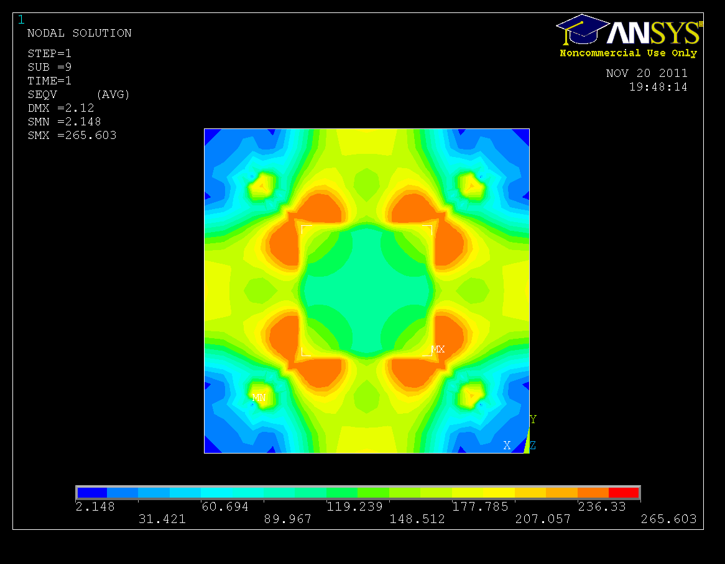
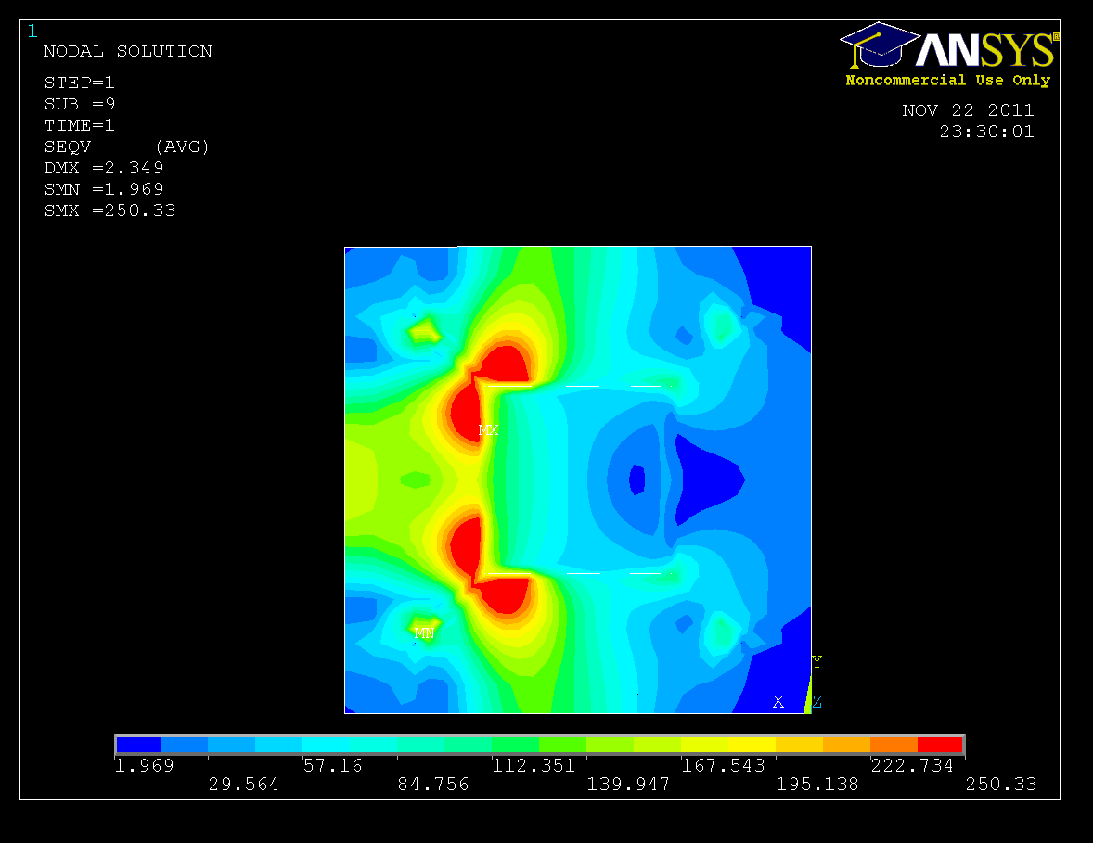
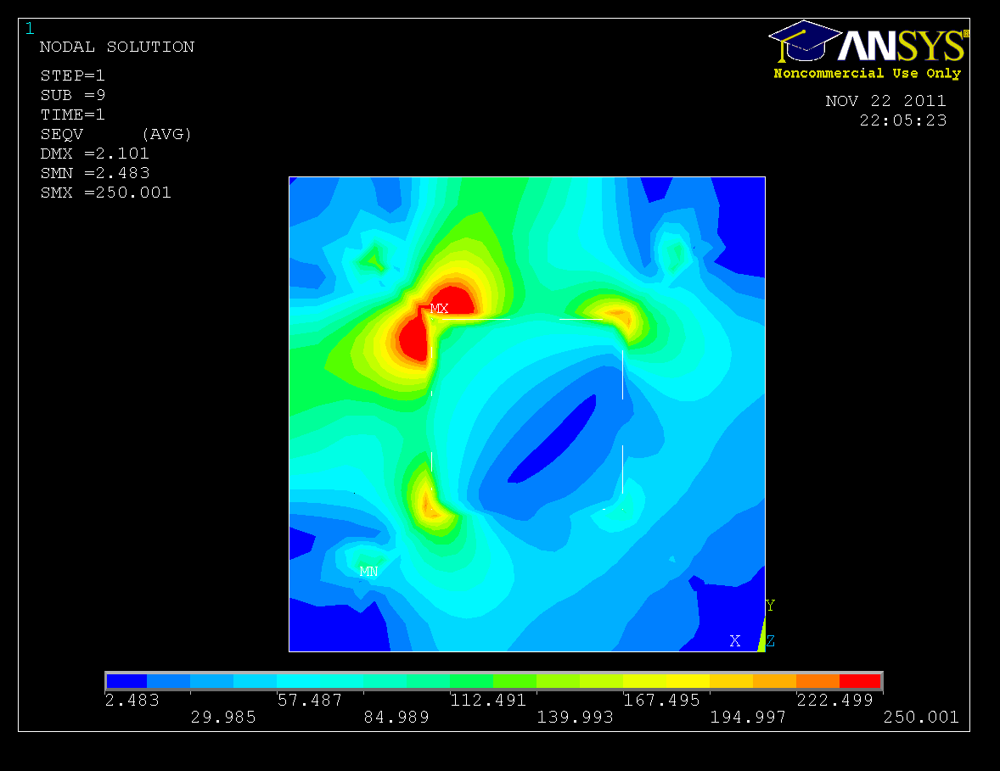
Flexural Stress Contours
Effect of Load Type:
Concentric Axial
Uniaxial bending
Biaxial Bending

Slide 46
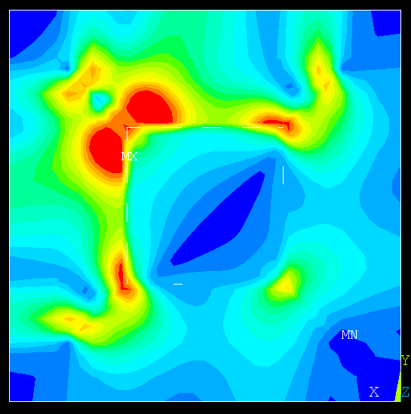
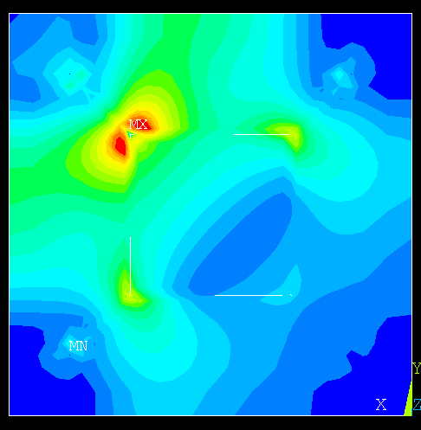
Flexural Stress Contours
Effect of Base Plate Thickness:
Thickness = 10 mm
Thickness = 20 mm
Thickness = 30 mm
Loading type: Biaxial Bending

Slide 47
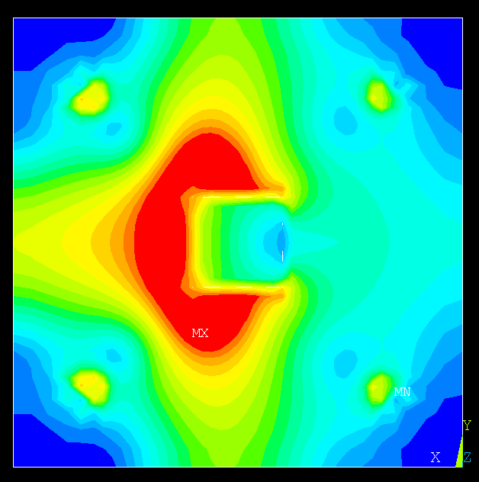

Flexural Stress Contours
Effect of Column Size:
100 mm x 100 mm
200 mm x 200 mm
300 mm x 300 mm
Loading type: Uniaxial Bending

Slide 48



Flexural Stress Contours
Effect of Number of Bolts:
4 bolts
8 bolts
Concentric Axial
Uniaxial bending
Biaxial Bending

Slide 49


Flexural Stress Contours
Effect of Bolt Eccentricity:
e =110 mm
e = 75 mm
e =40 mm
Loading type: Biaxial Bending

Slide 50

Results – Concentric Load Cases

Slide 51

Results – Uniaxial Bending Cases

Slide 52

Results – Biaxial Bending Cases

Slide 53




Results
Calculation of Angles
α
α
α
α
e
l
Notes:
The results of the parametric study were analyzed based on angle of plasticized section. The angle from the center of bolt to a failure line (often occurring at the face of the column) was measured for each case. These angles, referred to as influence angles, give an idea about how much of the base plate width is effectively utilized in resisting the bending at ultimate failure conditions. In each case, the load was applied until the plastic strains within the base plate reach at least a value of 6 times the yield strain or an unstable plastic configuration is obtained.

Slide 54
Results
Base Plate Thickness Parameter
LOAD/ CASE | Concentric | Uniaxial Bending | Biaxial Bending
1b (10 mm) | 66º | 67º | 62º
1a (20 mm) | 64º | 57º | 49º
1c (30 mm) | 62º | 50º | 40º
Column Size Parameter
LOAD/ CASE | Concentric | Uniaxial Bending | Biaxial Bending
2a (100 mm x100 mm) | 54º | 51º | 42º
1a (200 mm x 200 mm) | 64º | 57º | 49º
2b (300 mm x 300 mm) | 72º | 69º | 65º

Slide 55
Results
Influence Angles
Effect of Base Plate Thickness
Effect of Column Size

Slide 56
Results
No. of bolts parameter
LOAD/ CASE | Concentric | Uniaxial Bending | Biaxial Bending
1a (4 Bolts) | 64º | 57º | 49º
5b (8 Bolts) | 49º | 48º | 37º
Bolt Eccentricity from the column
LOAD/ CASE | Concentric | Uniaxial Bending | Biaxial Bending
6a (110 mm) | 62º | 56º | 46º
1a (75 mm) | 64º | 57º | 49º
6b (40 mm) | 71º | 67º | 64º

Slide 57
Results
Influence Angles
Effect of No. of bolts
Effect of Bolt eccentricity

Slide 58



Influence Angles Equations
For Concentric Loading Case
$$α=(67°−2t)∗\left(1.2−0.003e\right)$$
For Uniaxial Bending Case
$$α=(75°−t)∗\left(1.25−0.003e\right)$$
For Biaxial Bending Case
$$α=(70°−t)∗\left(1.25−0.003e\right)$$
where t = plate thickness (mm) & e = bolt eccentricity (mm)

Slide 59
Conclusions
Not all of the base plate width contributes to resisting the applied moment within the plate.
Regions of local flexural stresses within the base plate are always generated, even when the applied load is symmetrical.
The most heavily stressed regions are at the corners of the column within the base plate.
The nature of loading (whether concentric or eccentric) greatly affects the extent of the effective width of the base plate, which consequently dictates the required base plate thickness.

Slide 60
Conclusions
For Concentric loads and Uniaxial bending, the maximum flexural stress regions start originating opposite to anchor bolts next to the column edges and continue increasing along the column face with increase in loads.
For Biaxial bending, the failure line is usually along a tangent to the column corner and the plastic hinge develops along this bend-line.
The location of anchor bolts and the width of column are the most important factors to influence the flexural stress distribution in the base plate.

Slide 61
Conclusions
The clear spacing under the base plate and the size of nuts and bolts do not greatly affect the flexural stresses.
Preliminary sizing of base plates using simple equations that are based on finite element results is possible.
The equations derived in this study give adequate results if all possible failures at bend-lines are investigated.

Slide 62
Future Work
Future research in the area of base plates on leveling
nuts may consider the effects of:
Various shapes of columns
Effect of stiffeners
Dynamic loads
Fatigue strength
Notes:
Circular, wide flange, hexagonal column shapes can be considered for analysis

Slide 63
Questions?

