Slide 1


Modeling of Titanium alloys Machinability
American University of Sharjah
Mechatronics Graduate Program
Azza Al Hassani @26785

Slide 2
Outline
Introduction
Problem Statement & Objectives
Research Approach & Experimental Work
Modeling Methods
Results
Conclusions & Future Work

Slide 3
Introduction
Machining automation
  Helps meet the demand with better quality and surface finish.
  Requires supervision of a tool's status in order to change it just in time.
Advanced engineering materials
  Widely used because of its superior properties.
  Difficult to cut, high cost of processing and high cutting force and temperature that may cause tool break.

Slide 4
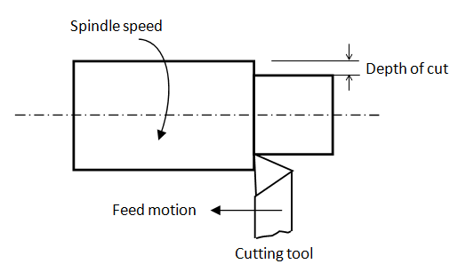
Turning Process
Turning is the removal of metal from the outer diameter of a rotating cylindrical work-piece.

Slide 5
Cutting Tool
Single point cutting tool has one sharp cutting edge that separate chip from the work-piece material.
Subjected to high temperature and stresses during machining.
Material properties: hardness, toughness, chemical stability and wear resistance.
A significant characteristics is having acceptable tool life before replacement is required.

Slide 6
Tool Failure
Tool wear: progressive loss or removal of tool material due to regular operation.
Types of wear include:
  Flank wear: the portion of the tool in contact with the finished part erodes.
  Crater wear: contact with chips erodes the rake face.

Slide 7
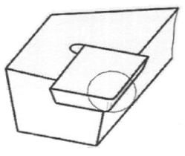
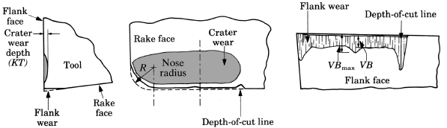
Flank Wear
S. Kalpakjian 2006

Slide 8
Effects of Tool Wear
Increased cutting forces → tool fracture.
Increased temperatures → soften the tool material.
  Poor surface finish and decreased accuracy of finished part.
  Increasing the production cost
Notes:
Cutting fluids
Sofen

Slide 9
Literature Review
In machining processes, major problems can be related to the condition of the cutting tools.
Achieve cost-effectiveness of machining processes by implementing an online Tool Condition Monitoring (TCM) .
Two major objectives for tool wear monitoring:
  Classify tool wear into several discrete classes.
  Model tool wear continuously with respect to certain wearing parameters.

Slide 10
Literature Review
Sensors are one of the most important elements of TCM:
  Sensing methodologies may include force, power, vibration, temperature and acoustic emission.
  Sensor fusion
  A significant amount of research has been based on the measurement of cutting forces since it has direct effect on the tool wear.

Slide 11
  Different signal analysis and feature extraction techniques are used in time and frequency domains.
Techniques used in modeling machining process are Artificial Neural Network (ANN), Fuzzy logic, Polynomial Classifier and Regression Analysis (RA).
Neural Network is widely used in modeling the machining process.

Slide 12
Problem Statement
  Titanium alloy is widely used in aerospace and medical applications.
  Growing interest of titanium alloy in the local market.
  Titanium alloy is difficult to cut material and requires high cost of processing.
  Improving the machinability of titanium alloy by monitoring the tool wear to achieve the required efficiency.
  Systematic replacement of tool inserts to avoid stopping the production process.

Slide 13
Main Objectives
Improving the efficiency of the machining process of difficult-to-cut materials.
Predict tool life and cutting tool status during machining.
Elongate tool usage by selecting the optimum cutting conditions.
Use Artificial Neural Network, Gaussians Mixture Regression and Regression Analysis to find correlation between sensors output and machining process parameters and tool wear.

Slide 14
Research Approach

Slide 15
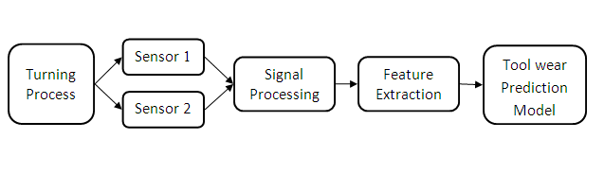
Tool Wear Monitoring System

Slide 16
Experimental Work

Slide 17
Design of Experiments
Planning stage:
  Defining the problem, set the objectives of the experiment, select the cutting parameters and their levels, and establish the measurement system.
Conducting stage:
  Conducting the experiments, collecting the sensors’ signals, measuring tool wear and surface roughness and collecting the chip samples.
Analyzing stage:
  Analyzing the data collected to interpret results

Slide 18
Planning of Experiments
Identify the problem:
  Machinability of difficult-to-cut material and the need to monitor tool wear to achieve the required efficiency.
Determine the objective:
  Establish a tool condition monitoring system to optimize the change of tool insert. Also to study the effect of cutting parameters on tool wear, cutting force and vibration signal.

Slide 19
Identify process factors to be studied:
  Select the work-piece and cutting insert material, cutting parameters and sensors.
    Work-piece: titanium alloy, Ti-6Al-4V.
    Cutting Tool: cemented carbide
      Sandvik triangular tool TCMT 16 T3 08-MM (1105)
    Cutting parameters:
      Cutting speed, feed rate and depth of cut.
    Measurements:
      Tool wear, surface roughness, cutting forces and vibration.

Slide 20
Planning of Experiments Cont’
Select the levels of cutting parameters and generate the test matrix.
    Total of 36 experiments
Cutting Parameter | Unit | Levels
 |  | 1 | 2 | 3 | 4
Cutting speed, v | m/min | 100 | 125 | 150 | -
Feed rate, f | mm/rev | 0.1 | 0.15 | 0.2 | -
Depth of cut, d | mm | 0.8 | - | - | -
Coolant, c | - | Dry | Flood | Mist | LN

Slide 21
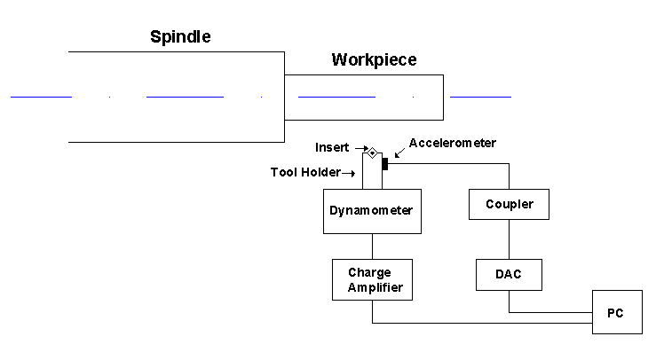
Conducting Experiments
Establish the experimental setup, carry out the tests and collect the experimental data.

Slide 22
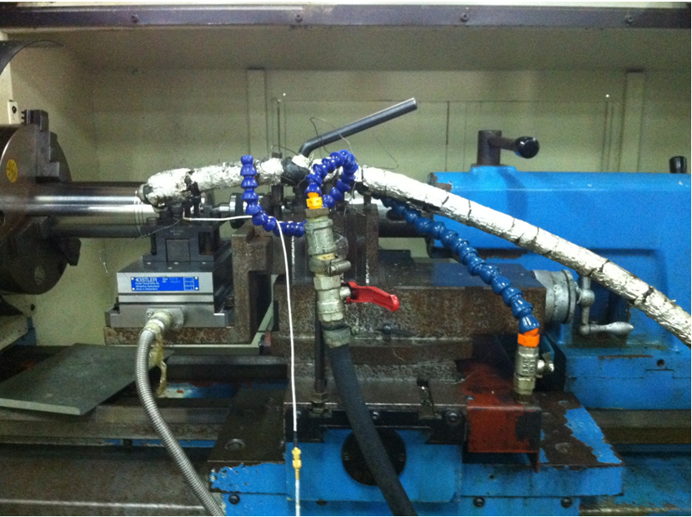

Slide 23
Experimental Procedure
Perform turning cuts at fixed cutting conditions with fresh tool inserts. Record the force and vibration signals.
Interrupt the test and take the insert out to measure tool wear.
Stop the turning operation when VB=0.3 mm (ISO368).
Measure surface roughness of the machined surface
Collect chip samples after the cut.

Slide 24
Output of the experiments
More than 300 turning tests within the 36 experiments with the following measurements:
  Cutting time where the cutting tool is removing material.
  Cutting forces in the three direction
  Vibration signal in the three direction
  Tool wear, VB in mm.
  Surface roughness after the cut, Ra in µm.
  Chip samples while turning

Slide 25
Data Analysis and Results

Slide 26
Signal Correction
Obtain the force and vibration signal in which the real cutting happened.

Slide 27
Cutting Forces &Cutting Conditions
Cutting forces increased with the increase of cutting speed or feed rate.
Cutting forces are higher for the dry cutting compared to other coolant environments.
Dry cutting
Mist cutting

Slide 28
Vibration & Cutting Conditions
Vibration amplitude decreased as the cutting speed increased.
Vibration amplitude for the dry cutting is higher than that with flood, mist or LN coolant.
Increasing the feed rate increased in the vibration amplitude.
Dry cutting
Flood cutting

Slide 29
Tool Wear & Cutting Conditions
Wear rate is rapid at higher cutting speeds and feed rates.
Wear rate is higher in dry machining compared to the mist, flood and LN coolant.
Dry cutting
LN cutting

Slide 30
Tool Wear & Cutting Conditions
Wear rate is rapid at higher cutting speeds and feed rates:
  High cutting temperature at the tool-work-piece and tool-chip interfaces leads to a rapid tool failure.
  Low thermal conductivity of titanium alloys increases temperature at the cutting zone.
  Tool wear enlarges the contact area between the cutting tool and work-piece and consequently increases the cutting forces.
  The presence of vibration increases with higher tool wear and cutting forces at higher speed.

Slide 31
  Coolants reduce the friction and temperature at the cutting zone and thus reduce the cutting forces generated during machining.
  Cooling by LN can significantly enhance tool life.
Cutting Parameters | Tool life (seconds),VB= 0.3 mm
 | Dry | Flood | Mist | LN
v= 100 m/min, f = 0.2 mm/rev | 30 | 51 | 48 | 70
v= 125 m/min, f = 0.15 mm/rev | 32 | 48 | 46 | 135

Slide 32
Features Extraction
Cutting forces and vibration signals of 319 experimental turning tests.
Obtain the common statistics of maximum, standard deviation, variance, skewness and kurtosis for the cutting force and vibration signals at the three axis.
Extract the relevant information from the collected force and vibration signal that show an effective trend towards the measured tool wear.

Slide 33
Features Extraction by Principal Component Analysis (PCA)
  A dimensionality reduction technique used to represent data according to the maximum variance direction(s).
  The percent of variance explained by each component:
  Force Signal: Fx_{max} (91.38%) and Fy_{max} (3.79%)
  Vibration Signal: Vx_{max} (94.36%) and Fy_{max} (5.18%)

Slide 34
Feature dimensionality reduction by Stepwise Regression
  Regression analysis in which variables are added and removed from the model based on their significance in representing the response.
Total of 14 variables were specified as significant variables to include in the model of the tool wear:
  Cutting time, cutting speed, feed rate, coolant.
  Forces values (X-maximum, Z-standard deviation, X-variance, Y-skewness and Y-kurtosis)
  Vibration values (X-maximum, Y-standard deviation, X-skewness, Y-skewness and Z-skewness)

Slide 35
Monitoring System
  Neural Networks
  Regression Analysis
  Gaussian Mixture Regression

Slide 36
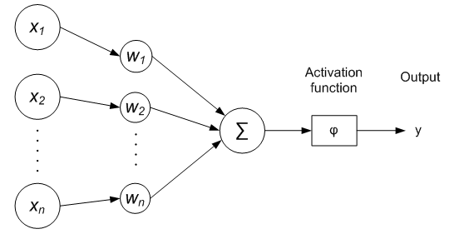
Neural Network
  Operates in the same way of human brain with neurons as processing elements.
  Neurons process small amounts of information and then activate other neurons to continue the process.
  Able to perform fast computations such as pattern recognition and classification and analyze complex functions.

Slide 37
  Able to learn and adapt to any change in operation parameters.
Learning basically is altering the connection weights over iterations to obtain the desired input-output relationship.
After training the network, testing (validation) is applied with another set of data.
The data is divided randomly into two sets allocated for training and testing with a ratio of 75% and 25% .

Slide 38
NN for Tool Wear Prediction
Type: Feed-Forward Back Propagation (FFBPNN)
Input: process parameters & characteristic features extracted from sensors signals.
Output: tool wear.
75% of the data for training and 25% for testing

Slide 39
Example of prediction by NN
Training time= 1.0181 second, mean of absolute error= 0.0183.

Slide 40
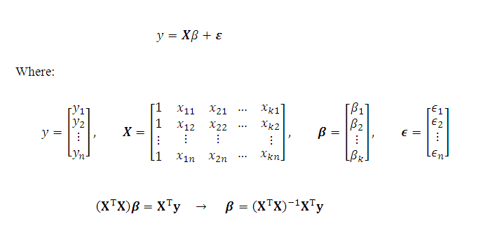
Regression Analysis
Regression is a simple method for investigating the functional relationships among variables.
Estimating the regression coefficients β that minimize the error.
Predicting the dependent variable using β.

Slide 41
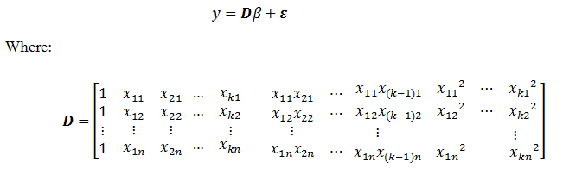
The relation between tool wear and cutting parameters is nonlinear.
Power transformation of variables X → D
Training set of data will be used to compute the regression parameters that will be used to predict tool wear.

Slide 42
Example of wear predicting by RA
mean of absolute error= 0.0212

Slide 43


Gaussian Mixture Models
Component Gaussian density:
A Gaussian mixture model is a weighted sum of k-component Gaussian densities given by:
Estimating the parameters that best matches the Gaussian distribution using the EM algorithm.

Slide 44

Gaussian Mixture Regression(GMR)
GMR model is developed using number of Gaussian mixture models to represent the joint density of the data.
The relationship between X and Y can be described by k-components GMM models with a joint probability density function of:
The parameters of the Gaussian distribution is estimated by maximizing the likelihood function using the iterative procedure of EM algorithm.

Slide 45
Example of wear predicting by GMR
mean of absolute error= 0.0267

Slide 46
Tool Wear Prediction Models Validation
Validation by repeated random sub-sampling method.
Training and validation data subsets (75% : 25%).
The model is fitted using the training data and then tested using the validation data.
Compare predicted tool wear to the measured one and compute the error and predicting accuracy.
The process is repeated and the results are averaged.

Slide 47
Data set 1
Inputs: machining parameters and the maximum values of force and vibration in the X direction.
Prediction accuracy
  NN:90.88%
  RA:89.64 %
  GMR:88.17 %

Slide 48
Data set 2
Inputs: machining parameters and the maximum values of force and vibration in the X and Y directions.
Prediction accuracy
  NN:89.742%
  RA:88.22%
  GMR:88.07 %

Slide 49
Data set 3
Inputs: machining parameters and the maximum and standard deviation values of force and vibration in the X, Y and Z directions.
Prediction accuracy
  NN:88.31 %
  RA:73.17 %
  GMR:85.78 %

Slide 50
Data set 4
Inputs: machining parameters and all the statistical features extracted from the force and vibration signal .
Prediction accuracy
  NN:86.78 %
  RA:-123.10 %
  GMR:72.00 %

Slide 51
Data set 5
Inputs: the significant variables indicated by the stepwise regression.
Prediction accuracy
  NN:90.01 %
  RA:76.87 %
  GMR:87.03 %

Slide 52
Comparison of modeling methods
Neural networks are better in predicting tool wear than the regression model and GMR.
Neural network yielded better performance with data set 1.
Among the different data subsets, data set with all the variables showed very high prediction errors.

Slide 53
Conclusions
Importance of tool wear monitoring while machining Titanium alloy.
Experimentation approach with different cutting parameters and force and vibration measurements.
The collected signals were processed to acquire the features to be used as input to the model of predicting the tool wear.
Implemented modeling methods: Neural networks, regression and GMR.
Neural network modeling yielded least prediction error

Slide 54
Future Work
Include the measurements of temperature and power consumption for optimizing the turning process of titanium alloys.
Develop a model to predict the surface roughness and the cutting forces using neural network and GMR.
Study the chip characteristic and establish a relationship with tool wear.
Develop more accurate way of quantifying the coolant.

Slide 55

Acknowledgement
We acknowledge Emirates Foundation for their generous financial support.

Slide 56
Questions?

Slide 57
Ti properties

Slide 58
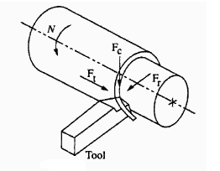
Cutting Forces
Fx: thrust force (feed force) (Ft)
Fy: cutting force acts downward (Fc)
Fz : radial force (Fr) .
The cutting forces acting on a tool during turning process ‎[2]
Notes:
There are three cutting forces which act on a single point tool (Fx, Fy and Fz) as illustrated in Figure ‎1.2.
The cutting forces were measured using 3-component dynamometer structure (3 components 9251A Kistler force sensor, multi channel charge amplifier type 5070 and data acquisition software DynoWare).
The cutting force (Fc) is main force in turning process.
The thrust force (Ft) or feed force acts in the direction of the feed motion of the cutting tool.
The radial force (Fr) acts in the radial direction

