Slide 1
Performance Degradation of 100 Gb/s PM-QPSK and 400 Gb/s PM-16QAM Coherent
Communication Systems Due to Optical Filter
Cascade and Chromatic Dispersion
Presented by:
Rami Yousef Al-Dalky
Supervised by:
Taha Landolsi
Aly Elrefaie
Mohamed Hassan

Slide 2
Outlines
Introduction
Impact of filter cascade on 100 and 400 Gb/s
  On single-carrier systems
  On dual-carrier systems
Equalization for CD using FIR filter
  For 100 Gb/s using 2 and 4 samples/symbol
  For 400 Gb/s using 2 and 4 samples/symbol
Conclusion and future work

Slide 3
Introduction
Telecommunications traffic demand has increased in recent years.
Data rates of 10 and 40 Gb/s need to be upgraded to 100 and 400 Gb/s with 50 and 100 GHz channel spacing, respectively.
  100Gb/s already in commercial products
  400Gb/s in research labs
There is a need to evaluate the performance of these next generation data rates, since its performance is severely affected by the transmission fiber and filter cascade.

Slide 4
Introduction-Cont.
This thesis is divided into two main parts of studies:
The impact of filter cascade on :
  Single-Carrier 100 and 400 Gb/s systems.
  Dual-Carrier 100 and 400 Gb/s systems.
Chromatic dispersion (CD) compensation using finite impulse response (FIR) filter for:
  100 Gb/s system using 2 and 4 samples/symbol
  400 Gb/s system using 2 and 4 samples/symbol

Slide 5
Impact of filter cascade on 100 and 400 Gb/s systems

Slide 6
WDM Network Diagram
100/400G
100/400G
TX
RX
TX
OXC
OADM
RX
WDM Mux
Filter
Filter
Filter
Filter
WDM Demux
…
WDM
Fiber
WDM
Fiber
…
TX
RX
Drop
Add
Filter Cascade

Slide 7
Introduction
There is a variety of optical filters technologies that can be used in the Mux/Demux inside an OADMs [1] such as:
  Array waveguide grating (AWG).
  Thin film filter (TFF).
  Fiber Bragg grating (FBG).
  Liquid crystal.
AWG could be used in OADMs since it has no dispersion but it has a high insertion[1].
Liquid crystal can be used in OADMs because of its low power consumption and has low loss but it may not be stable to be used in OADMs [2].
[1] John Downie, Frank Annunziata, Jason Hurley, and Jaymin Amin, ”Fixed low-channel-count optical add-drop multiplexer filter concatenation experiments with 50-GHz channel spacing and 10-Gbit/s NRZ signals,” J. Opt. Netw. 3, 204-213 (2004).
[2] J. Michael Harris, Robert Lindquist, JuneKoo Rhee, James E. Webb, ”Liquid-Crystal Based Optical Switching,” Optical Switching book, Springer, pages. 141-167, 2006.

Slide 8
Introduction-Cont.
FBG and TFF are attractive to be used in the Mux/Demux inside OADMs because of their flat passband and low insertion loss .
FBG has a low insertion loss and low manufacturing cost, but it has a high dispersion characteristics[3].
TFF was adopted very early on and is the current technology used for Mux/Demux in OADMs [4],[5].
[3] M. Kuznetsov, N. M. Froberg, S. R. Henion, and K. A. Rauschenbach, ”Dispersion-induced power penalty in fiber-Bragg-grating WDM filter cascades using optically preamplified and nonpreamplified receivers,” IEEE Photonics Technology Letters , vol.12, no.10, pp.1406-1408, Oct. 2000.
[4] http://www.auxora.com/doce/technical-default.html
[5] http://www.oplink.com/

Slide 9
Related Works
Performance degradation of optical communication systems employing different modulation schemes due to filter cascade has been investigated.
The eye closure penalty (ECP) due to filter cascade for 10 and 40 Gb/s systems has been studied in [6-9].
[6] N. N. Khrais, A. F. Elrefaie, and R. E. Wagner, ”Performance degradations of WDM systems due to laser and optical filter misalignments,” Electronics Letters , vol.31, no.14, pp.1179-1180, 6 Jul 1995.
[7] N. N. Khrais, A. F. Elrefaie, R. E. Wagner, and S. Ahmed, ”Performance degradation of multiwavelength optical networks due to laser and (de)multiplexer misalignments,” Photonics Technology Letters, IEEE , vol.7, no.11, pp.1348-1350, Nov. 1995.
[8] N. N. Khrais, A. F. Elrefaie, R. E. Wagner, and S. Ahmed, Performance of cascaded misaligned optical (de)multiplexers in multiwavelength optical networks, IEEE Photonics Technology Letters , vol. 8, pp. 1073- 1075, 1996.
[9] Haiqing Wei, Hwan J. Jeong, Aly F. Elrefaie, David V. Plant, ”Dispersion-induced signal distortion in cascaded OADMs”, in Optical Devices for Fiber Communication IV, Michel J. F. Digonnet, Editors, Proceedings of SPIE Vol. 4989 (SPIE, Bellingham, WA 2003), pp.93- 292.

Slide 10
Related Works-Cont.
The receiver power penalty due to the dispersion of a FBG filter cascade has been evaluated for 10 Gb/s systems in [3,10].
The impact of liquid-crystal filter cascade on the end-to-end performance of 127 Gb/s PM- QPSK systems at 50 GHz spacing has been investigated experimentally and through simulations in [11].
[10] M. Kuznetsov, N. M. Froberg, S. R. Henion, and K. A. Rauschenbach , ”Power penalty for optical signals due to dispersion slope in WDM filter cascades,” IEEE Photonics Technology Letters , vol.11, no.11, pp.1411- 1413, Nov. 1999.
[11] Bo Zhang; Malouin, C.; Liu, S.; Schmidt, T.J.; Guangxun Liao; Ping Wang; Washburn, H.; Jim Yuan; , ”Penalty-free transmission of 127-Gb/s coherent PM-QPSK over 1500-km of NDSF with 10 cascaded 50-GHz ROADMs,” Optical Fiber Communication (OFC), collocated National Fiber Optic Engineers Conference, 2010 Conference on OFC/NFOEC) , vol., no., pp.1-3, 21-25 March 2010.

Slide 11
Related Works-Cont.
A system of 224 PM-16QAM was generated with 50 GHz channel spacing and the wavelengths were passed through three WSSs in [12].
The transmission of dual-carrier 115.2 Gb/s DP-QPSK with 50 GHz channel spacing has been characterized in [13] and the wavelengths were passed through 10 micro-electromechanical system (MEMs)-mirror-based WSSs.
[12] A. H. Gnauck, P. J. Winzer, S. Chandrasekhar, X. Liu, B. Zhu, and D. W. Peckham, ”Spectrally Efficient Long-Haul WDM Transmission Using 224-Gb/s Polarization-Multiplexed 16-QAM,” J. Lightwave Technol. 29, 373-377 (2011).
[13] Nelson, L.E.; Woodward, S.L.; Foo, S.; Moyer, M.; Yao, D.; O’Sullivan, M.; , ”100Gb/s dual-carrier DP-QPSK performance after WDM transmission including 50GHz wavelength selective switches,” Optical Fiber Communication Conference and Exposition (OFC/NFOEC), 2011 and the National Fiber Optic Engineers Conference , vol., no., pp.1-3, 6-10 March 2011

Slide 12
Related Works-Cont.
The compatibility of 448 Gb/s dual-carrier PM-16QAM modulation with a 87.5 GHz channel spacing in the presence of cascaded optical filtering has been experimentally verified in [14].
[14] V. Sleiffer, D. van den Borne, V. Veljanovski, M. Kuschnerov, M. Hirano, Y. Yamamoto, T. Sasaki, S. L. Jansen, and H. Waardt, de, ”Transmission of 448-Gb/s dual-carrier POLMUX-16QAM over 1230 km with 5 flexi-grid ROADM passes,” in Optical Fiber Communication Conference, OSA Technical Digest (Optical Society of America, 2012), paper OW4C.3.

Slide 13
System Model
We have studied the effect of cascading multiple optical filters on the eye diagram for:
  Single-carrier 100 Gb/s PM-QPSK systems using 50 GHz channel spacing.
  Single-carrier 400 Gb/s PM-16QAM systems using 100 and 150 GHz channel spacing.
Single-carrier 100 and 400 Gb/s is considered a challenge because of the low speed electronics, some researches have showed interest in dual-carrier.
We have also studied the effect of cascading multiple optical filters on:
  Dual-carrier 100 Gb/s PM-QPSK systems using 50 GHz channel spacing.
  Dual-carrier 400 Gb/s PM-16QAM systems using 100 and 150 GHz channel spacing.

Slide 14
System Model-Cont.
ECP is used as a performance evaluation metric, which is defined as: , where a: is the eye opening without filter
cascade and b: is the eye opening with filter cascade.
ECP has been calculated for two types of filters cascade: FBG and TFF filters.
The amplitude and the dispersion characteristics of FBG filters used in our simulation are similar to the characteristics measured for FBG used in [3,10]
TFF filters used in our simulation has been modeled as Butterworth filters [8,9] whose order is adjusted to match the FBG filters amplitude response at the same bandwidth.

Slide 15
Single Carrier 100 and 400 Gb/s Systems

Slide 16
Butterworth electric filter with 3-dB bandwidth
of ¾ of the symbol rate
In this model, only the X-component of the signal passing through the filter cascade will be analyzed

Slide 17
Simulation Results

Slide 18
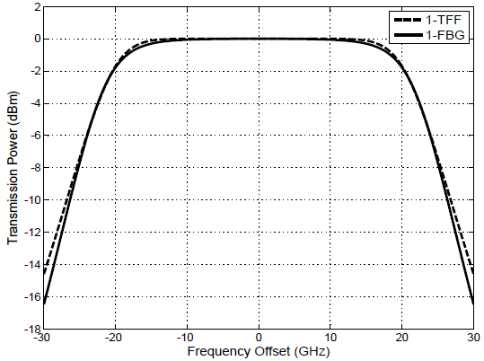
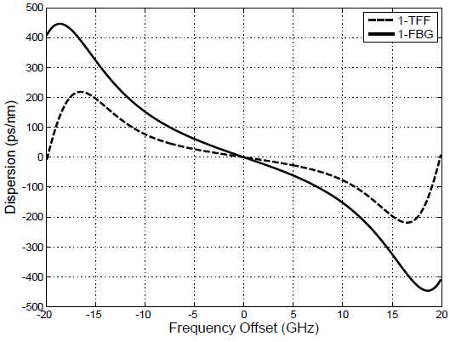
Single-Carrier 100 Gb/s PM-QPSK System
We used FBG and TFF filters at 50 GHz channel spacing with 3-dB bandwidth of 43 GHz.
Fig. below shows the amplitude response and the dispersion for one FBG and one TFF with 3-dB bandwidth of 43 GHz at 50 GHz channel spacing.

Slide 19
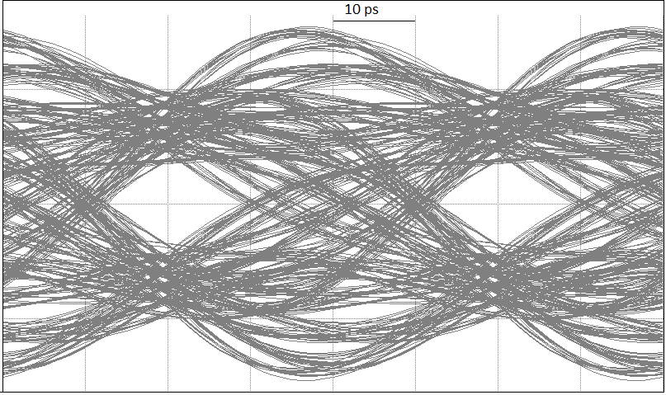
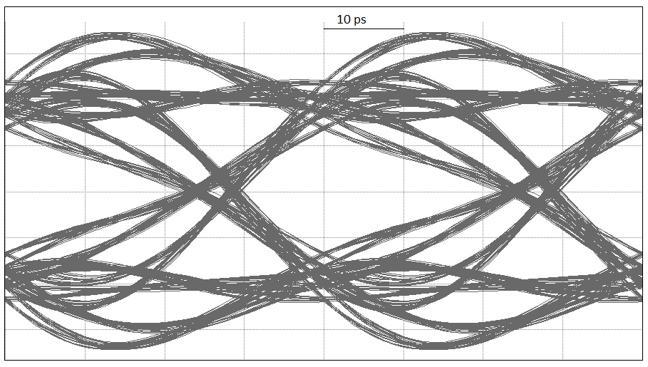
Single-Carrier 100 Gb/s PM-QPSK System-Cont.
The simulation has been performed to study the effect of cascading a number of FBG and TFF filters on the in-phase of the X-component of the receiver output.
Eye diagrams when cascading six 43 GHz
FBG with 50 GHz channel spacing
Eye diagrams when cascading six 43 GHz TFF with 50 GHz channel spacing

Slide 20
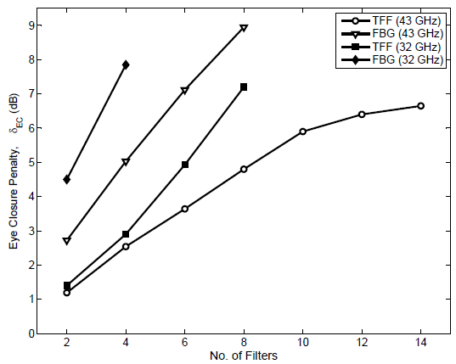
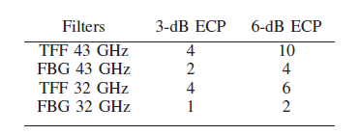
Single-Carrier 100 Gb/s PM-QPSK System-Cont.
Fig. below shows the ECP as a function of the number of FBG and TFF with 3-dB bandwidth of 32 and 43 GHz at 50 GHz channel spacing.
FBG
TFF

Slide 21
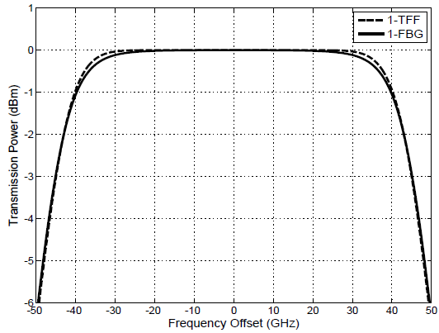
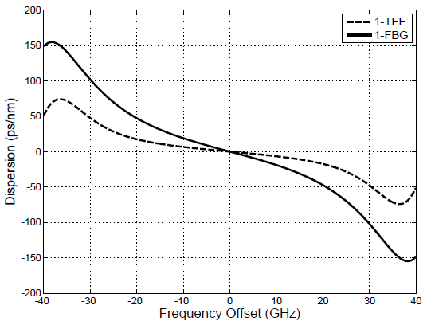
Single-Carrier 400 Gb/s PM-16QAM System
We used FBG and TFF filters at 100 and 150 GHz channel spacing with 3-dB bandwidth of 90 and 135 GHz; respectively.
Fig. below shows the amplitude response and the dispersion for one FBG and one TFF with 3-dB bandwidth of 90 GHz at 100 GHz channel spacing.

Slide 22
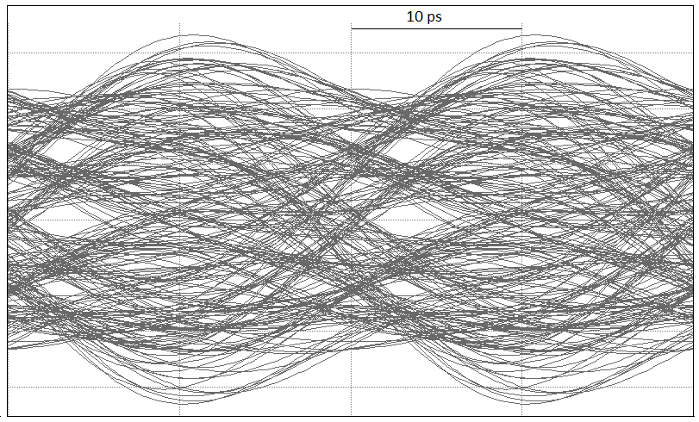
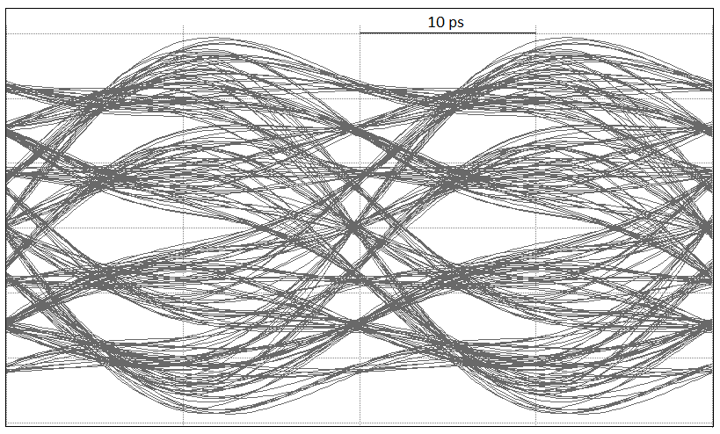
Single-Carrier 400 Gb/s PM-16QAM System-Cont.
The simulation has been performed to study the effect of cascading a number of FBG and TFF filters on the in-phase of the X-component of the receiver output.
Eye diagrams when cascading two 90 GHz
FBG with 100 GHz channel spacing
Eye diagrams when cascading two 90 GHz
TFF with 100 GHz channel spacing

Slide 23
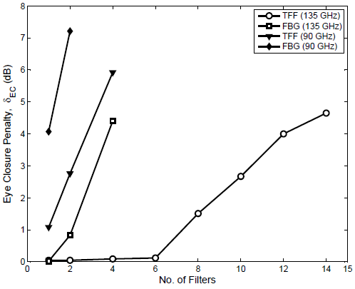
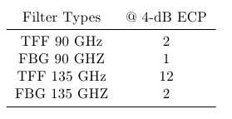
Single-Carrier 400 Gb/s PM-16QAM System-Cont.
Fig. below shows the ECP as a function of the number of FBG and TFF with 3-dB bandwidth of 90 and 135 GHz at 100 and 150 GHz channel spacing; respectively.
FBG
TFF

Slide 24
Dual Carrier 100 and 400 Gb/s Systems

Slide 25
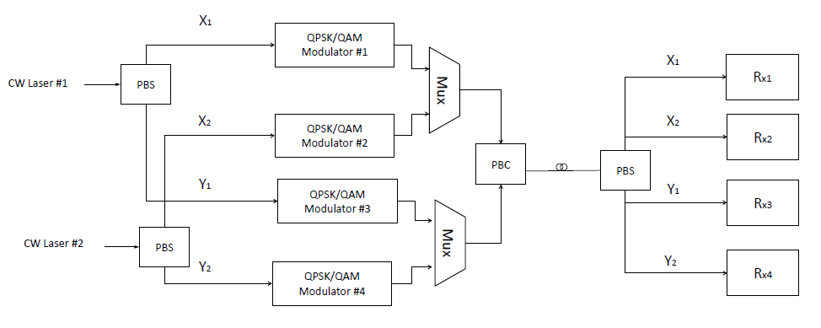
System Block Diagram
In this model, only the X-component of the signal passing through the filter cascade will be analyzed

Slide 26
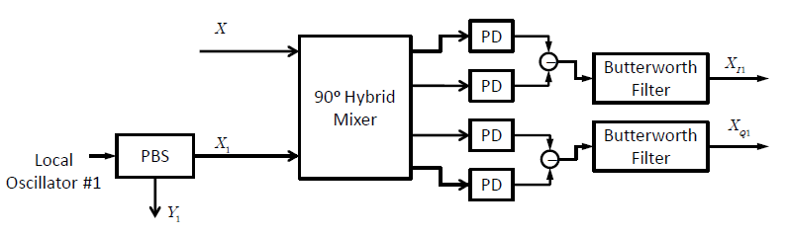
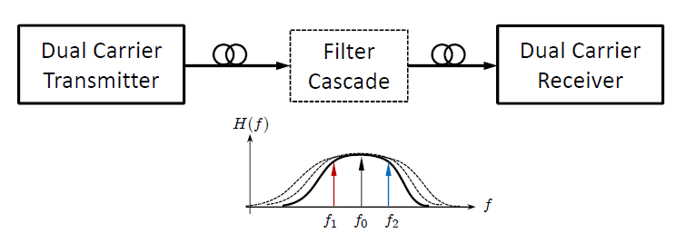
System Block Diagram-Cont.
Block diagram of Rx1
f1 and f2 are separated by
20 GHz in terms of QPSK
f1 and f2 are separated by
45 GHz in terms of
16-QAM
Simulation block diagram

Slide 27
Simulation Results

Slide 28
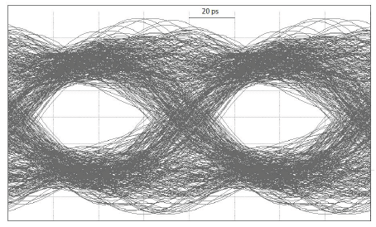
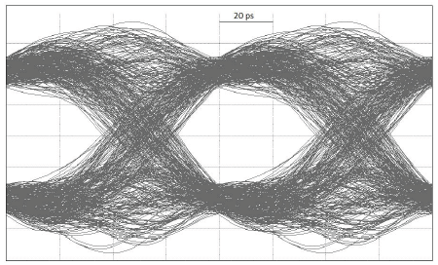
Dual-Carrier 100 Gb/s PM-QPSK System
We used the same FBG and TFF filters at 50 GHz channel spacing with 3-dB bandwidth of 43 GHz that are used in single-carrier 100 Gb/s system.
The simulation has been performed to study the effect of cascading a number of FBG and TFF filters on the in-phase of the X-component of one carrier the receiver output.
Eye diagrams when cascading two 43 GHz
FBG with 50 GHz channel spacing
Eye diagrams when cascading two 43 GHz TFF with 50 GHz channel spacing

Slide 29
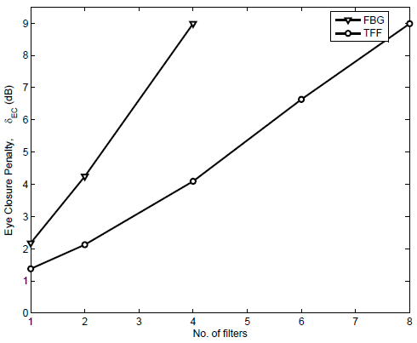
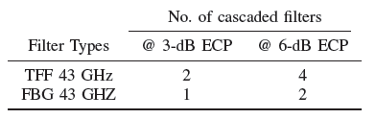
Dual-Carrier 100 Gb/s PM-QPSK System-Cont.
Fig. below shows the ECP as a function of the number of FBG and TFF with 3-dB bandwidth of 43GHz at 50 GHz channel spacing.

Slide 30
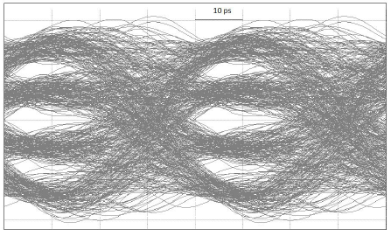
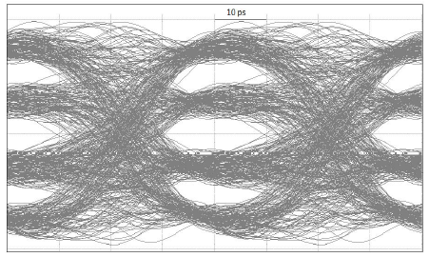
Dual-Carrier 400 Gb/s PM-16QAM System
We used the same FBG and TFF filters at 100, 150 GHz channel spacing with 3-dB bandwidth of 90 and 135 GHz that are used in single-carrier 400 Gb/s system.
The simulation has been performed to study the effect of cascading a number of FBG and TFF filters on the in-phase of the X-component of one carrier the receiver output.
Eye diagrams when cascading one 90 GHz
FBG with 100 GHz channel spacing
Eye diagrams when cascading one 90 GHz TFF with 100 GHz channel spacing

Slide 31
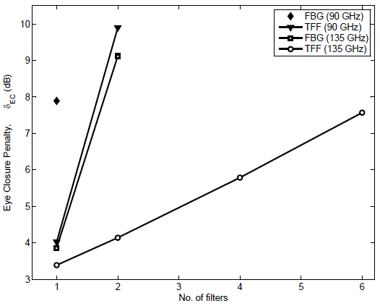
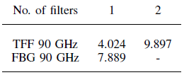
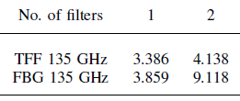
Dual-Carrier 400 Gb/s PM-16QAM System-Cont.
Fig. below shows the ECP as a function of the number of FBG and TFF with 3-dB bandwidth of 90 and 135 GHz at 100 and 150 GHz channel spacing; respectively.

Slide 32
Chromatic Dispersion Equalization for 100 and 400 Gb/s Systems
Using FD-FIR Filter

Slide 33
Introduction
The performance of a high speed transmission systems is severely affected by CD.
Digital coherent receivers allow equalization for linear transmission impairments in the electrical domain, where it is possible to compensate for CD using EDC techniques.
Several digital filters are used to compensate for CD in time and frequency domains.
We are interested in time domain equalization using fiber-dispersion finite impulse response (FD-FIR) filter.

Slide 34
Related Works
The first CD equalizer was proposed by [15] using the MLSE method for OOK system.
The first CD equalizer based on FIR filter was proposed by [16]. FIR filter with various number of taps (19 and 39 taps for 100 and 200 km; respectively) was implemented to compensate group-velocity dispersion.
[15] A. F¨arbert, S. Langenbach, N. Stojanovic, C. Dorschky, T. Kupfer, C. Schulien, J. P. Elbers, H. Wernz, H. Griesser, and C. Glingener, Performance of a 10.7 Gb/s 87 receiver with digital equaliser using maximum likelihood sequence estimation, in Proceeding of IEEE European Conference on Optical Communication, 2004.
[16] S. Tsukamoto; K. Katoh; K. Kikuchi; , ”Unrepeated transmission of 20-Gb/s optical quadrature phase-shift-keying signal over 200-km standard single-mode fiber based on digital processing of homodyne-detected signal for Group-velocity dispersion compensation,” Photonics Technology Letters, IEEE , vol.18, no.9, pp.1016-1018, May 1, 2006.

Slide 35
Related Works-Cont.
A time domain FD-FIR was used by [19] to compensate the CD of 42.8 Gb/s transmission over 1000 and 4000 km fiber without using DCFs. It provided a design for digital FD-FIR filter from the digitalization of the time domain impulse response of the inverse of the fiber’s transfer function.
[17] Savory, S.J.; Gavioli, G.; Killey, R.I.; Bayvel, P.; , ”Transmission of 42.8Gbit/s Polarization Multiplexed NRZ-QPSK over 6400km of Standard Fiber with no Optical Dispersion Compensation,” Optical Fiber Communication and the National Fiber Optic Engineers Conference, 2007. OFC/NFOEC 2007. Conference on ,vol., no., pp.1-3, 25-29 March 2007.
[18] Seb J. Savory, Giancarlo Gavioli, Robert I. Killey, and Polina Bayvel, ”Electronic compensation of chromatic dispersion using a digital coherent receiver,” Opt. Express 15, 2120-2126 (2007).
[19] Seb J. Savory, ”Digital filters for coherent optical receivers,” Opt. Express 16, 804-817 (2008).
Notes:
-. This was considered the first time of transmitting 40 Gb/s over such a distance on standard fiber.

Slide 36
Related Works-Cont.
An adaptive FIR digital filter based on NLMS algorithm was proposed by [20],[21]. The adaptive FIR filter was developed to compensate for CD in a 112 Gb/s PM-QPSK transmission system.
[20] Tianhua Xu, Gunnar Jacobsen, Sergei Popov, Jie Li, Evgeny Vanin, Ke Wang, Ari T. Friberg, and Yimo Zhang, ”Chromatic dispersion compensation in coherent transmission system using digital filters,” Opt. Express 18, 16243-16257 (2010).
[21] Tianhua Xu, Gunnar Jacobsen, Sergei Popov, Jie Li, Ke Wang and Ari T. Friberg, ”Digital compensation of chromatic dispersion in 112-Gbit/s PDM-QPSK system”, Proc. SPIE 7632, 763202 (2009).

Slide 37
Electronic CD Compensation using FIR Filters
We compensated for CD of SMF at 100 Gb/s and 400 Gb/s systems in time domain approach.
Since the dispersion is a linear operation on the electrical field, its effect can be undone by linear filtering.
The transfer function of the fiber with chromatic dispersion given by [22]:
        , where
To compensate for CD, we use Finite Impulse Response (FIR) filter.
[22] A. F. Elrefaie, R. E. Wagner, D. A. Atlas, and D. G. Daut, “Chromatic dispersion
limitations in coherent lightwave transmission systems,” J. Lightwave Technol., vol. 6,
pp. 704–709, May 1988.

Slide 38
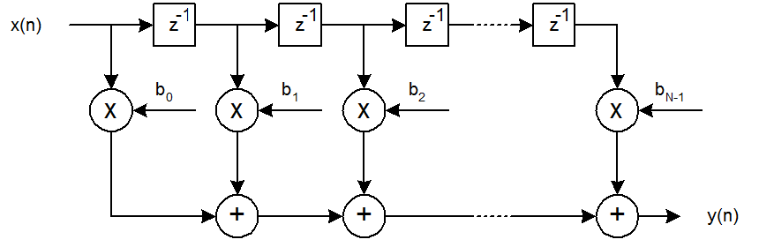
Electronic CD Compensation-Cont.
The block diagram of FIR is shown below and the formula for FIR filter is:

Slide 39
Electronic CD Compensation-Cont.
Taking the Inverse Fourier Transform for , will give the impulse response function of the compensating filter.
The impulse response is infinite in duration , so we truncate the impulse response to a finite duration by using the Nyquist frequency
By sample the impulse response depends on the filter order, we can calculate the tap weights as follow [19]:
The number of taps are given by [19]:

Slide 40
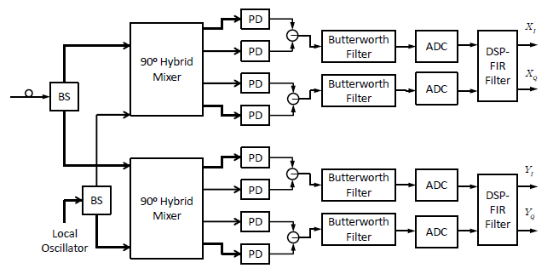
System Model
Block Diagram of the receiver used in the simulation

Slide 41
Electronic CD Compensation-Cont.
We compensated for CD for 100 Gb/s PM-QPSK system
  Use 2 samples/symbol
  Use 4 samples/symbol
Also, we compensated for CD for 400 Gb/s PM-16QAM system
  Use 2 samples/symbol
  Use 4 samples/symbol

Slide 42
Simulation results for 100 Gb/s
The number of taps to compensate for CD.
Distance | No. of taps (2 samples/symbol) | No. of taps (4 samples/symbol)
500 | 171 | 683
1000 | 341 | 1367
2000 | 683 | 2733
3000 | 1025 | 4101
4000 | 1367 | 5467

Slide 43
Simulation Results-100G system using 2 samples/symbol

Slide 44
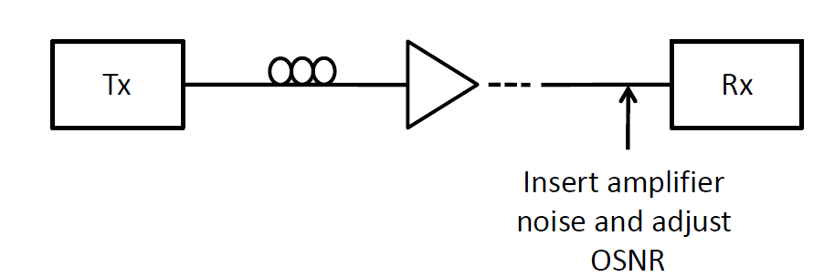
Simulation Results-100G system using 2 samples/symbol
We used FIR filter to compensate for CD at different distances using 2 samples/symbol.
To have a clear validation of CD compensating filter, we have generated OSNR versus BER curves.
The OSNR at the receiver is relative to the equivalent amplifier cascade noise measured in a bandwidth of 0.1 nm

Slide 45
Simulation Results-100G system using 2 samples/symbol
We have generated OSNR versus BER of the back-to-back (0 km) and after the CD compensating for 1000 km and 4000 km fiber length.
BER was measured over a total bits of 262144 bits for different OSNR values.
We have generated OSNR versus BER using maximum number of taps ( ) and using 75% and 50% of

Slide 46
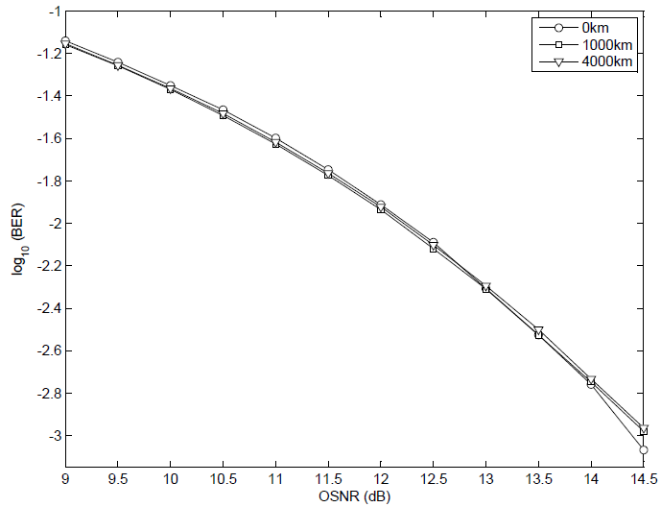
Simulation Results-100G system using 2 samples/symbol
OSNR versus BER for QPSK using 2 samples/symbols with maximum
number of taps.

Slide 47
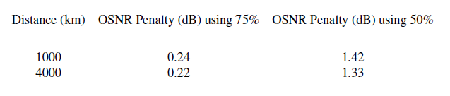
Simulation Results-100G system using 2 samples/symbol
There is a minor penalty when using 75% of , while there a notable penalty when using only 50% of
We calculated OSNR penalty (at BER of relative to back-to-back) when using 75% and 50% of , given that the back-to-back OSNR level required for a BER of is 14.4 dB.

Slide 48
Simulation Results-100G system using 4 samples/symbol

Slide 49
Simulation Results-100G system using 4 samples/symbol
We used FIR filter to compensate for CD at different distances using 4 samples/symbol.
We have generated OSNR versus BER of the back-to-back (0 km) and after the CD compensating for 1000 km and 4000 km fiber length.
We have generated OSNR versus BER using maximum number of taps ( ) and using 75% and 50% of

Slide 50
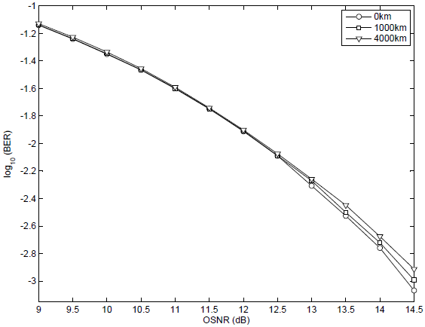
Simulation Results-100G system using 4 samples/symbol
OSNR versus BER for QPSK using 4 samples/symbols with maximum
number of taps.

Slide 51
Simulation results for 100 Gb/s
There is no notable penalty when using 75% and 50% of and its even performing better compared to using .
When comparing the results of CD equalization using 2 samples/symbol and 4 samples/symbol, we can notice that there is no difference in performance when using .
For CD equalization in 100 Gb/s PM-QPSK, using 2 samples/symbol is the best approach to compensate for CD.

Slide 52
Simulation results for 400 Gb/s
The number of taps to compensate for CD
Distance | No. of taps (2 samples /symbol) | No. of taps (4 samples /symbol)
200 | 273 | 1093
500 | 683 | 2733
1000 | 1367 | 5467

Slide 53
Simulation Results-400G system using 2 samples/symbol

Slide 54
Simulation Results-400G system using 2 samples/symbol
We used FIR filter to compensate for CD at different distances using 2 samples/symbol.
We have generated OSNR versus BER of the back-to-back (0 km) and after the CD compensating for 500 km and 1000 km fiber length.
BER was measured over a total bits of 262144 bits for different OSNR values.
We have generated OSNR versus BER using maximum number of taps ( ) and using 75% and 50% of

Slide 55
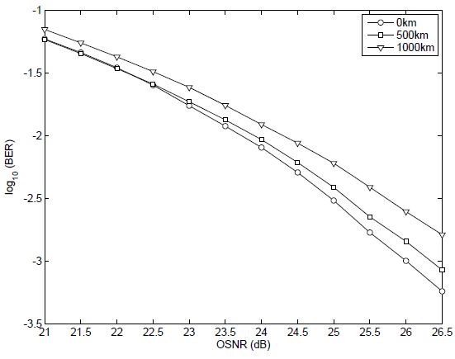
Simulation Results-400G system using 2 samples/symbol
OSNR versus BER for 16-QAM using 2 samples/symbols with maximum
number of taps.

Slide 56
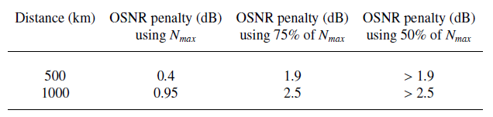
Simulation Results-400G system using 2 samples/symbol
We calculated OSNR penalty (at BER of relative to back-to-back) when using , also using 75% and 50% of , given that the back-to-back OSNR level required for a BER of is 26 dB.

Slide 57
Simulation Results-400G system using 4 samples/symbol

Slide 58
Simulation Results-400G system using 4 samples/symbol
We also used FIR filter to compensate for CD at different distances using 4 samples/symbol.
We have generated OSNR versus BER of the back-to-back (0 km) and after the CD compensating for 500 km and 1000 km fiber length.
We have generated OSNR versus BER using maximum number of taps ( ) and using 75% and 50% of

Slide 59
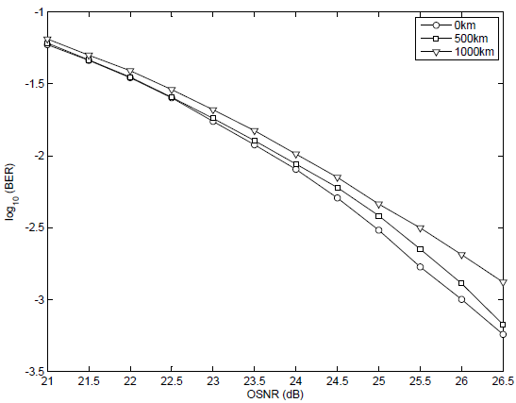
Simulation Results-400G system using 4 samples/symbol
OSNR versus BER for 16-QAM using 4 samples/symbols with maximum
number of taps.

Slide 60
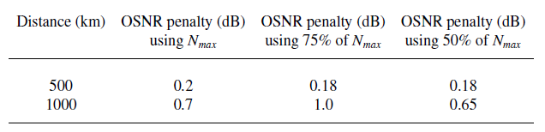
Simulation Results-400G system using 4 samples/symbol
There is no notable penalty when using maximum number of taps also when using 75% and 50% of after CD compensation for 500 km fiber.
While there is minor penalty after CD compensation for 1000 km fiber.

Slide 61
Simulation results for 400 Gb/s
When comparing the results of CD equalization using 2 samples/symbol and 4 sample/symbol, we can notice that using 4 samples results in better performance compared to the case of using 2 samples/symbol when using . Also using 50% of with 4 samples/symbol gives better results.
For CD equalization in 400 Gb/s PM-16QAM, using 4 samples/symbol is the best approach to compensate for CD.

Slide 62
Maximum Tolerable Fiber Distance for CD Compensating Filter

Slide 63
Maximum Tolerable Fiber Distance for CD Compensating Filter
We have compensated for a static amount of CD using FD-FIR filter.
The CD compensating filter was designed to compensate for CD after specific distance, where the number of taps for FD-FIR filter is a function of fiber distance.
We tried to calculate the maximum tolerable distance that may not affect the performance after compensating of CD.

Slide 64
Maximum Tolerable Fiber Distance for CD Compensating Filter
We calculated the maximum tolerable distance for 100 Gb/s PM-QPSK and 400 Gb/s PM-16QAM systems using [22].
We find the maximum distance for 100 Gb/s system is 8 km, while the distance for 400 Gb/s system is only 2 km.
To see the effect on the performance of both systems, we generate OSNR versus BER curves.

Slide 65
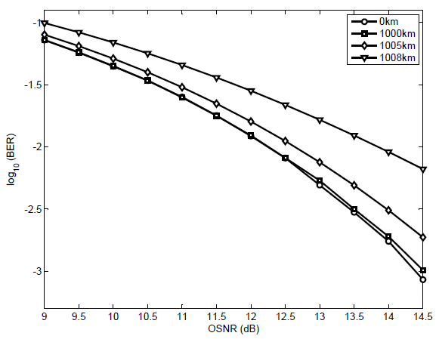
Maximum Tolerable Fiber Distance for CD Compensating Filter
OSNR penalty
of 0.6 dB
OSNR versus BER for 100 Gb/s system with FD-FIR designed for 1000
km with fiber length of 1000, 1005 and 1008 km.

Slide 66
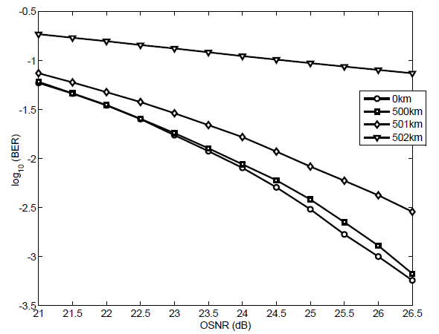
Maximum Tolerable Fiber Distance for CD Compensating Filter
OSNR penalty
of 1.7 dB
OSNR versus BER for 400 Gb/s system with FD-FIR designed for 500
km with fiber length of 500, 501and 502km.

Slide 67
Conclusions
We studied the effect of cascaded filters on single-carrier and dual-carrier 100 and 400 Gb/s systems.
The results indicate that filter cascade has severe effect of the performance of dual-carrier compared to single-carrier, this is because of the crosstalk between the two carriers.
Also we compensated for chromatic dispersion electronically using FIR filter for 100 and 400 Gb/s systems.
For CD equalization in 100 Gb/s PM-QPSK, using 2 samples/symbol with maximum number of taps is the best approach to compensate for CD.
While for CD equalization in 400 Gb/s PM-16QAM, using 4 samples/symbol with 50% of is the best approach to compensate for CD.

Slide 68
Future Work
Incorporate CD as well as PMD and fiber non-linear effects for 100 Gb/s PM-QPSK and 400 Gb/s PM-16QAM coherent communication systems.
Also future work should take into account the residual CD that may exist which can be compensated using adaptive filter.
Also we propose to incorporate the filter cascade with fiber effects (CD and PMD) and study the impact of these factors together and build a DSP model that may compensate these effects.
Notes:
We may use DCF and compensate for the residual using FIR

Slide 69
Thank You

