Slide 1
Middle East Academic
Libraries Symposium

Slide 2

Background about Jisc Collections
Jisc Collections is the UK library consortium representing 160 higher education institutions and 500 further education institutions
We are uniquely placed to provide our members with:
  expertise in negotiating and procurement, within the scholarly communications sector, to save librarians time and money
  high-quality e-resource collections selected for academic research, teaching and learning
  best pricing and licensing, using our collective influence to obtain value for money
  environmental scanning and research into innovative resources, licensing models and evaluation tools
  shared knowledge about e-resource acquisition and research.
  Now, more than ever, librarians must show value for money. We provide annual efficiency gains to our members of approximately £75 million, and enable scholars and learners to use each resource to its fullest potential

Slide 3
E-books and the end user
In this presentation I will focus on the changing requirements of the end user
The staff and students who use the e-books provided by their university
I will use the evidence that Jisc Collections collected in 2008 -9 and the case-study of one current medical student to highlight how fast user demand and expectations are changing

Slide 4
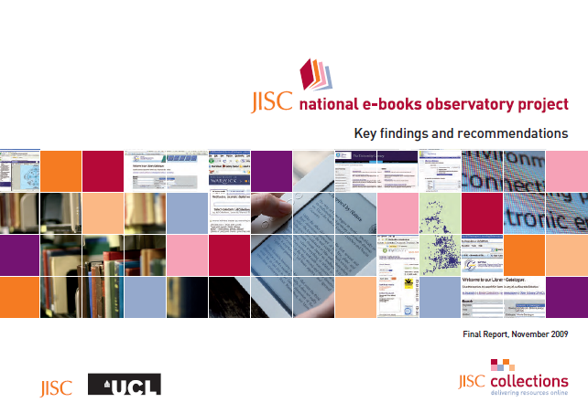
Jisc national e-books observatory project
Jisc national e-books observatory project – published in 2009
The project licensed a collection of course text e-books highly relevant to UK higher education taught courses in four discipline areas: Business and management studies, Engineering Medicine and Media Studies
We used surveys, focus groups and deep log analysis to asses the user behaviours and expectations
http://observatory.jiscebooks.org/reports/jisc-national-e-books-observatory-project-key-findings-and-recommendations/

Slide 5
What we found in 2009
E-books are part of the academic mainstream – nearly 65% of teaching staff and students had used e-books
More than half of the users said that the last e-book they used was by courtesy of their university library
In universities the demand for print editions of short loan collections exceeds supply – for librarians course e-text books were a valuable back-up to print

Slide 6
User behaviour
Behavioural evidence (deep-log analysis) suggested that course text e-books were used for text extraction and brief viewing rather than continuous reading
Users were observed to “bounce” and “click” through e-resources
They view and “power browse” as much as read pages on line, so page and session times are typically short

Slide 7
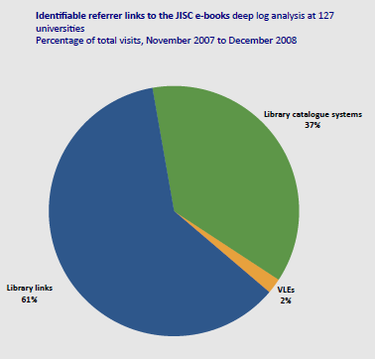
The importance of metadata
Identifiable refer links to the Jisc e-books showed that:
  61% came from library links
  37% came from library catalogue systems
  2% from VLEs

Slide 8
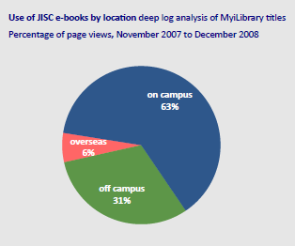
Times when are e-books used
E-books were used throughout the day and night with the heaviest uses between 8am and 2pm
Use by location:
  63% on campus
  6% overseas
  31% off campus

Slide 9
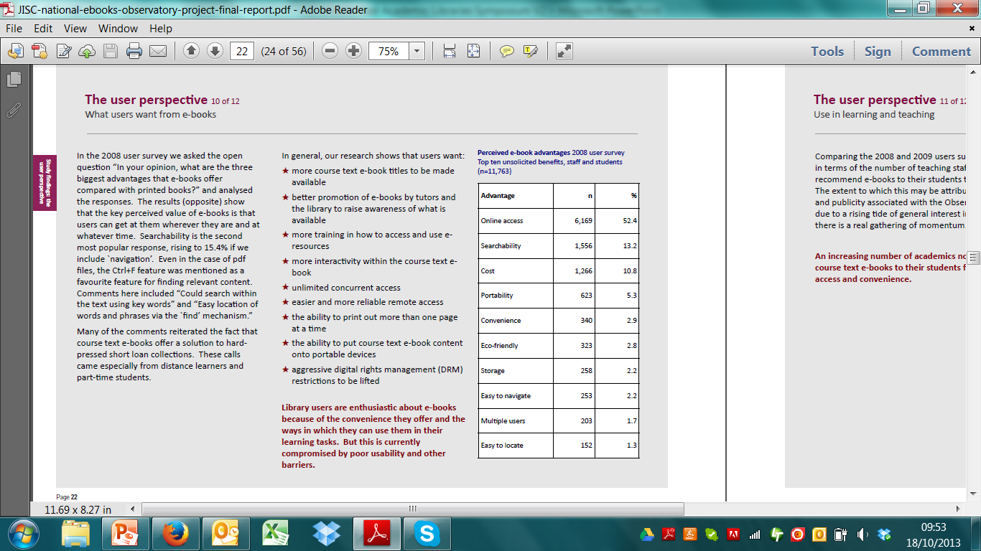
Users: Perceived advantages of e-books
Perceived advantages of e-books
2008 user survey
Top ten unsolicited benefits, staff
and students
(n+11,763)
The national e-books observatory surveyed
end users across the UK receiving 52,000 responses.

Slide 10
Now?
Much has happened since we published the national e-books observatory project in 2009:
  Mobile is ubiquitous
  iPads / tablets
  Amazon
  18- to 34-Year-Olds Are Now 'Generation C’ – connected!

Slide 11
What about the students of the future
How will students of the future will use technology like the iPad and its successors; what they will expect, what problems they are likely to encounter?
How can libraries and publishers prepare to support the new wave of digital students?

Slide 12

A case study
JOSHUA JAMES HARDING
Medical student
Warwick Medical School
This medical student gave an inspiring speech at the UKSG 36th Annual Conference and Exhibition which took place from 8-10 April 2013 at the Bournemouth International Centre.
The follow up article he wrote will be published in the November edition of http://uksg.metapress.com/content/122388

Slide 13
What this student has to say:
“A number of initiatives in universities and schools have adopted the iPad, placing it at the focal point for teaching and learning, moving from the rigid textbook and paper of analogue classrooms to a digital, portable, personalized learning environment. As the adoption of tablets increases, students’ expectations will rise and they will require instant access to their most used resources, whether they are currently digital or analogue.”
“So the obvious question would be: as an institution, library, or publisher, are you ready to meet this inevitable demand?”

Slide 14
“… the pace and complexities of discussing just one patient in a group work render the paper textbook as useful as the proverbial chocolate teapot”
“I am now a completely paperless student.
My primary source of information for
medicine is now my iPad, providing me with a
tool to access everything I require to study the
academic portion of my course all on one
device the size and weight of a paper
note-book.”

Slide 15
“A paper textbook cannot play you videos, it cannot play you audio to help explain diagrams or pictures, and it cannot provide you with a way to manipulate its content. All these things may mean the difference between a student understanding a concept, and not.”

Slide 16
“Using a digital approach during a lecture, I am able to download the slides, export them to my note taking app and annotate during the lecture using text or handwriting whilst recording the speaker. I can switch between my note taking app and other resources, giving me access whilst in the lecture to the same textbook the majority of my classmates will consult that evening to fill in the gaps.”

Slide 17
“’Smart’ textbooks are something I would like to see in the future.”
“Imagine a book that whilst I study it, is studying me, observing which chapters I have read the least and most, when I first covered a topic and my scores on each quiz and test taken.”

Slide 18
The future?
This is one case study – but perhaps a vision of the future expectations:
  A truly interactive e-book – with video and audio and self assessment
  Institutions can use data analytics to turn the “e-text book” into a “study buddy”

Slide 19
Questions and discussion
Lorraine Estelle
Director of Jisc Content and Resource Discovery and CEO of Jisc Collections
l.estelle@jisc.ac.uk
For more on our ebook activity please visit: http://jiscebooks.org/ and http://www.jisc-collections.ac.uk/Reports/

