Slide 1
Middle East Academic
Libraries Symposium

Slide 2

About ebrary
Founded in 1999 by Kevin Sayar & Christopher Warnock
Variety of models, products, and services
  Subscription (ebrary pioneered this e-book model)
  Perpetual archive
  Patron-driven acquisition
  Short-term loans
  SaaS and DASH!
Headquartered in Palo Alto, CA, USA
2011 became a ProQuest business

Slide 3

About EBL
Company founded in 1997 by Australian booksellers
EBL launched in 2004
Variety of models, products, and services
  Perpetual Access
  Non-linear Lending Model (EBL pioneered this e-book model)
  Demand-driven Acqusition (EBL pioneered this model)
  Short-term loans (EBL pioneered this model)
Originally headquartered in Perth, West Australia
May 2013 became a ProQuest business

Slide 4

Our Vision: Better Together
Choice ∙ Experience ∙ Integration
Innovation ∙ Value ∙ Support

Slide 5
Combined Content Offering
CONTINUED EXPANSION OF UNRIVALED CONTENT
Nearly
500K
unique titles
400K
titles available for DDA
600+
Publishers:
The world’s leading STM publishers, essential specialty publishers, highly respected publishers of business content, strong international coverage, major academic publishers and university presses
Curated Packages and Flexible Subscription Offerings
Bundling with ProQuest
TOP SUBJECT AREA COVERAGE
19%
14%
14%
23%
30%
Language & Literature
Social
Science
Science
Technology
Medicine

Slide 6
Access Models
Subscription | ✔
Perpetual Archive | ✔ | ✔
Single-user | ✔ | ✔
Non-linear lending | ✔ | ✔
3-user | ✔ | ✔
Multi-user | ✔ | ✔
Extended Access | ✔ | ✔
DDA / PDA | ✔ | ✔
Short-term loan | ✔ | ✔
Collections | ✔ | ✔
Consortia | ✔ | ✔
Evidence Based Acquisition
Subscription
Perpetual Archive
  Single-user
  Non-linear lending
  3-user
  Multi-user
DDA / PDA
Short-term loan
Collections
Consortia

Slide 7
Our Environment
Researcher
Publisher
Library
Discovery Access Research Tools
Aggregator
Optimise Budget & Streamline Workflow
Maximise Dissemination & Revenue

Slide 8
Pitfalls
Either / Or
All or Nothing
Restrict Access
Forcing electronic content back into the ‘print box’
Forcing new models into old workflows
Building walls rather than containers

Slide 9

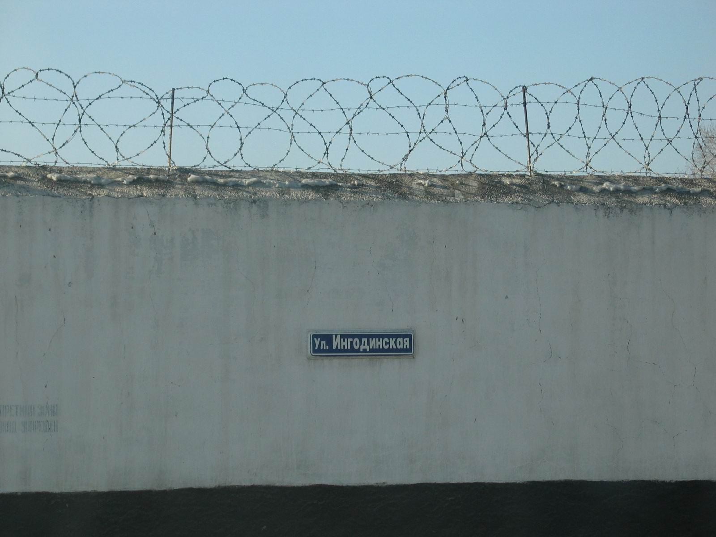
Walls vs. Containers
Walls
Containers
Restricted Choice
Content invisible or Siloed
Turnaways
Restrictive DRM
Dead links
ILL
Subscription / DDA
Discovery Services
Multi-user, NLL Extended Access
No or Light DRM
STL

Slide 10
Challenges Libraries Face
Monograph budgets in decline – squeeze by electronic journals, databases, etc.
Lack of space in the library
Cost of keeping books on shelves
Web – changing users expectations`
Use of print monographs low and in decline
Rise in expenditure on Interlibrary loan
Stretched resources
The Economy

Slide 11
Define needs & goals
Each library has a micro-climate of their own
Understand your needs and goals:
  Space
  Critical mass
  Meet Demand
  Extend print access
  Specialised collection curation
Define your values and expectations
  Ownership vs. access
  What do you want to achieve?
Set a budget and timeframe

Slide 12
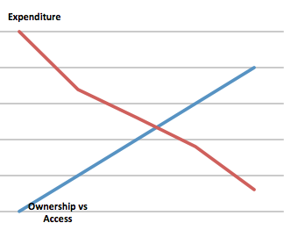
Define Goals & Expectations
Budget

Slide 13
Continuum of Access Models
[SUB] Subscription
Affordable base, unlimited multi-user access and continued growth
Subscriptions based on specific industries, engineering disciplines, business skills, and corporate departments
PA
[PA] Perpetual Archive
84% of titles have multiple concurrent access
Extended Access™ for
single-user titles
Non-Linear™ Lending
Multiple simultaneous access at or near hardback price
Diversifying models aids in collection development and
shows the greatest ROI
SUB
[DDA] Demand-driven Acquisition
Just in time, not just in case
Sophisticated profiling tools
Flexible Short-term Loans (STL) options
DDA

Slide 14
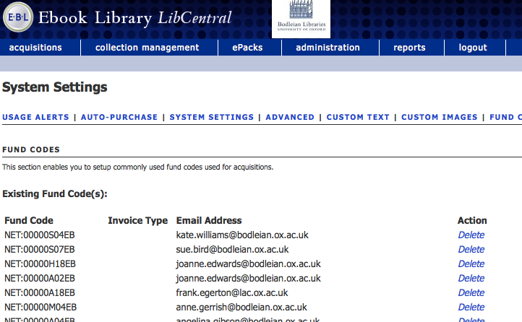
Curated Collection
Oxford University
Perpetual Access – EBL
Sophisticated selector/acquisition workflow
Supplementary small DDA program
ebrary Academic Complete subscription

Slide 15
Just in time access
Swinburne University
First full catalogue DDA - since 2006
Currently no mediation
e-preferred policy
Much higher usage of DDA auto purchase
Increased percentage usage of owned titles
Print purchases only for selected non-e available
Sustainable annual spend

Slide 16
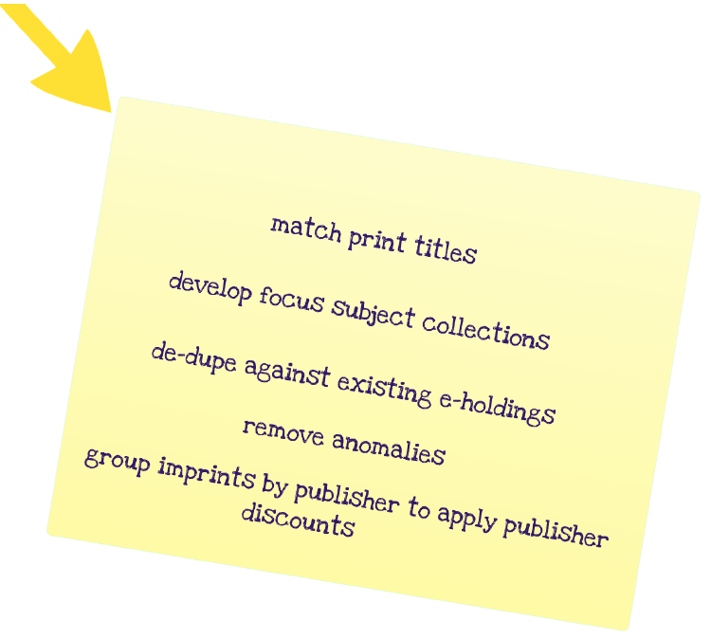
TMF – Title Matching Fast!
ISBNs – Cleaning, Matching, Reporting
Benefits – No duplicates, Space Saving, Collection Development, Strategic Acquisition (Sub, DDA, Purchase, NLL), Discounts, High Use
Curtin University
P to E conversion
Academic Complete
Publisher Packages Discount
PDA
University of South Australia
Space saving
P to E conversion
Publisher Packages Discount
Perpetual Purchase

Slide 17
End-to-End Workflow Management Tools
Selector Workflow
Real-time Reports
Customized Profiling
Electronic Ordering & Invoicing
Acquisitions Platform
De-
duplication
Budget & Fund Code
Tools
Notes:
Administration and acquisition platform
Support for selector workflows - Custom new-title alerts, Differentiated permissions for librarians and patrons, lists
De-duplication
Electronic ordering and invoicing
Budget management tools
Fund code support
Real-time usage and expenditure reports
Customizable analytics by user – who’s using content and how? (can this be a quick pop up pointing to reports box???)
Usage and expenditure reports directly feed into acquisition policies completing the circle
Fund code:
- preassign fund codes
- reports
- alerts
- build workflow based on fund code – different people get different alerts based
Customizable analytics by user – who’s using content and how?
- remains anonymous, doesn’t impede privacy but you can custom
Differentiated permissions
- support for a selector workflow
Circles with arrow leading to the next circle, next circle. Usage then feeds back into acquisitions

Slide 18
Integrated Workflow Solutions
DISCOVERY
Summon
PQ platform
Other Discovery Services
ILS VENDORS
Intota
OCLC
Other ILS vendors
ebrary/
EBL
BOOK VENDORS
YBP
Coutts
SSO AND AUTHENTICATION
EZProxy
Athens
Shibboleth
Notes:
Need to highlight PQ products more. Don’t like that grey is on one side while orange on the other. Enhance color a bit??
ExLibris Alma, OCLC WorldShare, OPAC
We want to play nice with everyone you work with. Looking to maximize. Core missing is to integrate where we can.
Discoverable in the PQ platform – list out other integration with PQ products – RefWorks, Flow, Bowker
Order direct using acquisition tools or purchase through book vendors
Integration with ILS Vendors – electronic invoicing for Innovative, etc. etc.
Integration with Next gen library services – purchase through Alma, OCLC WMS and soon Intota
Integrate with book vendors such as YBP to streamline print and electronic workflows
Automatically set holdings in your discovery layer, removing need to load MARC records for non-owned titles
If you do want MARC records, flexible options with proprietary records or facilitate OCLC WorldCat Cataloging Partners
Automated de-duplication against your OCLC holdings
Integrate with existing authentication methods to make access seemless for your patrons
Arrows should go both ways – can they be dynamic?

Slide 19
DATA!

Slide 20
Thank you!

