Slide 1
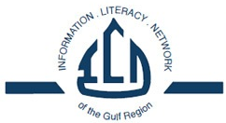
Threshold Concepts & Assessment
Ahmed Alwan, American University of Sharjah
Threshold Concepts For Information Literacy:
The Good, the Bad and the Ugly
January 2015

Slide 2
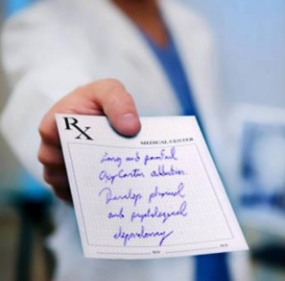
Where Are My Outcomes?
No more prescribed outcomes!
The omission may be due to three factors:
Shift in format
Outcomes must be context-based
No guidance on how to transform TCs into outcomes (Oakleaf, 2014)
How do I design lesson plans, activities etc. and how do I assess?
Notes:
In the past, with the old IL standards what we had were a set of 5 abilities that an individual (usually a student) needed to acquire to be IL literate, and a list of outcomes attached to those 5 abilities.
Librarians would use the provided outcomes to design classes, activities, and assessment measures.
With the new framework no outcomes have been provided. So where have the outcomes gone?
There are 3 reasons why outcomes do not exist in the new framework:
Firstly, the Task Force made a conscious decision to shift away from the format of the previous IL Standards which included over a hundred statements formatted as learning outcomes. (Oakleaf, 2014)
Secondly, the Task Force hopes that developing specific outcomes will be the responsibility of librarians working in a local, campus context rather than provide them at a national, profession-wide level.
Thirdly, Meyer and Land, originators of the threshold concept idea, have provided little guidance on ways to transform threshold concepts into outcomes. (Oakleaf, 2014)
So what does this mean?

Slide 3

‘Bite The Bullet’
Bite the bullet and develop your own learning outcomes!
Two-Step Process:
Identify what it is you want to teach
Transform those concepts into learning outcomes
Learning Outcomes:
Content for instruction
Help in designing pedagogy
Drive assessment
Notes:
The answer is simple, develop new outcomes connected to the new framework!
As the new framework does not include a set of prescribed learning outcomes, it is now the responsibility of librarians to design learning outcomes based on their own context.
Learning outcomes are essential as they assist librarians in establishing the content for instruction, a framework for designing pedagogy and allow for meaningful assessment.

Slide 4
Writing Outcomes
The aim is to answer the following question: What do I want students to know, understand or be able to do?
Verbs help identify behaviors that will demonstrate level of learning in a measurable way!
Good learning outcomes:
Specific
Achievable
Assessable
Notes:
A learning outcome in itself is the answer to the question 'when the students leave (this class, session or course), what do I want them to know, or understand, or be able to do?’
Good learning outcomes are specific (not vague), achievable (realistic), and possible to assess (measurable).

Slide 5
Writing Outcomes continued
Verb + What + IOT + Bloom Verb + Why
Identify divergent perspectives, in publications, during information gathering and assessment in order to integrate and synthesize ideas gathered from multiple sources.
(Research as Inquiry)
Notes:
Knowing the formula for writing a good learning outcome is key, as it will allow librarians to design outcomes that are specific, achievable and assessable.
IOT = In order to
Bloom Verb = Verbs from Bloom’s Revised Taxonomy
Bloom verbs from Blooms taxonomy are very useful as the allow you to select verbs from a set of 6 skills that are steadily more difficult to achieve.

Slide 6
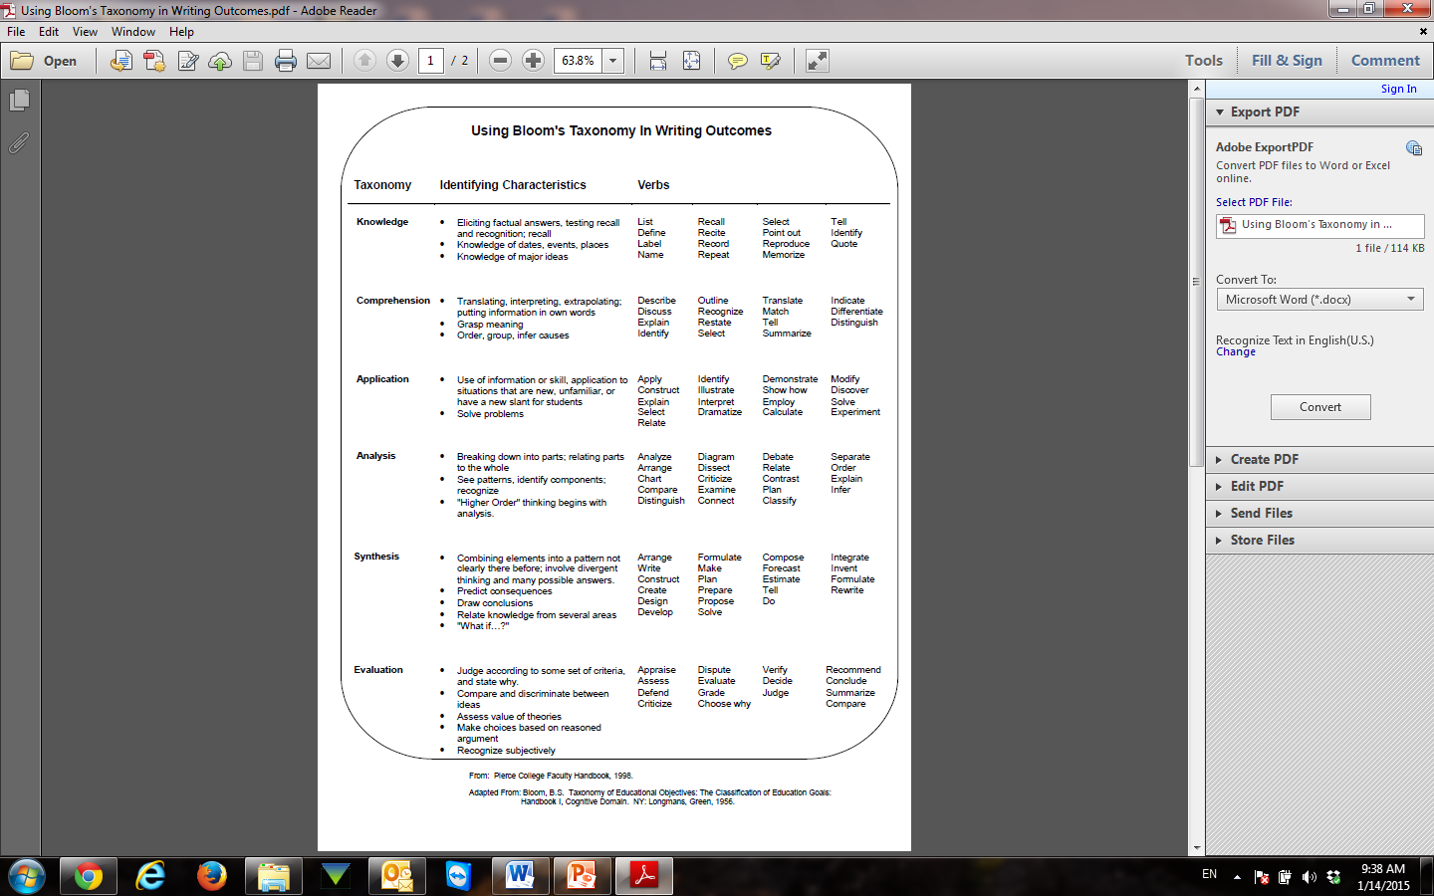
Notes:
Six levels in the taxonomy, moving through the lowest order processes to the highest.

Slide 7
Achieving Outcomes
Debra Gilchrist @ Pierce College
Important Considerations
Outcomes should guide your assessment!
Begin with the end goal in mind!
Helpful Questions:
How will I know students have achieved the outcome?
What could students do to show they have achieved the outcome?
Notes:
Often assessment is about evaluating whether students have achieved the outcomes you have developed.

Slide 8
Assessment Strategy
Tackle portion at a time…Not every outcome needs assessing
Collaborative work with faculty yields the best integrated assignments
Make the assessment practical and meaningful
Manage your assessment measures so that they can add up to a complete picture
Notes:
When developing an assessment strategy it is important to consider the following:

Slide 9
1. Outcome
What do you want the students to be able to do?
2. Content
What does the student need to know to do this well?
5. Criteria
How will you know the student has done this well?
Debra Gilchrist – Pierce College
4. Assignment
How will the student demonstrate the learning
3. Pedagogy
What’s the learning activity?

Slide 10

Assessing Effectively
When developing your criteria for assessing consider the following:
Clear scale for grading
Clear guidelines and parameters
Explaining the unexplainable
Stepping Stones
Accomplished by:
Clear guidelines
Expectations
Interpret terms
Show examples
Notes:
When developing criteria consider the following:
Develop a clear scale for grading or judging
Provide students with clear guidelines and parameters
Explain the sometimes unexplainable (i.e. things that seem commonsensical)
Develop stepping stones for students throughout the assignment (i.e. drafts, break down assignment into sections)
Accomplished by:
Provide clear guidelines and parameters for what you require
Be clear about your expectations and what you will be assessing
Do not expect students to understand terms that we take for granted. Make sure to interpret terms like: scholarly, quality, effective etc.
Provide students with examples of what you require

Slide 11
Performance Assessment
Framework emphasizes concepts rather than skills (Oakleaf, 2014)
Shift away from surveys, fixed-choice test questions etc.
Move towards:
Research logs
Reflective writing
Self/peer evaluation
Research drafts or papers
Open-ended questions
Posters/Presentations
Portfolios
Concept maps
Notes:
With the new framework emphasis is on concepts rather than skills (Oakleaf, 2014)
This shift impacts the way in which we conduct assessment and the assessment tools we use
There is a move to use performance assessment, which emphasize the grasping of concepts

Slide 12
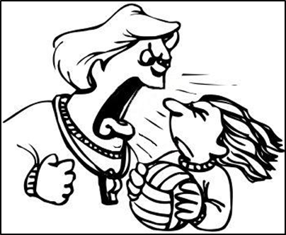
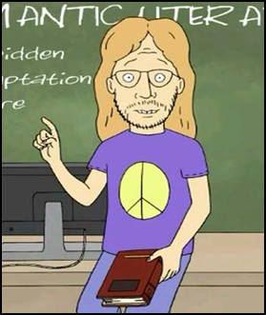
Performance Assessment continued
Allows for qualitative or quantitative analysis
Can be used formatively or summatively
Notes:
Formatively: To give feedback to learner and help librarians revise their teaching strategies
Summatively: To establish what students have learned at some end point (e.g. the end of the course or program)

Slide 13

Self Assessment
Allows students to become conscious of the skills they employ
Emphasizes self-reflection and thinking as practitioner
Assesses decisions students encounter and make
Notes:
Self Assessment allows students to become conscious of the research strategies, critical thinking steps, and other transferrable skills that they employ to complete an assignment.
This type of assessment emphasizes self-reflection and internalization of the use and value of specific skills and allows students to think as a practitioner.
It goes beyond analysis of the final product and assesses the decisions students encounter and make while completing an assignment and why they make certain choices.

Slide 14
Self Assessment continued
• How will you use, analyze, and synthesize information while on the job as a social worker? (Gilchrist & Oakleaf, 2012)
• What are the important parts of this research assignment? How well have you done them? How do you know?
• Describe the three to five most important things you learned about the research process and yourself as a researcher while doing this assignment.
Notes:
Examples of questions that allow students to self assess.

Slide 15
Rubric Assessment
A rubric is a descriptive scoring scheme, connected to an assignment, exercise, activity etc., created by educators to guide analysis of a student’s work. (Oakleaf, 2009)
Rubrics allow for consistent scoring and provision of student feedback
Help in leveling the skills and describing them in a developmental manner
Clarify to students where their work falls along a continuum

Slide 16
Rubric Assessment continued
Ask yourself these questions:
What learning outcome/s will I be measuring?
What will student artifacts look like?
Begin by knowing what you are looking for (specific elements) in a students artifact?
How will students need to preform these elements?
Notes:
Before you begin creating and designing a rubric to assess a specific student artifact, consider the following questions! (Oakleaf, 2014)

Slide 17
Rubric Assessment continued
A rubric includes 4 components:
1) Task Description
2) The Scale (3-5 levels)
3) Dimensions
4) Description of the dimensions
Notes:
1) Task Description
• The task should be tied to a threshold concept and by extension a specific learning outcome
• The task involves a “performance” of some sort by the student
• The task can take the form of a specific assignment, exercise or overall behavior (e.g. participation, use of proper protocols etc.)
2) The Scale
• 3-5 levels of mastery are typically used
• These will describe how well or how poorly a student performs on a given task
• Try to use positive terms to describe various levels of mastery (e.g. mastery, partial mastery, progressing, emerging etc.)
• Judgmental and competitive language should be avoided
• The more levels, the more difficult it becomes to differentiate between them. Conversely, the more specific the levels the clearer the task is for the student. Find a balance!
3) Dimensions
• Identify the various components of the task
• Make them simple and complete
4) Description of the dimensions
• Provide a description of dimensions with all levels of performance described in detail
• Some rubrics only provide descriptions for the highest level of performance

Slide 18
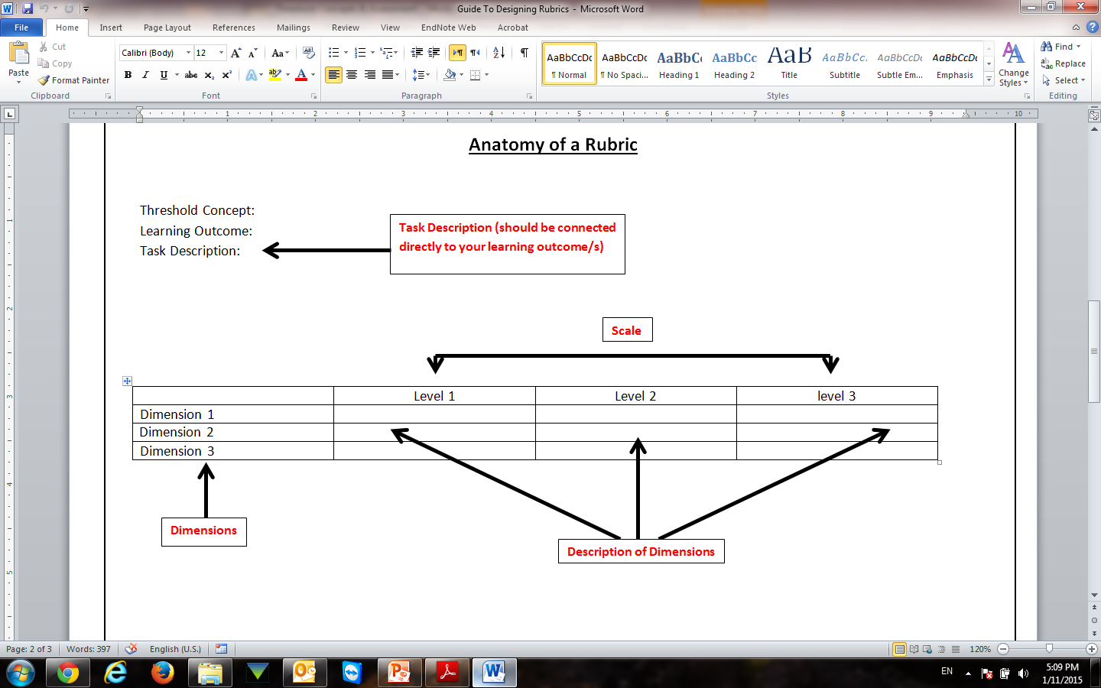
Anatomy Of A Rubric

Slide 19
Threshold Concept: Research as Inquiry
Learning outcome: Students will be able to identify divergent perspectives, in publications, during information gathering and assessment in order to integrate and synthesize ideas gathered from multiple sources.
Task Description:
Post liminal stage = Where the student thinks like a practitioner or expert
 | Accomplished (exceeds expectations) | Developed (meets expectations) | Emerging (needs improvement)
Examine divergent viewpoints/bias | Effectively examines and compares information from various sources in order to evaluate all diverging points of view or bias. | Examines and compares information from various sources in order to evaluate some diverging points of view or bias. | Has difficulty examining and comparing information from various sources and fails to evaluate any diverging points of view or bias.
Recognize context and impact | Recognizes the cultural, physical, or other context within which the information was created and understands the impact of context on interpreting the information. | Recognizes the cultural, physical, or other context within which the information was created but fails to understand the impact of context on interpreting the information. | Has difficulty recognizing the cultural, physical, or other context within which the information was created and fails to understand the impact of context on interpreting the information.
Synthesize ideas and information | Communicates, organizes and synthesizes information from various sources to fully achieve a specific purpose, with clarity and depth. | Communicates and organizes information from a variety of sources. However, the information is not yet synthesized. | Communicates information from a small number of sources. However, the information is fragmented and/or used inappropriately (misquoted, taken out of context, or incorrectly paraphrased, etc.).

Slide 20
Closing The Loop
Assessment is a culture of evidence.
Consider the following:
Where is the data going?
What are your doing with it?
What have you done differently as a result of the data?
What progress, improvements or changes has the data helped you make?
Notes:
Closing the loop = What actions will you take?
Assessment is a culture of evidence. The question is what information are you able to deduce from your assessment and what does analysis of the information prove or disprove?
Based on the answer to these questions, it is your responsibility to ‘close the loop’ and make decisions.

Slide 21
References
Gilchrist, D. (2013). Assessment as learning. Retrieved from ACRL Immersion Teacher Track lecture notes.
Gilchrist, D., & Oakleaf, M. (2012). An essential partner: the librarian's role in student learning assessment. National Institute for Learning Outcomes Assessment: Occasional Paper, 14.
Oakleaf, M. (2014). A Roadmap for Assessing Student Learning Using the New Framework for Information Literacy for Higher Education. The Journal of Academic Librarianship, 40(5), 510-514.

