Slide 1
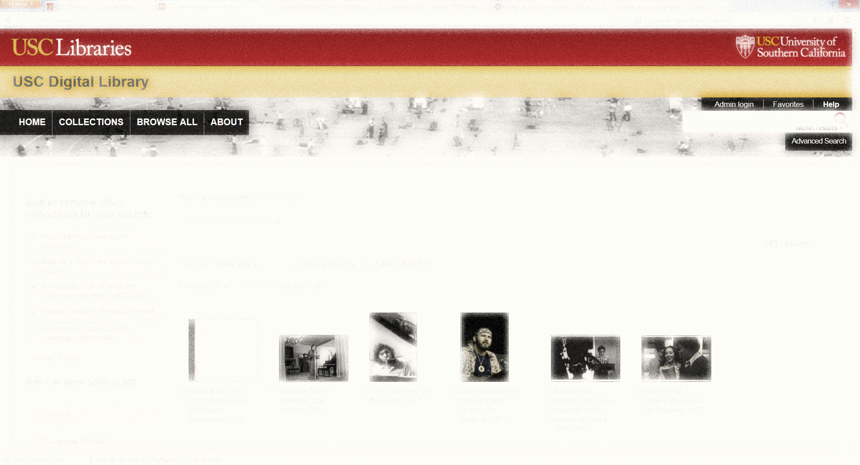
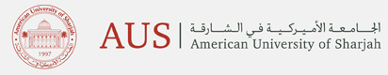

Changing Roles in Academic Libraries
John McDonald
Associate Vice President &
Chief Information Officer
Claremont University Consortium
October 23, 2013
Notes:
Thank you very much for the invitation to present at this Symposium for Middle East Libraries at this excellent institution. I’m very pleased to be here and look forward to interesting and fruitful discussions throughout the two days. I would like to especially thank both the American University of Sharjah and Proquest for sponsoring the event and all of the staff from both organization who have worked hard to plan and coordinate this meeting.
My biography is in your materials, but I would like to quickly mention that began my career in Collections and Acquisitions at Virginia Commonwealth University and then the California Institute of Technology in Southern California, then moved to the Claremont Colleges in 2007, where I began as the Associate Director for User Services & Technology Innovation. After restructuring of the Library administration, I served as Interim Director of the Library until two years ago when I moved to the role of Chief Information Officer and Associate Vice President in our central administration offices. While in that role I was in charge of all aspects of information technology, including the strategy and direction for implementation of technology in the Library.

Slide 2
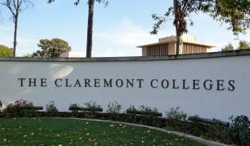
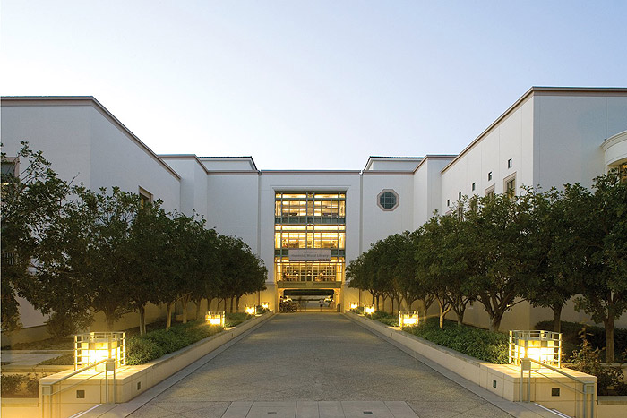
Notes:
The Claremont Colleges are a unique model for higher education in the United States. The model is based on the Oxford model of liberal arts college education. Quoting the founder James Blaisdell, “My own very deep hope is that instead of one great, undifferentiated university, we might have a group of institutions divided into small colleges—somewhat on the Oxford type—around a library and other utilities which they would use in common. In this way I should hope to preserve the inestimable personal values of the small college while securing the facilities of a great university.”
The Claremont Colleges are a set of 8 independent institutions that are contiguously located in the small town of Claremont, California. The 5 undergraduate colleges and two graduate universities, began with the founding of Pomona College in 1887 and then added a new institution every decade or two, including the Claremont Graduate University, Scripps College, Claremont McKenna College, Harvey Mudd College, Pitzer College, and the Keck Graduate Institute. The central Claremont University Consortium offices make up the 8th member of the consortium.

Slide 3
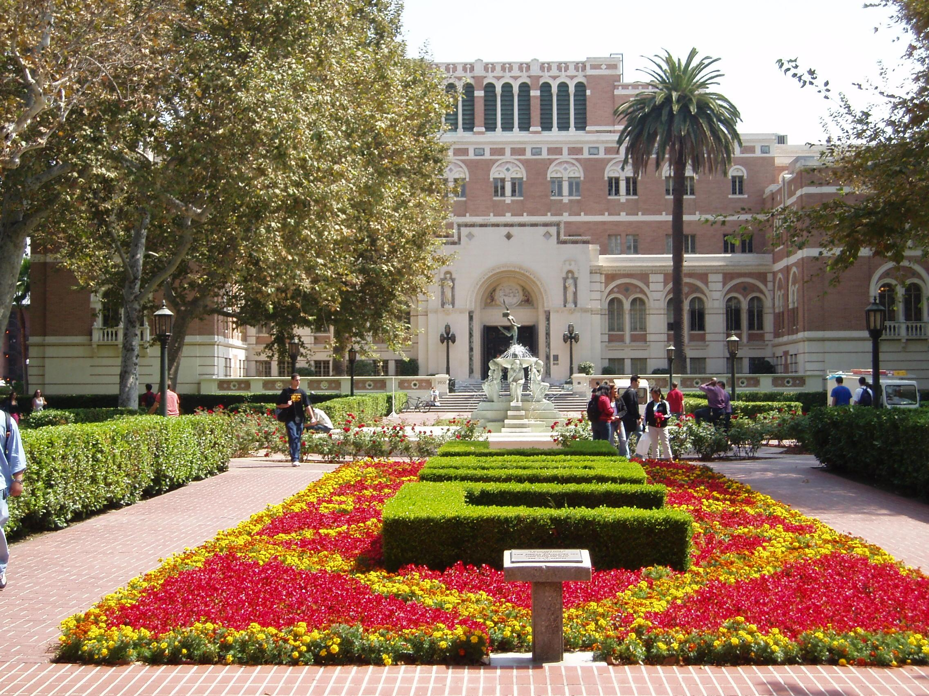
Notes:
I would be remiss if I didn’t mention that in a few weeks, I will assume the position of the Associate Dean for Collections for the University of Southern California, which is one of the world's leading private research universities. The USC Libraries includes the Doheny Memorial Library and fourteen specialized libraries with an operating budget of approximately $41 million USD. Library collections encompass over 4.2 million volumes and a collections budget of $16.4 million USD. In that role, I will develop strategy and direction for Library collections, including licensing, acquisitions and cataloging, preservation, storage and collection access, and relevant scholarly communications initiatives.
Today I’ll be talking about issues that face all academic research libraries and using examples drawn mostly from our experiences at the Claremont Colleges.

Slide 4
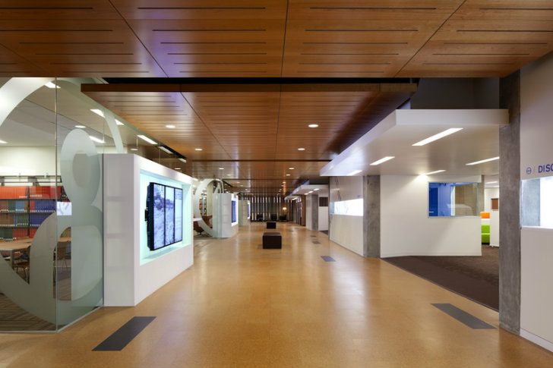
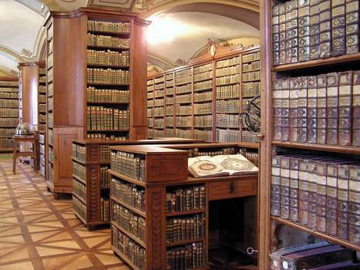
Notes:
This was our traditional view of our academic research libraries of the past. What differentiated us was our collections, the physical items that we had acquired, organized, housed, and provided to our users. We built elaborate organizations and associated industries around finding this information, selecting it for our collections, preparing it for the short and long term storage, and then locating it and providing it to our students, faculty, and researchers. But the academic research libraries of the present and future have been changing radically over the past decade. Our physical spaces are radically shifting due to changes in information technology and the changing nature of storage and retention of physical items. And there is no end to the changes that are in store for our libraries.

Slide 5







Notes:
One of the main reasons that I feel our roles and responsibilities have changed over the recent past is that we are now at the point to quote my colleague in Southern California, Robert Kieft, the ‘End State’ of library collections, as our academic research collections have grown closer and closer to homogeneity over time. We no longer expect the diversity in collections from our universities in the United States, as almost every institution has site licenses to major publisher and vendor packages. Furthermore, national and international efforts to establish a quote collective collection unquote, have made great progress in over the past few years, including the Hathi Trust initiative to scan and preserve digital copies of books from major libraries, both in and out of copyright, as well as the US-based Western Regional Storage Trust, who has made substantial progress towards the collective sharing of the print archiving efforts of important journal literature.

Slide 6
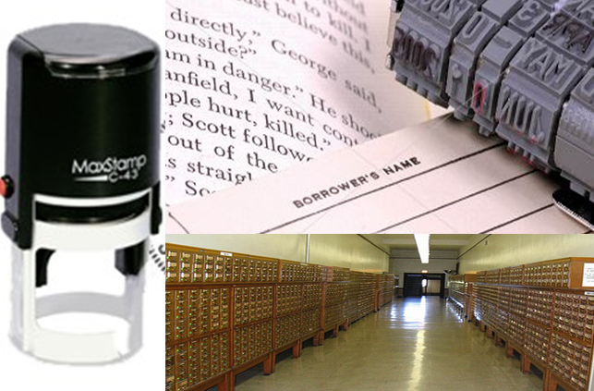
Notes:
Of course, we still have our daily operational challenges relating to collections and making them accessible, but not to the same extent as in the past. What does a library do now? How do we distinguish ourselves and provide value to our students and faculty that they can know and understand. Some libraries, and I recently heard of another large US academic library who stated that their administration still takes for granted that the Library is an integral part of the fabric of the academic campus? By and large, the majority of our academic libraries are no longer able to engage in a collections – based economy any longer, meaning that we have to do things differently now.

Slide 7
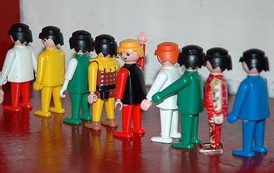
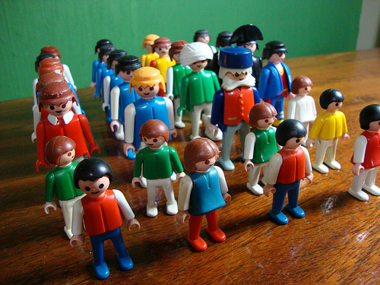

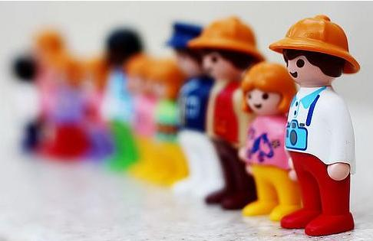
People
Notes:
Since our value is no longer nearly completely derived from those collections-based value judgments, then it is definitely about the people we have and their ability to produce new services of real value for our students and faculty. We really need to focus our resources on our librarians and staff and put them in a position to provide an extensive array of services that will prove our value as information specialists and experts.
And although this concept is not new, it’s important to understand a shift in focus away from a majority of staff who are devoted to acquiring and organizing information to a staff that is largely focused outward from the library to the faculty and students that we serve, providing outreach, instruction, and be proactive in connecting users to collections that are now much broader and distributed than ever before.

Slide 8
Librarians supporting…
Future Roles for Academic Libraries
Institute new collections workflows & strategies
Faculty & student publishing
Developing modes of collaboration
Assessment efforts
Notes:
What then are the roles for our libraries in the future?
First, we need to institute new workflows and develop new collections strategies. The nature of collection development and collections management has changes much more than ever before. Resources are no longer hard to identify, locate, acquire, store, and retrieve. We need new workflows to address new ways of acquiring materials in bulk, managing them constantly, and promote them prolifically.
Second, we need to support the Library as Publisher movement, assisting our faculty and students with publishing and storing the research that they produce and that they want to be discovered, used, and built upon by future researchers.
Third, our libraries and librarians can definitely begin to engage in new modes of collaboration at both the information production stage, as stated earlier, as well as in the teaching and learning stages, assisting faculty in better use of information resources and students in a better understanding of the use of information.
And finally, most academic libraries, unlike the one I mentioned earlier, do face a crisis of confidence in their performance and value to the overall mission of the academy. We face of rising doubts about our value to both the local and the academy and increasing disintermediation of libraries from the individual student and faculty member’s information seeking and information usage behaviors.

Slide 9
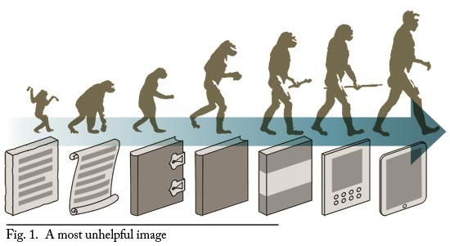

Evolution or Extinction?
Notes:
As everyone is well aware, our Libraries have begun to adapt well to the evolution of whatever the information container is or has been in the past. And we are developing new techniques to handle continued change in the future.

Slide 10
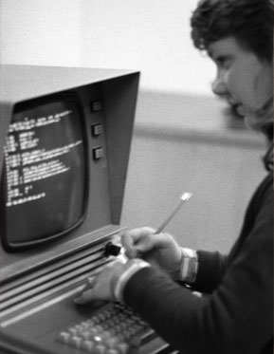
What do many technical services staff do?
Selection
Acquisition
Cataloging
Licensing
Marketing
Usage Statistics
Vendor relations
Troubleshooting
Notes:
I’m going to start with the evolution of the tasks that might were and are still being performed in our still evolving technical services departments. Many of these include a majority of our common tasks surrounding the former print-based culture with some newer tasks listed for the e-based environment that is the primary focus of our current users. The first few tasks are those associated with print – selecting, acquiring, cataloging, and focusing on the individual item, whether print or electronic as the most important unit of attention. But focusing primarily or only on the tasks that benefit a print-based library collection or item-by-item in isolation is misplacing what our focus should be now and wasting valuable resources.

Slide 11
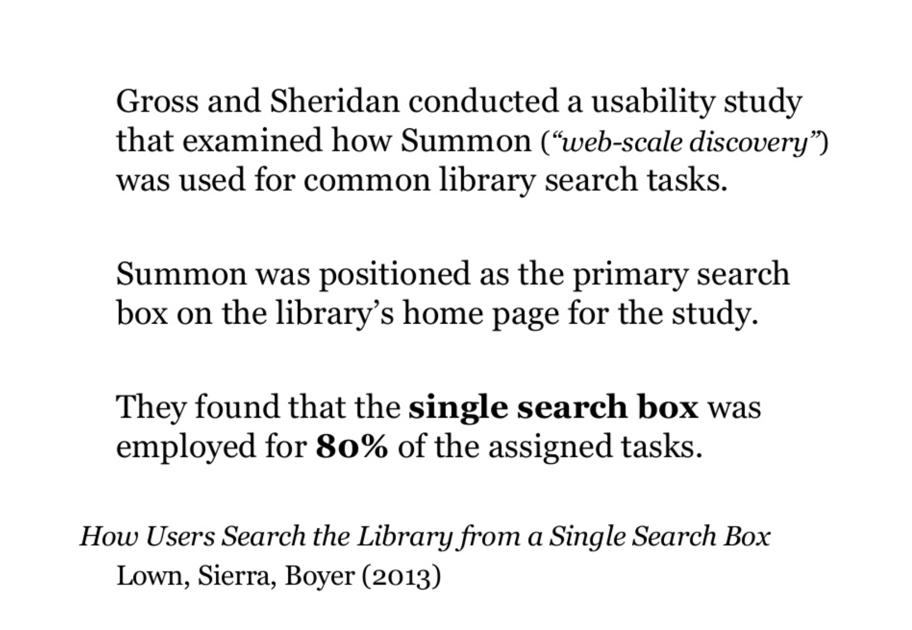
Notes:
If you need any more evidence that today’s academic library has changed and evolved extensively, I’d like to point out a few recent studies about changing user behavior. In this first one, Lown, Sierra, and Boyer quoted the Gross and Sheridan usability study about Summon and found that when made the primary search box, users utilized it 80% of the time.

Slide 12
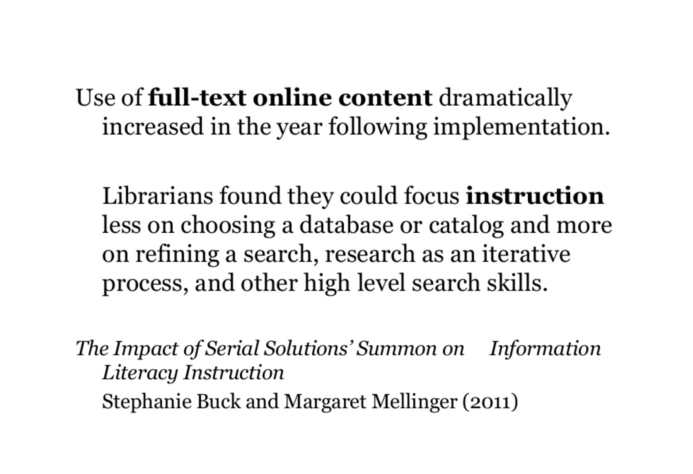
Notes:
Second, Buck & Mellinger found that after implementation of a discovery tool, librarians could alter their instruction and focus on higher level skills for students like refining a search, and developing an iterative search process. Maybe more importantly is the first statement on the slide, that they found that use of full-text online content increased dramatically after implementation.

Slide 13
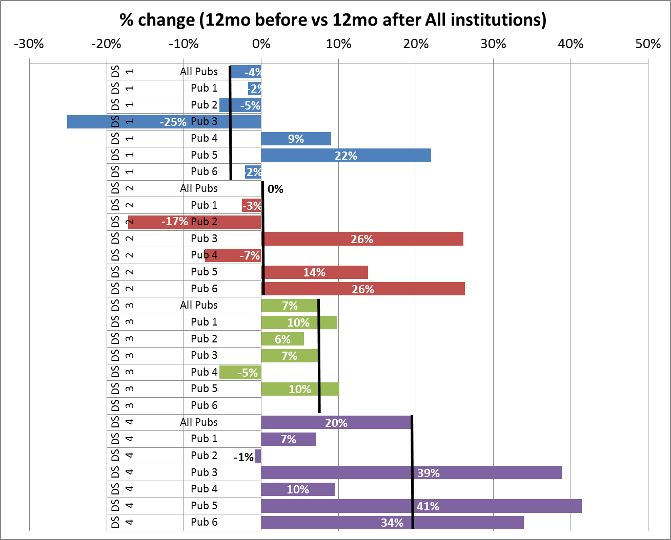
McDonald, Price, Levine-Clark. (In progress).
Discovery or Displacement: The Effect of Discovery Services on Online Journal Usage.
Notes:
My own current research is taking a closer look at this type of claim. With my colleagues, Jason Price and Michael Levine-Clark, we are analyzing usage statistics for 24 libraries (with the potential for up to 150 more) from 6 major publishers and have begun to analyze the differing effects of a discovery system on that journal usage. And as you can see from this preliminary analysis, not all discovery systems affect usage in the same manner, although some discovery systems generally have led to increased usage, as you can see from the green and purple bars to the bottom of the chart. This is very preliminary information and we are not yet to the stage where we can build our statistical models to determine if the increase is statistically significant or if there are other factors affecting the increase or decrease.

Slide 14
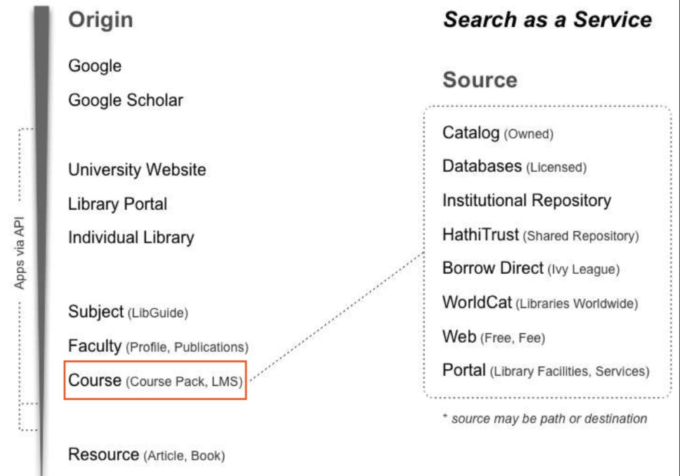
Peter Morville, Library 2.013, Inspiration Architecture: The Future of Libraries.
Notes:
So the ground breaking introduction of discovery systems can, as Peter Morville, recently pointed out, lead to innovative new integrations of tools with more traditional services to introduce efficiency and effectiveness into the information. In this example, he’s pointing out how a variety of source, all integrated into a discovery service, can then more effectively be integrated into a new information realm like the Learning Management System.

Slide 15
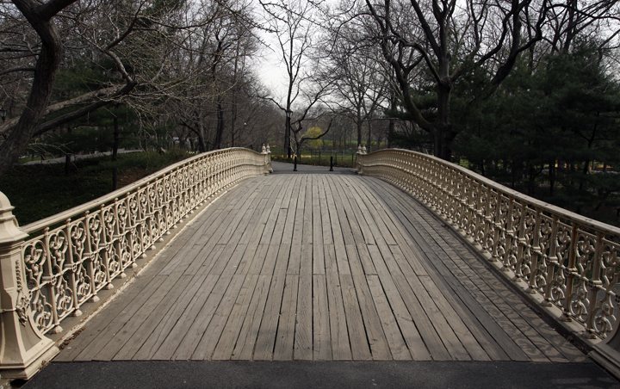
What will your technical services staff do?
Tool Development
Problem prevention
Assessment / ROI
Publishing Support
Training
Troubleshooting
Notes:
Therefore those developments in information organization and improvements in efficiency provides us with extra capacity to develop our staff to do newer tasks supporting e-resources and performing newer tasks that allow them to bridge from our collections to our other librarians as well as the efficiently bridging directly from our e-resources to the user. I’ll talk more in depth about some of these activities in the later slides.

Slide 16

New collections strategies

Slide 17
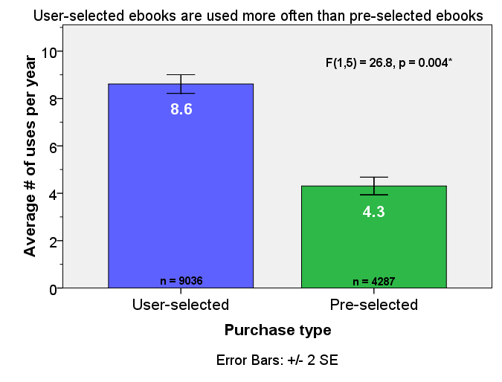
New Access & Selection Models
Notes:
To further illustrate that our primary focus should be on our e-resources, research that Jason Price & I did on different e-book selection models indicated that the average number of post-purchase uses per year is significantly greater for user-selected ebooks, which helped dispel an early hypothesis that demand driven acquisition would lead to users who select ebooks for one time usage and that librarian selected books were better for the collection.

Slide 18
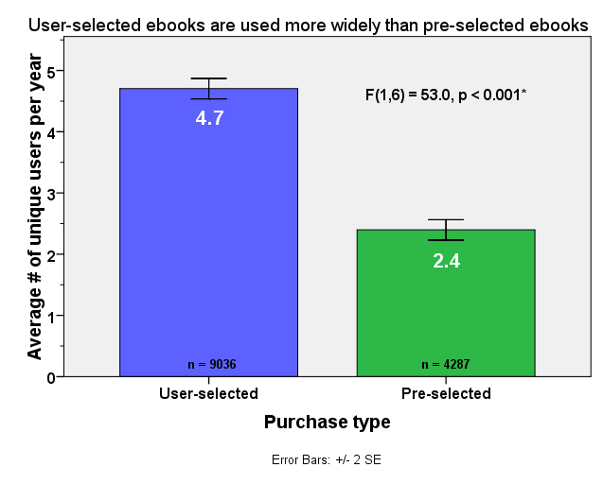
New Access & Selection Models
Notes:
In the same research study, we discovered that users also selected ebooks that were of more interest to other users, rather than the librarian selected ebooks, allowing us to reject the hypothesis that users select books that are only of interest to themselves. Clearly DDA for ebooks is a new strategy that has not negatively impacted the quality of collections or potential use by others.

Slide 19
DU EBL Data
 | Actual | List
619 titles purchased | $49,003 | $49,003
5,031 titles with at least one STL | $85,338 | $398,278
4,154 titles with at least one browse | $0 | $328,872
Total (9,804 titles) | $134,341 | $776,153
Savings | $641,812
Notes:
Research by Michael Levine-Clark at the University of Denver on demand driven acquisitions has also indicated that the DDA ebook purchase models in place for at least EBL at the time showed great promise as a budget mitigation technique that allowed them to save a potential $600,000 in acquisitions for their library. I say potential because they clearly wouldn’t have bought all those books, but the fact that their students used them indicates that in addition to the savings they provided a greater breadth and depth of resources to their students then they could have with direct purchase of the same resources.

Slide 20
Cost Projections - GVSU
 | # of Ebooks Purchased | Total $ of Ebooks not Purchased | Additional STL Costs | Total Savings over Existing Plan
Purchase on 4th Loan | 89 | $17,382.31 | $3,327.20 | $14,055.11
Purchase on 5th Loan | 58 | $24,512.55 | $4,621.09 | $19,891.46
Purchase on 6th Loan | 34 | $25,722.11 | $5,041.64 | $20,680.47
Purchase on 7th Loan | 22 | $26,899.83 | $5,324.84 | $21,579.99
Notes:
Similar research by Doug Way and Julie Garrison on the Demand driven acquisition program at Grand Valley State University in Michigan has shown that the declining cost commitment as the purchase of ebooks based on the total short-term loans provided by the ebook provider. Take together these two studies also show that DDA for ebooks has a net positive benefit for the library’s budget as well as to the depth and breadth of collections available to the student.

Slide 21
Resource Sharing: CAMINO Collections
Notes:
I have two additional examples of new collections strategies. The first being increased and enhanced, rapid resource sharing agreements. The consortium that Claremont belongs to in the United States is focused on private academic research libraries primarily in California. In that consortium, we have a nascent print book resource sharing program called CAMINO, based on the OCLC Navigator product. As part of the development of that program, We did some analysis on the book holdings to show the benefit to each member indicating uniqueness (the blue bars), commonality (the red bars), and scarcity (the orange bars)

Slide 22
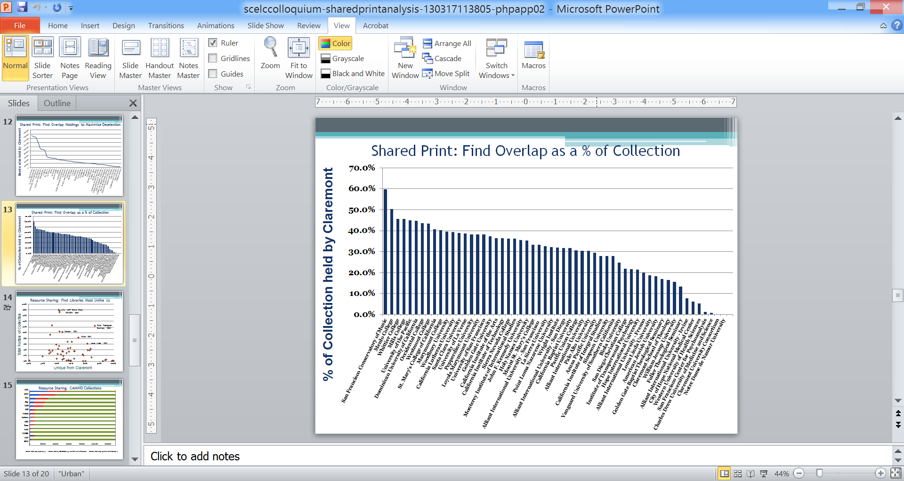
Shared Print: Find Overlap in each collection
Notes:
In addition, we were able to use the same dataset of print book holdings to determine overlap in collections to assist in planning for a shared print program. In that potential program, which is still in the early stages of planning, participants may agree to retain unique or scarce print books in their collections, while divesting of those with high overlap with other collections. In this slide, I compared a collection of libraries with the collection held at Claremont. As you can see from the slide, libraries such as the San Francisco Conservancy of Music, Menlo College, Whittier College and Mills College have collections that overlap highly with us at Claremont, indicating that we could possibly benefit from a potential partnership in a shared print program.

Slide 23
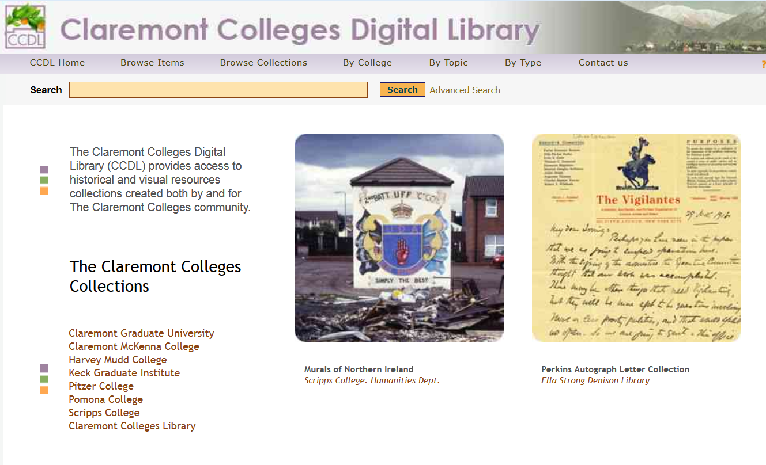
Publishing Support
Notes:
Now onto publishing support for our faculty and students. I find this to be a critical component of modern academic research library service to our patrons and one that not only provides a service at the local level but also begins to provide the foundation for an alteration in the entire scholarly communications environment.

Slide 24
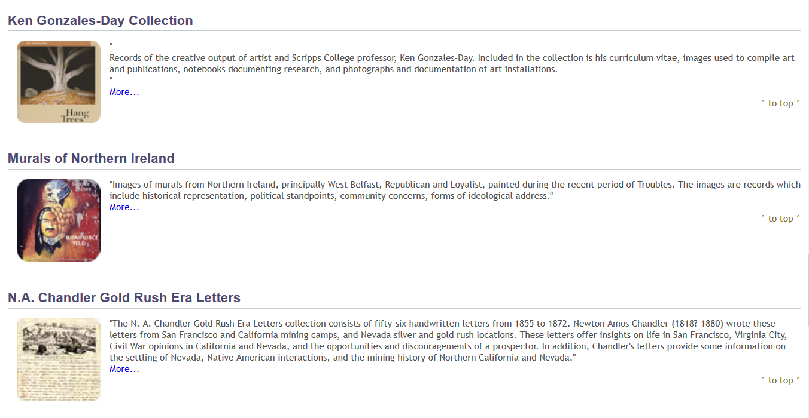
Faculty Specific Publishing
Notes:
This publishing support results in faculty-specific research archives that are developed, implemented, and maintained by the library. It brings exposure to their corpus of research or creativity and gives them a personal and professional interest in new services that the Library can provide for them now and in the future. In this example, the top two archives are faculty-specific and the Murals of Northern Ireland has become so valued by the faculty member, the Library, and the research community that even though this faculty member has left Claremont, his research archive has remained and he has actively added to it after leaving.

Slide 25
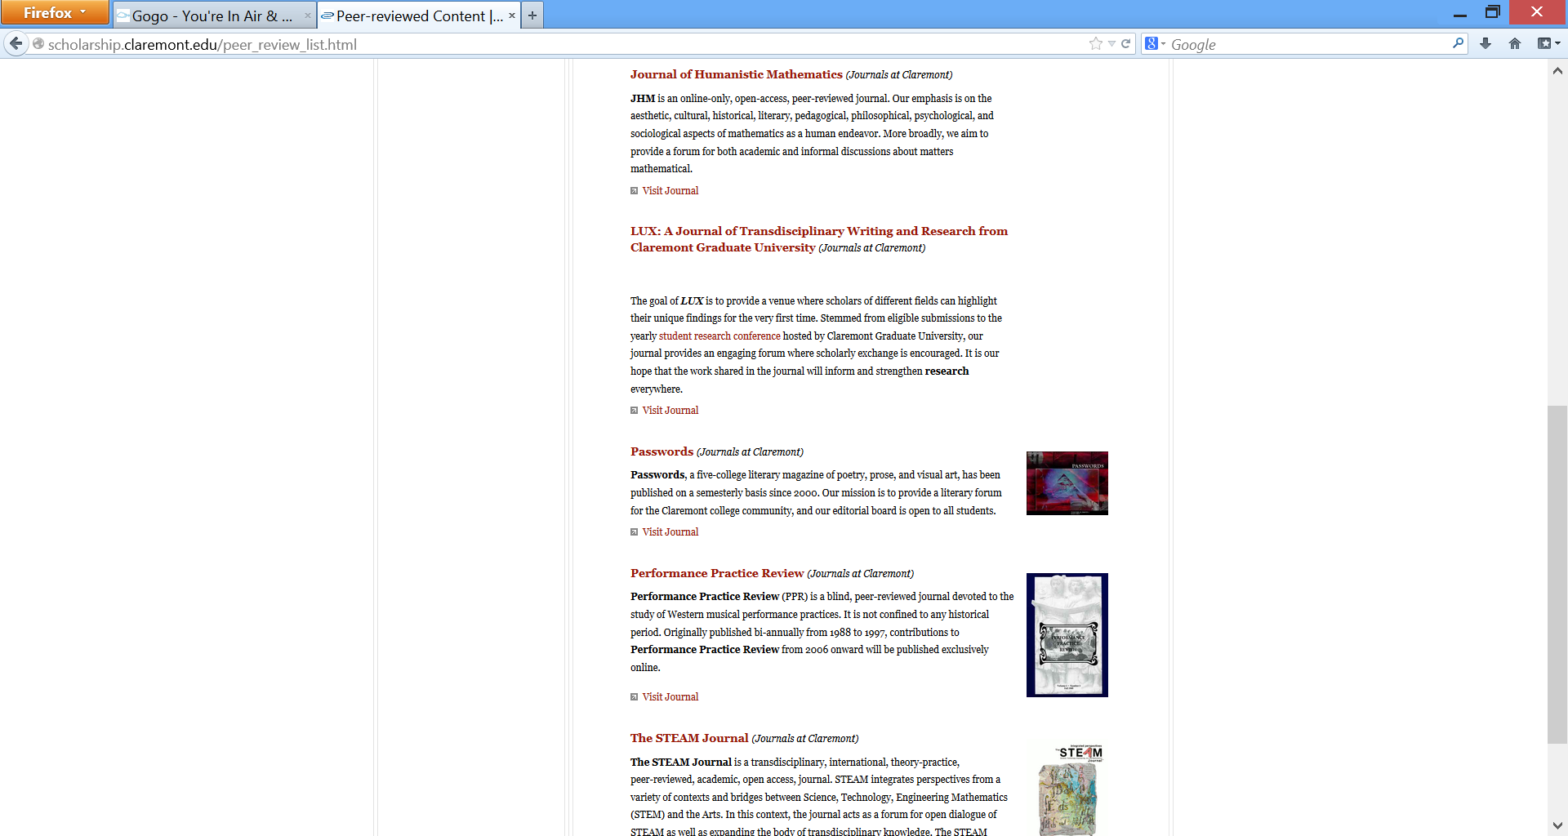
Academic research journals
Notes:
In addition to supporting them in their modes as authors, we are supporting our faculty in their modes as readers as well by producing traditional academic research journals. The examples shown here are all normal research journals that are affiliated either with particular editors on our campuses or are produced from particular academic departments on the campuses.

Slide 26
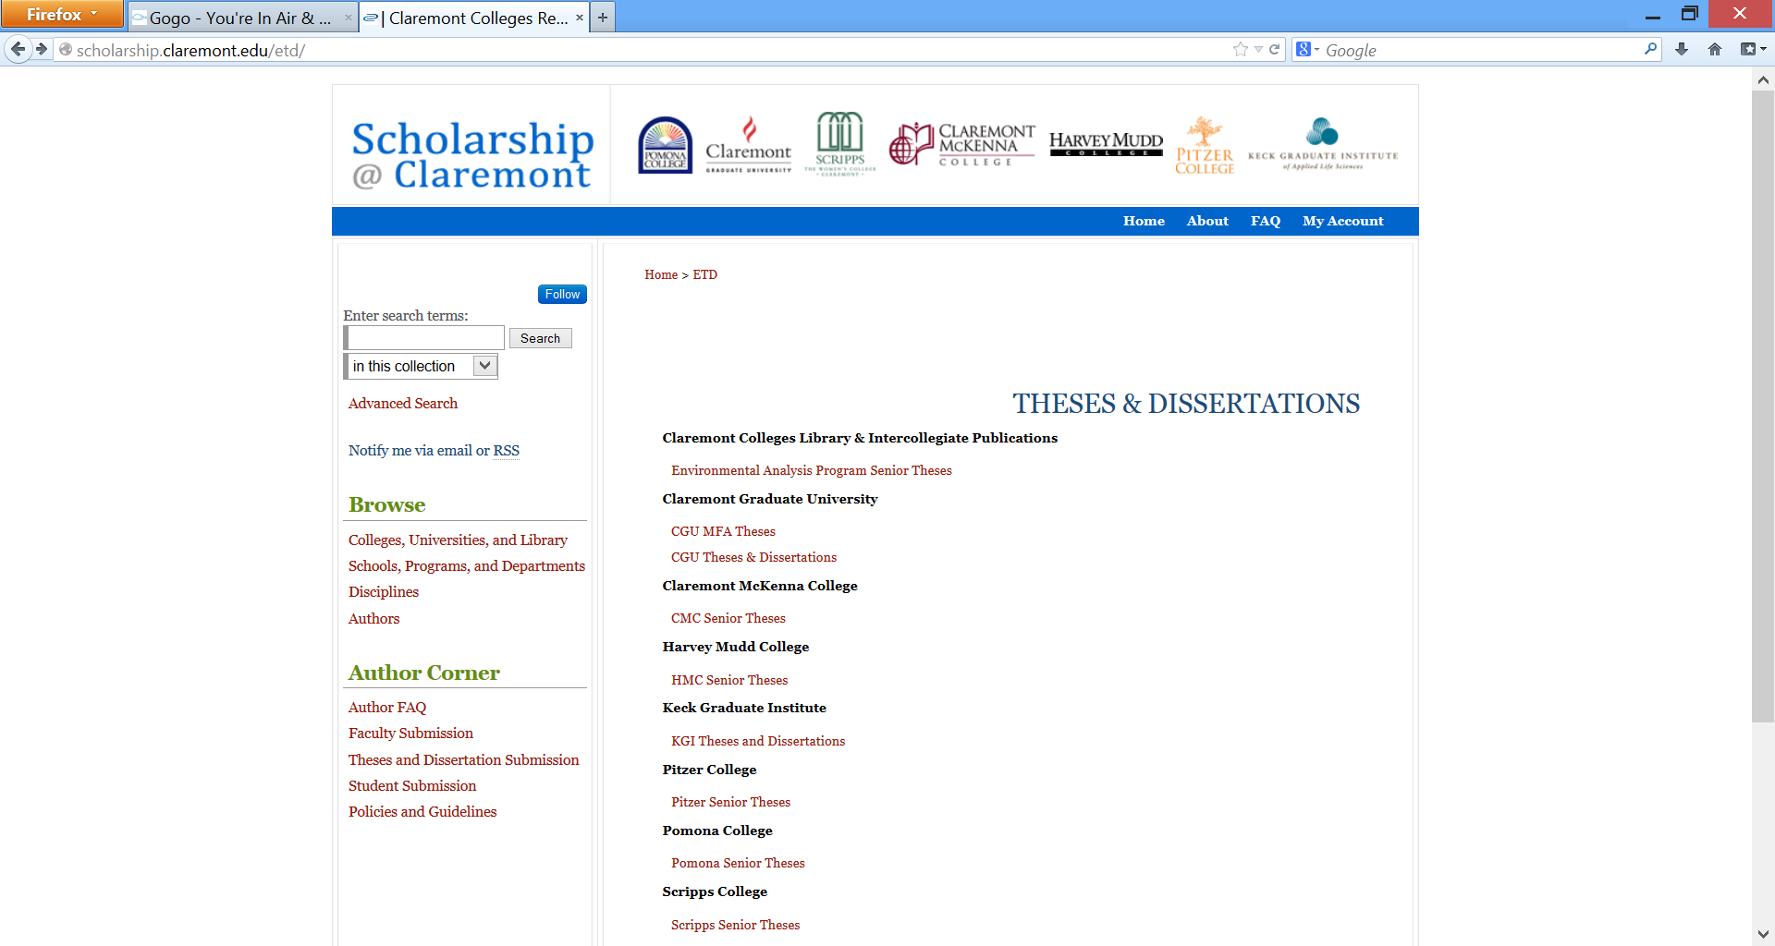
Undergraduate & Graduate Research
Notes:
In addition, the Library provides theses and dissertation services to the colleges and the students. The program has been successful, with a number of Colleges and departments adopting mandates for deposit of both graduate and undergraduate research. This provides value to both the institution by highlighting the research of their students but also to the students themselves as their first entre into being published and knowing that their research will reach a wider audience.

Slide 27
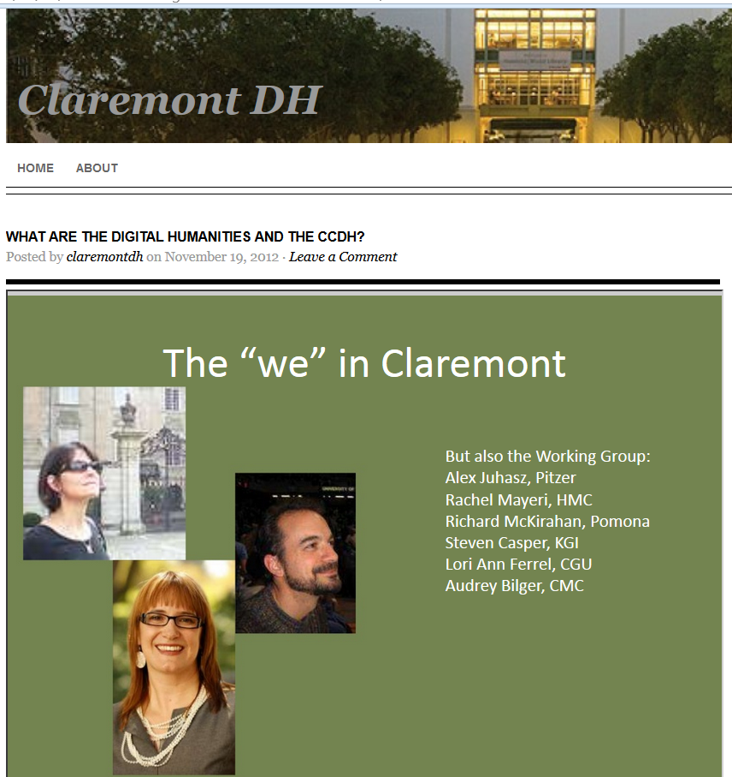
New forms of scholarship
Notes:
We are also partnering with faculty to support them in the development of new forms of scholarship. At Claremont, this is in the form of the Claremont Digital Humanities center, which is currently in the planning stages, funded by the Andrew Mellon foundation.

Slide 28
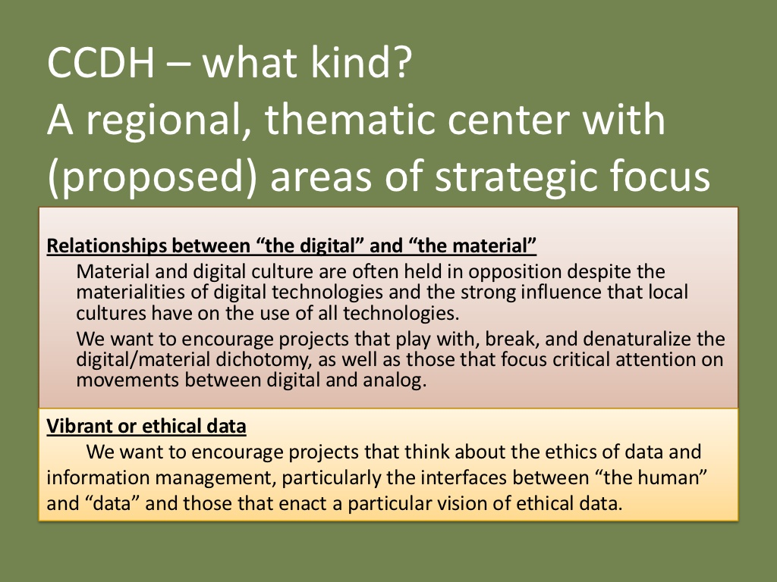
Notes:
Our faculty and librarians see the Center for Digital Humanities as a center to seed a project and build capacity amongst faculty or students, or possibly as a collaborative resource for two faculty to come together and tap into a resource that has greater capacity in either personnel resources or innovative tools to perform groundbreaking analysis.

Slide 29
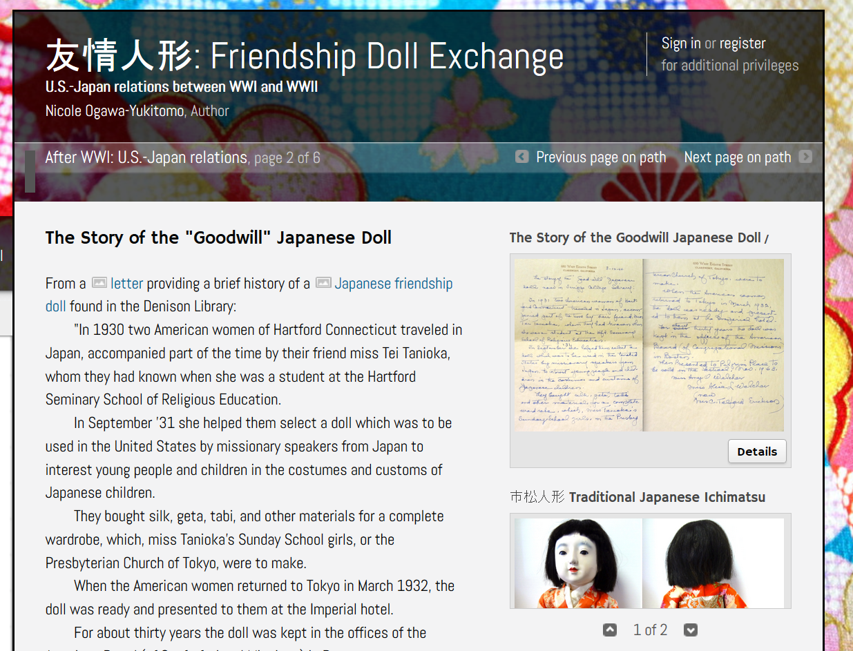
Notes:
That type of collaboration and capacity in a special center leads to projects like this Friendship Doll Exchange program, where students took physical objects and paired them with library archival material in the form of letters to build a digital multi-media book.

Slide 30
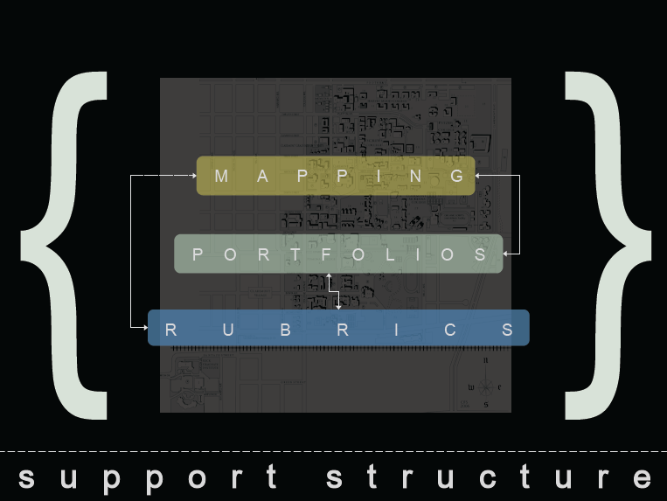
New modes of collaboration
Notes:
I just want to give you an example from our own recent experience. A group of our instruction librarians have developed a unique program over the past year and redefines their connection to faculty and students and provides a great example of how we can leverage our librarians to make those connections, and make them lasting and permanent.
Char Booth, Natalie Tagge, and Sean Stone have developed a three part program to develop a new support structure for information instruction. Briefly, this includes Curriculum Mapping, Portfolio Development, and Rubrics.

Slide 31
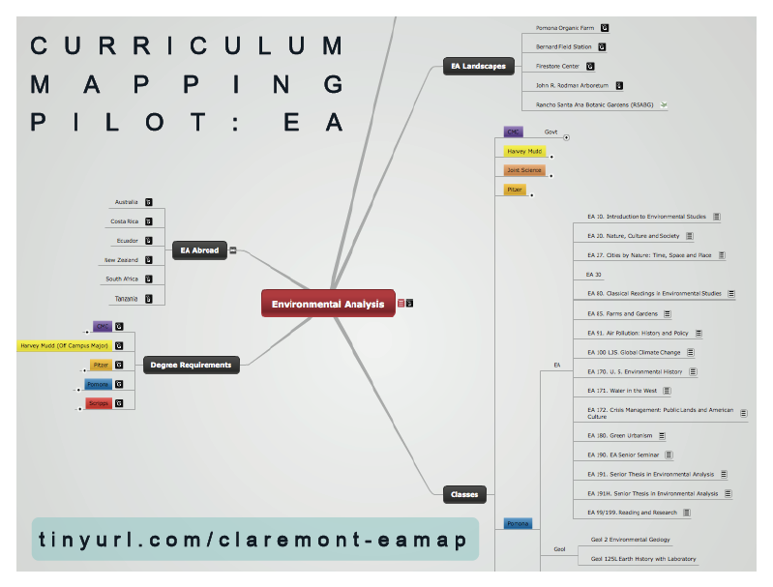
Notes:
This program starts with curriculum mapping, and they’ve leveraged a software package called Mindomo to do this. Every inistitution likes to think they are unique, but in many ways, at Claremont, we are unique or at least we present unique symptoms that make a diagnosis and treatment more challenging.
Take, for instance the Environmental Analysis program. This is an intercollegiate effort with faculty and classes being taught at all 5 undergraduate colleges and it is rather loosely organized. Our staff went through the information we had and outlined the degree requirements, the courses, the field study, and study abroad options.

Slide 32
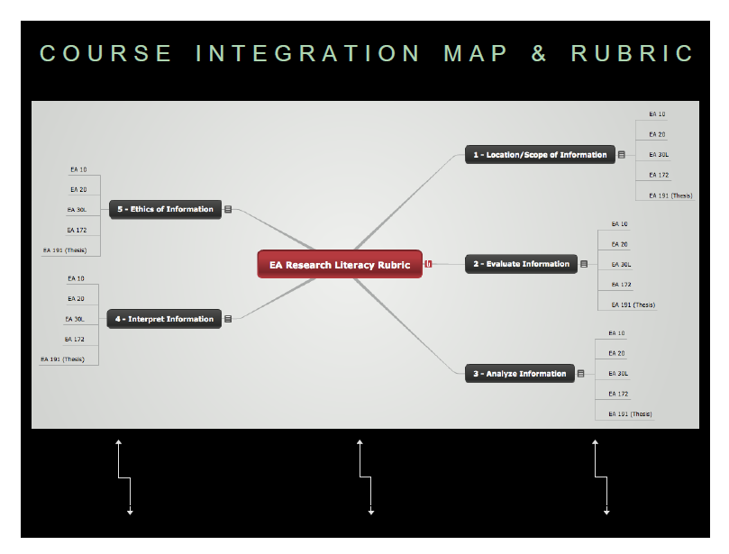
Notes:
This allowed them to build a course-based rubric for research literacy that defined which courses were focused on each stage, whether it was information scope, evaluation, analysis, interpretation, or ethics. This really allowed each librarian working with those classes to refine and revise their instructional focus to match the needs of the instructor and the course.

Slide 33
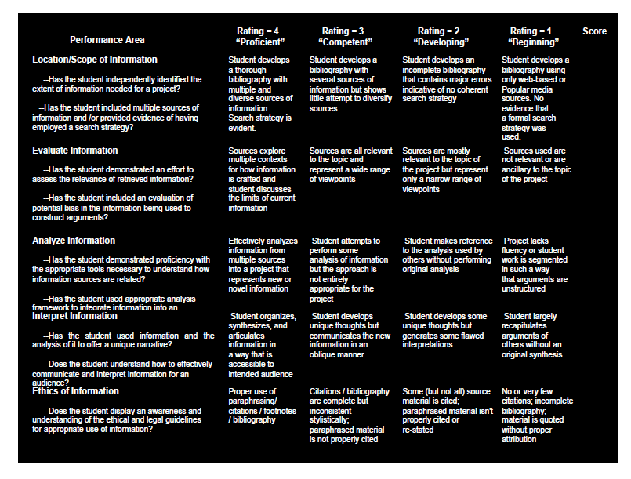
Notes:
They then could design a set of courses addressing each component of the rubric in a systematic way, either in course-based instruction or individual research consultations with individual students or groups, leading to an effective assessment component that could be used by librarians as instructors, or faculty as evaluators of student or librarian performance.

Slide 34



Notes:
My final new role for librarians in academic research libraries is as key players in assessing performance and productivity and developing new measures of return on investment for our institutions. This is especially important as the competition for budget dollars across our campuses increases and entities throughout the campuses want to prove their value to the learning outcomes and research productivity inherent in our mission.

Slide 35
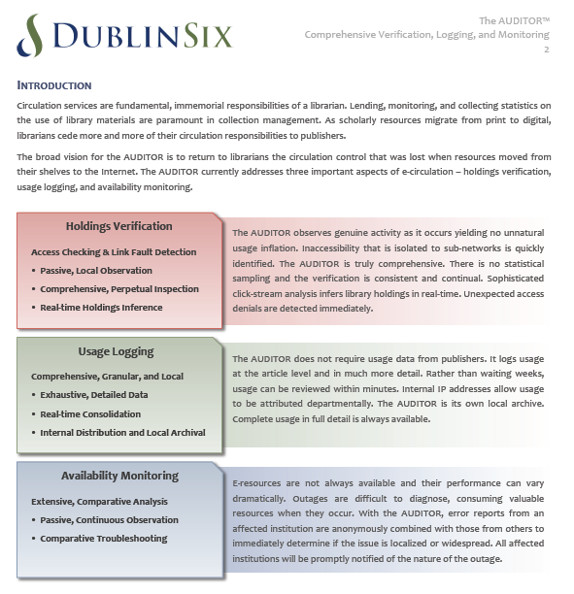
Better technology
Notes:
How are we doing this at Claremont? Well, first through the use of better technology to collect data about our collections. We are a beta partner with a company called DublinSix which has developed hardware & software solutions for tracking the usage of electronic resources. They have flipped the model of publishers and vendors providing COUNTER compliant usage reports to us to a model where we track the usage of resources originating from within our network. This allows us to verify holdings authomatically, track usage in new and interesting ways, and through network effects, monitor publisher availability.

Slide 36
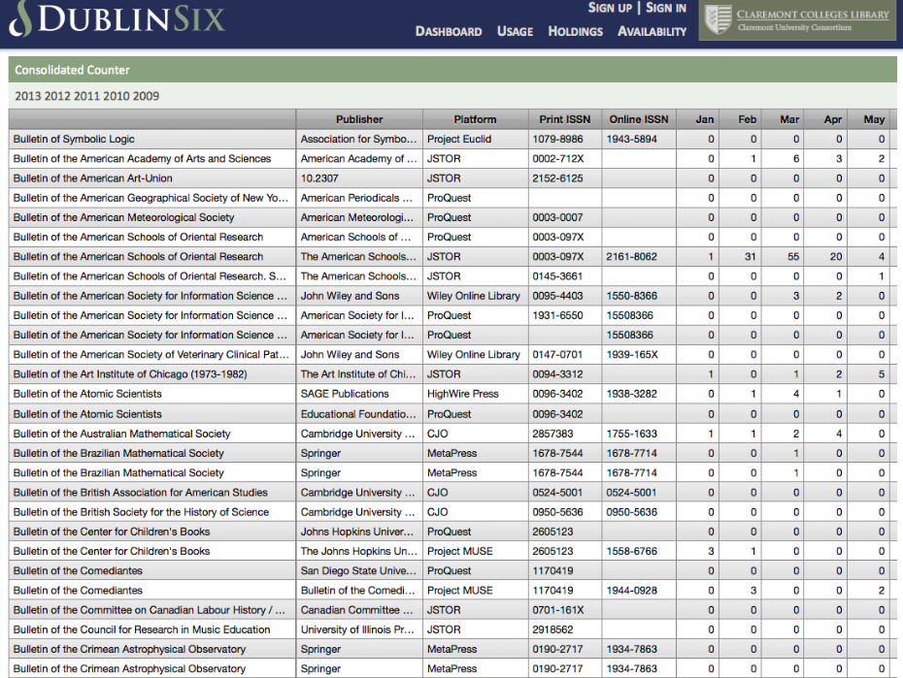
Click through to article and user level detail!!!
Notes:
This will allow us to produce and use more granular reports, such as this draft mock-up that counts off real-time usage.
And since it is tracking us at the article and user level, click-through capability to that data as well.

Slide 37
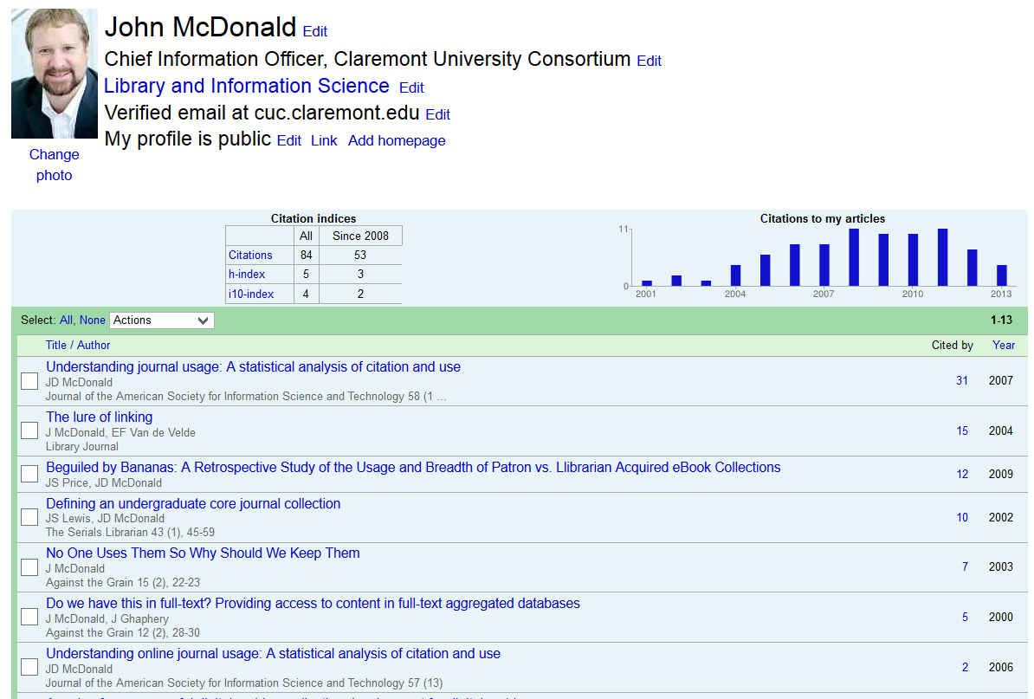
ROI at the Campus level:
Google Scholar Institutional profiles
Notes:
In addition, we have been discussing with the staff at Google Scholar, new methods to aggregate google scholar profiles at the institutional level in addition to the researcher level. This would potentially allow us to highlight productivity and performance in research across our 7 members and even potentially compare them to their peers in new and interesting ways.

Slide 38
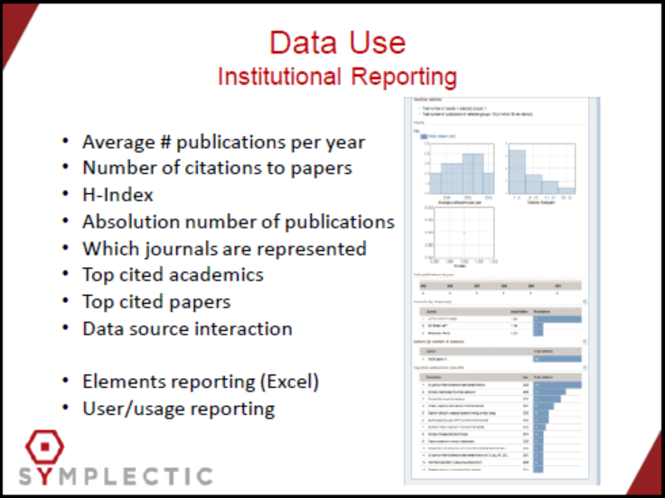
Notes:
We are also talking with commercial companies about the same concepts. One of them is Symplectics, who already has a product on the market to help libraries develop these institutional reporting components., including citations, h-index, journal citation scope, and other measures.

Slide 39
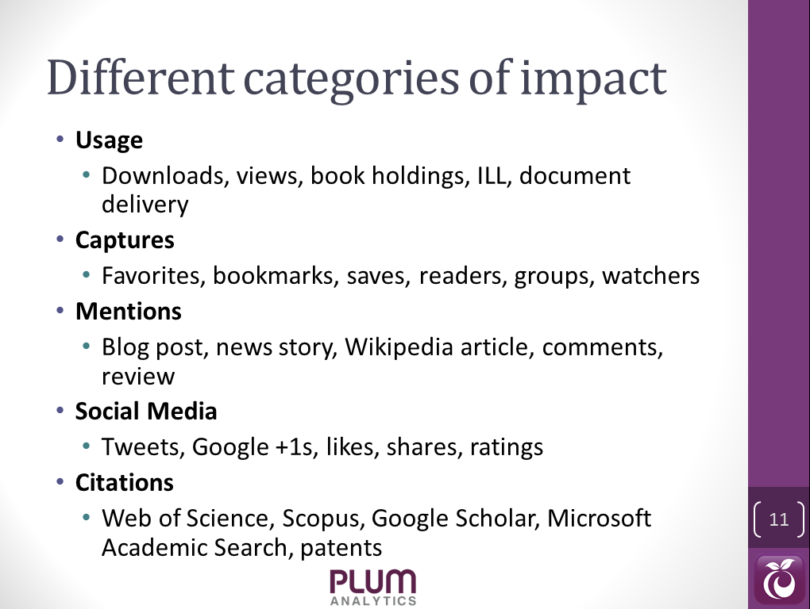
Notes:
And we are closely monitoring and looking for opportunities to incorporate a host of alt-metrics, especially with the founders of Plum Analytics, so we are prepared to integrate those into our systems and services as they start to become more significant and provide measures of impact that are important to our researchers and institutions.

Slide 40
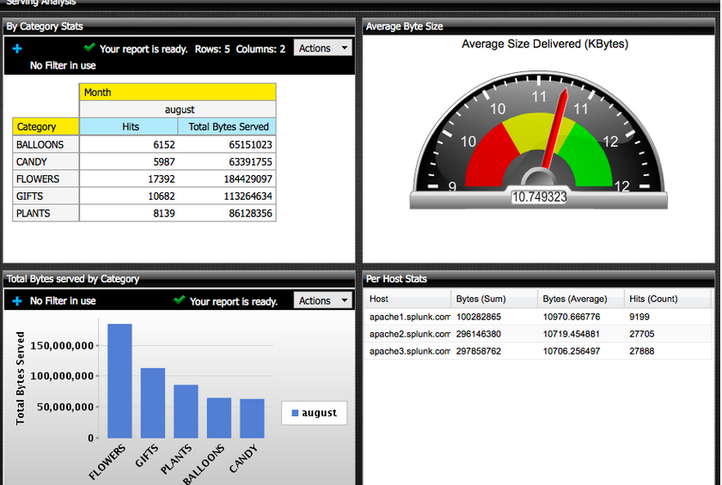
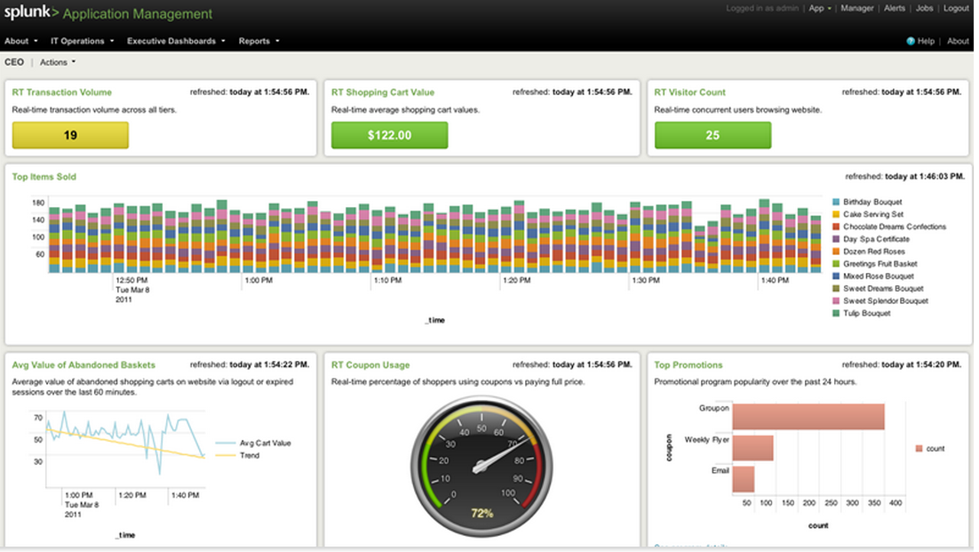
Productivity & Performance Visualizations
Notes:
And we are also mindful that having usage and impact reports are valuable in and of themselves, that a picture is sometimes worth a thousand words, so we are learning how to use non-library based visualization and analysis tools. One of them is software called Splunk, which is essentially transaction log analysis software that allows you to produce dashboard like reporting for many measures that are important to you.

Slide 41
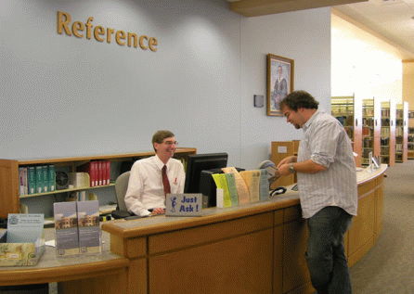
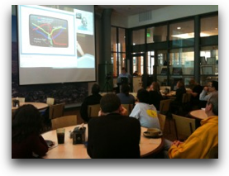
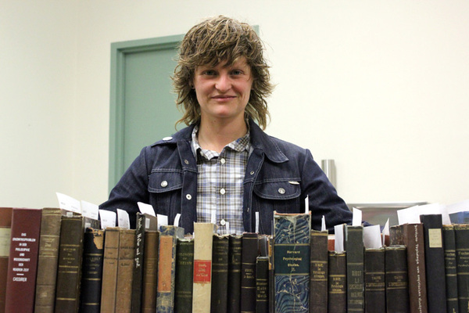
Notes:
Finally to sum it up: Our institutions are now more about people and the work that they can do to provide innovative and effective services than they are about collections. But don’t get me wrong, we are still based on a solid foundation of information resources and need to continue to provide those in the most efficient and effective manner so that your librarians can focus not on the easy or mundane tasks but rather on the advanced and impactful services that really make a difference to our faculty and students.

Slide 42

Questions

